Slide 1
AP Exam Information
Exam Process + Procedures + Preparation

Slide 2
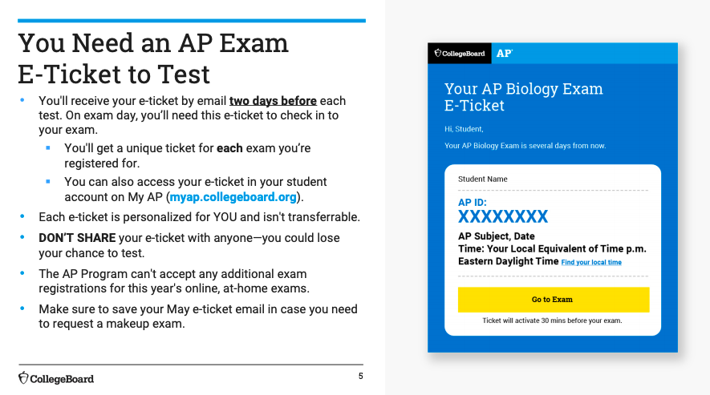
The Most Important Thing = AP Exam E-Ticket
AP Government: Saturday, May 9
AP Human: Sunday, May 10
AP Econ: Tues, May 17
Click here to access the MyAP page for College Board
Notes:
-Sharing the e-ticket with someone OTHER THAN YOU will possibly trigger the security apparatus to flag you

Slide 3
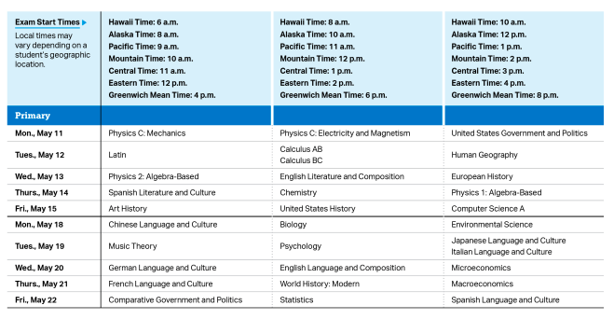
MAY AP Exam Dates & Times
Notes:
All of the tests are being administered simultaneously, SO BE LOGGED IN ON TIME!!!!!
Students need to understand that the MAY exam date is the preferred date for all students, UNLESS there are extenuating circumstances
If there are circumstances that are preventing you from testing on your allotted date, then you can test in June

Slide 4
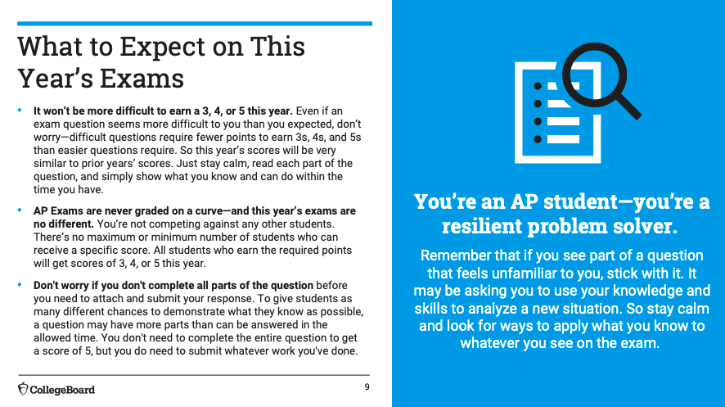
Notes:
Written responses are never curved but based on averages
You do not need to finish the entire prompt in order to get a 5: this is based off of points earned (you will never be penalized points for something) - words to wise: ANSWER THE PARTS THAT YOU KNOW RIGHT AWAY then go to the parts that you are stuck on.
It is always recommended that you submit what you have in order to finish in the allotted time frame

Slide 5
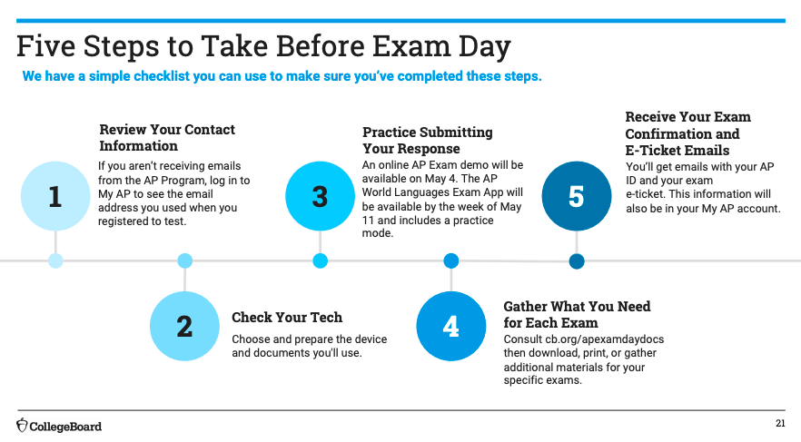

Slide 6
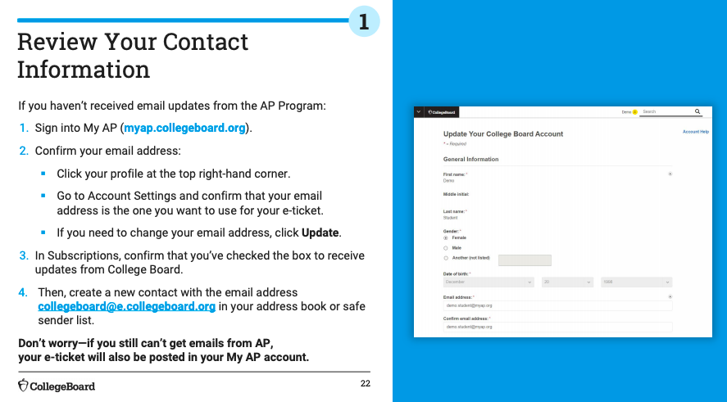
DO NOT FORGET TO DO THIS!

Slide 7
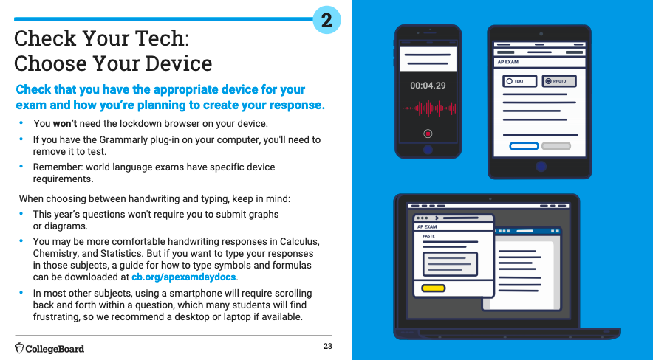
Notes:
Choose the option that will work best for you. You can practice to see how fast you type compared to how fast you write (you’ve practiced both).
You need to remove Grammarly from your extensions (or disable it)
Recommend a laptop or desktop computer!

Slide 8
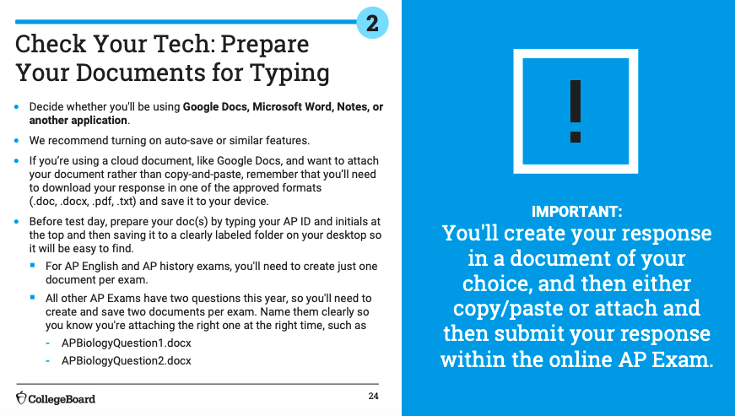

Slide 10
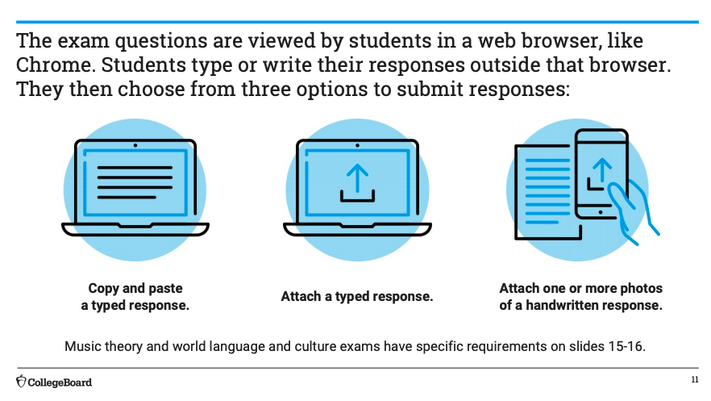
THREE OPTIONS TO SUBMIT RESPONSES

Slide 13
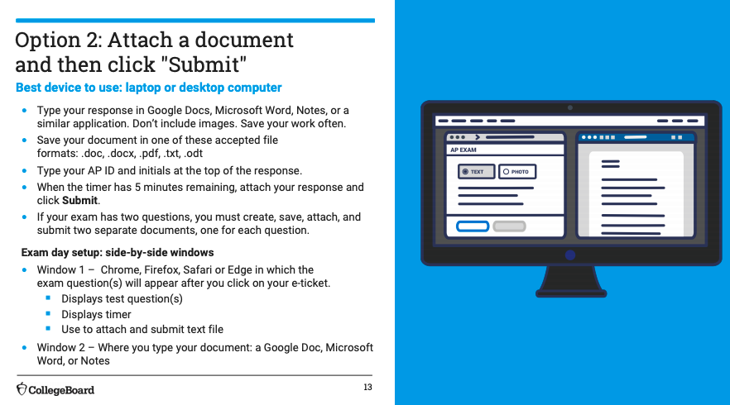
Notes:
You can save the document as a Google Doc, PDF, Word Document (but stick with Google Doc since it autosaves
You can still work during the 5 minute warning, but you run the risk of not uploading your responses on time.

Slide 14
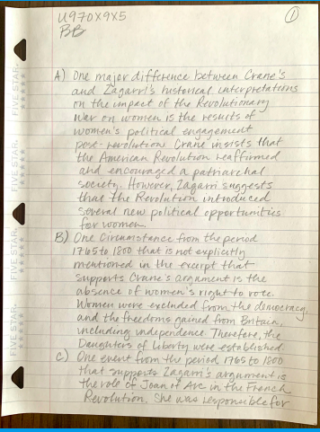
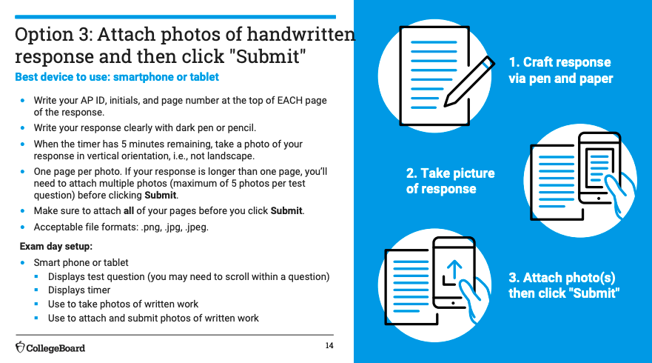
Notes:
THE KEY ERROR: students submitting WITHOUT ATTACHING the photos. The only thing that will be graded are the photos that have been attached.
The smartphone that you use should be what you will use to take a picture and submit on College Board!
DO NOT WRITE ON THE BACKSIDE OF THE PAPER!!!!!!!

Slide 15
Page # here
AP ID & Initials here
Label the parts of the FRQ that you are writing first. You can go out of order but you better label it!
Don’t waste your time double spacing (that will double the amount of paper that you use!). SINGLE SPACE ONLY!

Slide 16
Notes:
Do not worry about grammar and spelling! It takes way too much time.
You can print the test question and annotate on it if you want but you can’t use KAMI

Slide 17
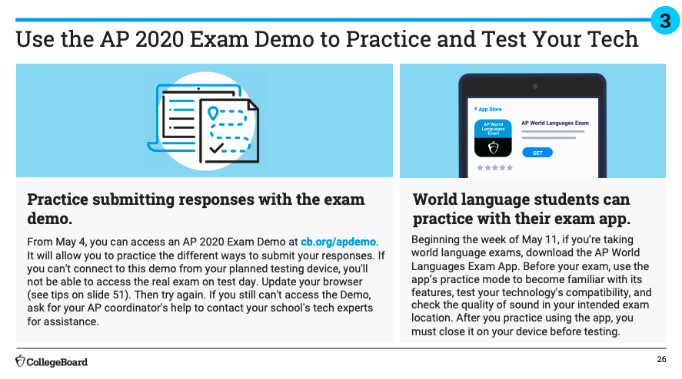
CLICK HERE: AP 2020 Exam Demo
Notes:
THIS IS HIGHLY RECOMMENDED!

Slide 19
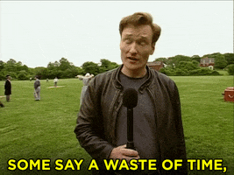
Notes:
Internet searches could adversely impact your score
Talking and conversing with other people could cause your exam to be flagged

Slide 20
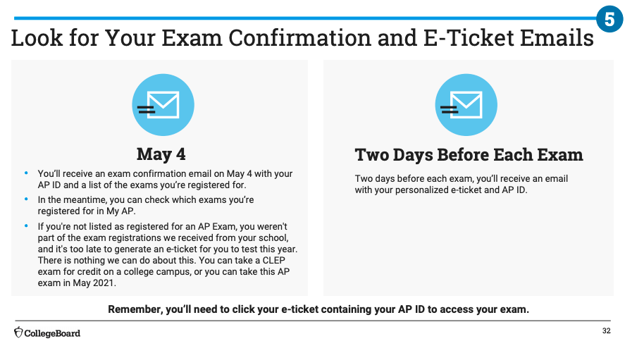
THIS IS MONDAY!
IF YOU DON’T GET THE EMAIL, IT’S OKAY. JUST GO TO MyAP

Slide 21
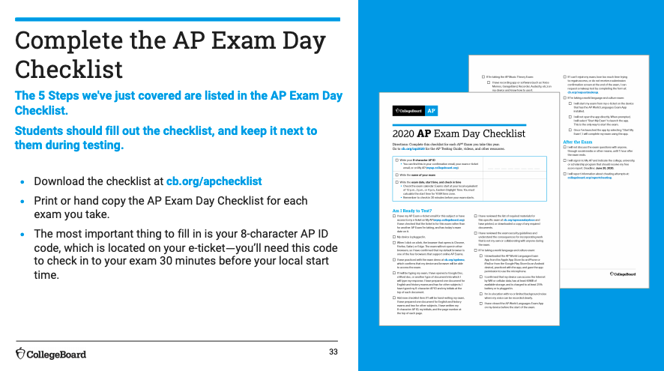
CLICK HERE: AP EXAM CHECKLIST

Slide 22
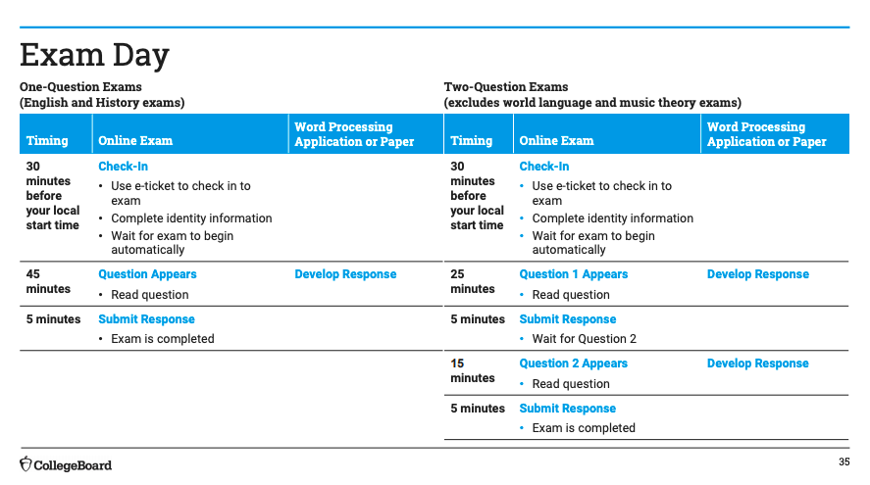
AP EXAM DAY
This is YOUR test!

Slide 23
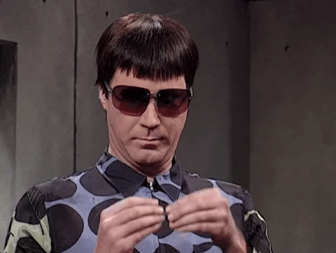
SENIORS!

Slide 24
Notes:
Student exams will be shared with ALL TEACHERS, which means that we can tell if you have cheated or not!

Slide 25
You HAVE to disable any extensions or your TEST WON’T WORK!

Slide 26
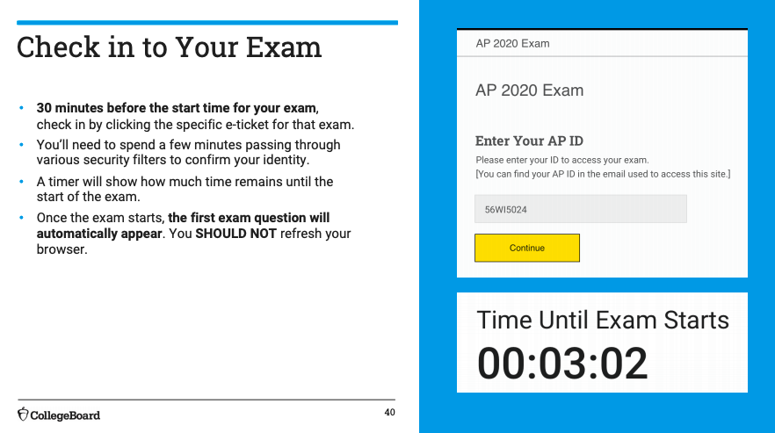
Do not refresh under ANY circumstances!

Slide 28
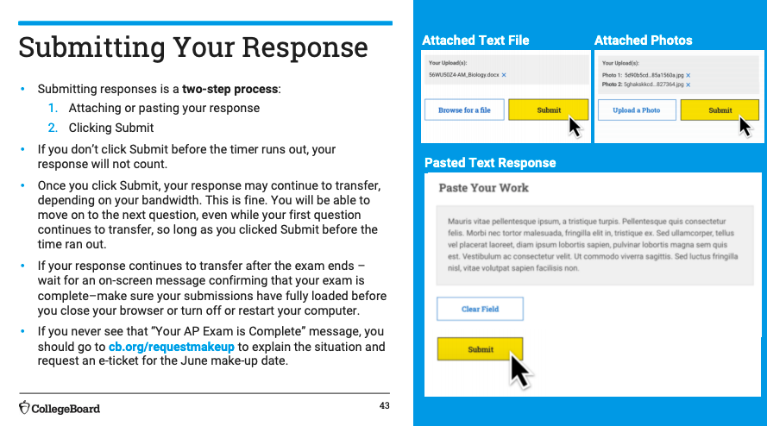
Notes:
Do not worry about the upload time (just wait for the confirmation page): DO NOT TURN YOUR COMPUTER OFF AT ANY MOMENT IN TIME! JUST DON’T DO IT!

Slide 29
WHAT HAPPENS IF SOMETHING GOES WRONG?
CLICK HERE: Request Makeup Exam
Notes:
-Do not call the AP Services Hotline (no one will be there)

Slide 30
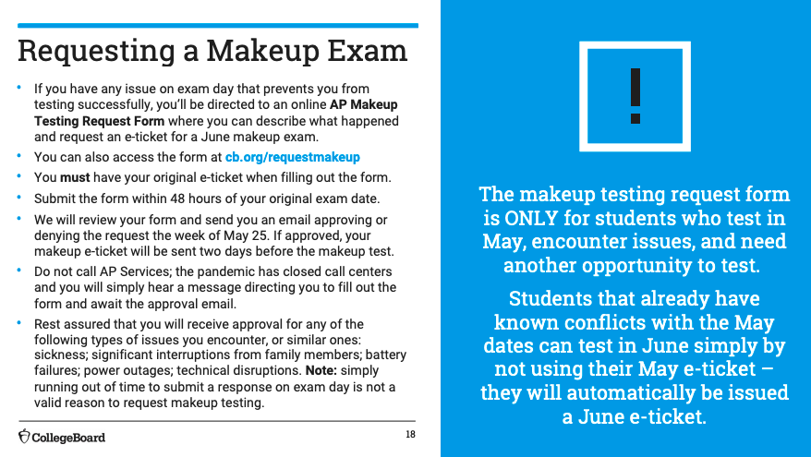
Notes:
Make sure to contact CollegeBoard within 48 hours of your exam.
Students should know what a meaningful excuse is: running out of time is NOT an excuse.

Slide 31
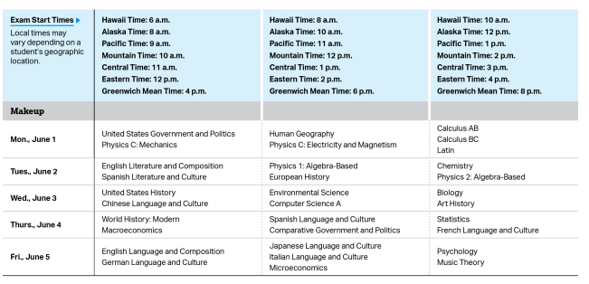
JUNE AP Exam Makeup Dates & Times

Slide 32
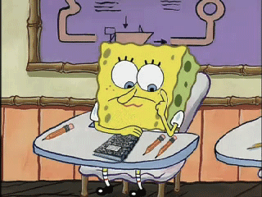
You’ve got this! Remember, if you have any questions, don’t hesitate to reach out to Nicholson or myself!

