Slide 1
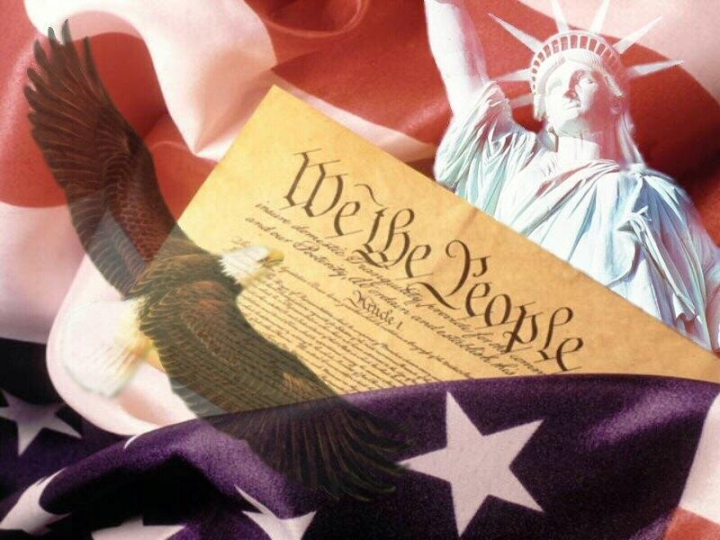
Post-WWII American Presidents
1948-2004
chapters 25 - 33

Slide 2
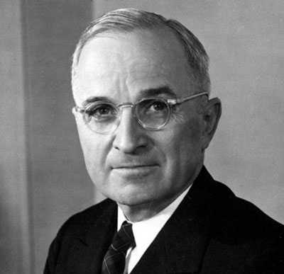
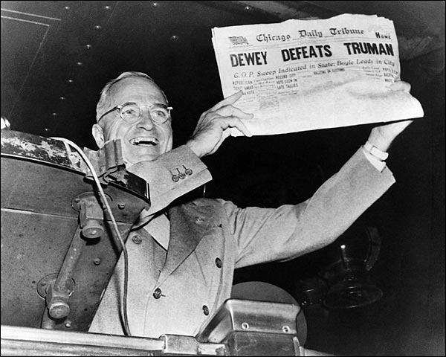
Election Year: 1948
Truman (D) v. Dewey (R) v. Thurmond (States’ Rights)

Slide 3
Truman’s Domestic Highlights
“Fair Deal” – program that would strengthen New Deal programs & create new ones
Integration of U.S. military

Slide 4
Truman’s Foreign Highlights
Decision to drop atomic bomb 1945
Beginning of Cold War:
Truman Doctrine (’47)
Marshall Plan (’48)
Berlin Airlift (’48-49)
Formation of NATO (’49)
China became communist (’49)
Korean War began (’50-53)
“Red Scare” began

Slide 5
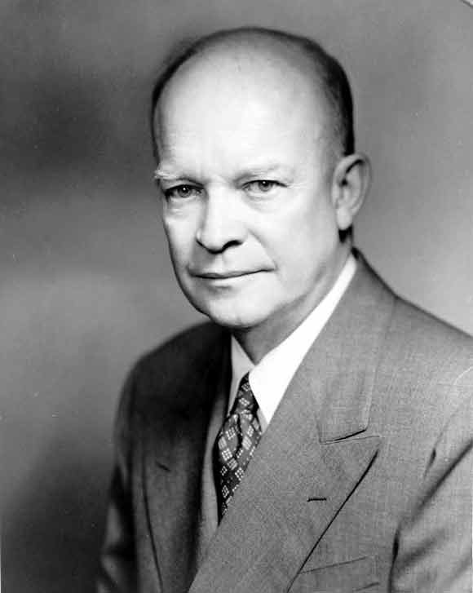
Elections of 1952 & ‘56
1952: Eisenhower (R) v.
Stevenson (D)
1956: Eisenhower (R) v.
Stevenson (D)

Slide 6
Eisenhower’s Domestic Highlights
Interstate Highway Act – authorized spending $32 billion to build 41,000 mi. of highway
Brown v. Board of Ed. decision (’54)
Little Rock, Arkansas desegregation (’57)
Red Scare / McCarthyism
Alaska & Hawaii statehood (’59)

Slide 7
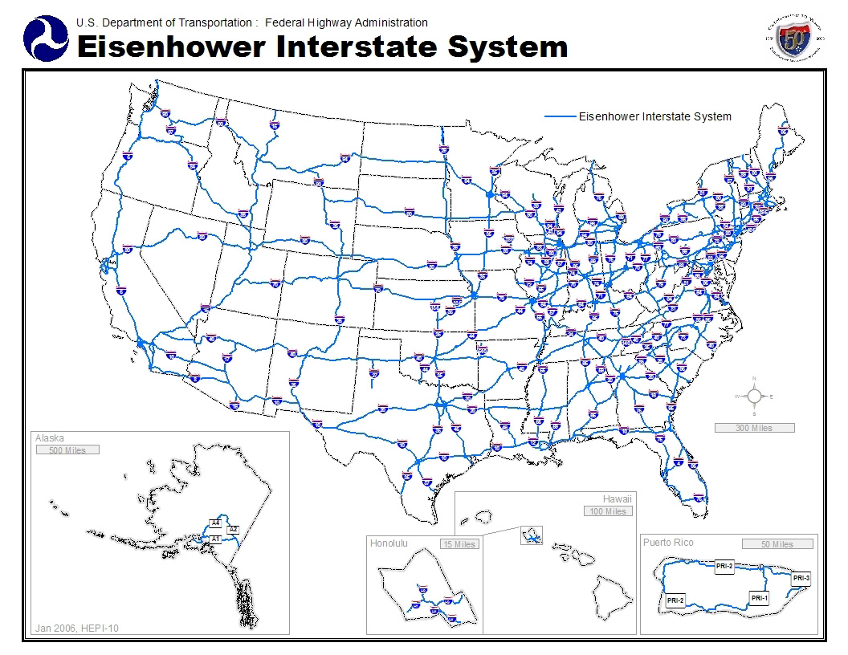
Interstate Highway Act

Slide 8
Eisenhower’s Foreign Highlights
Korean War ended w/ armistice (’53)
U.S. “advisors” sent to Vietnam (‘54)
Sputnik launched by Soviets (’57)
Castro overthrew Batista in Cuba (’59)

Slide 9
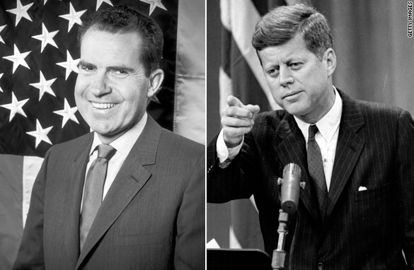
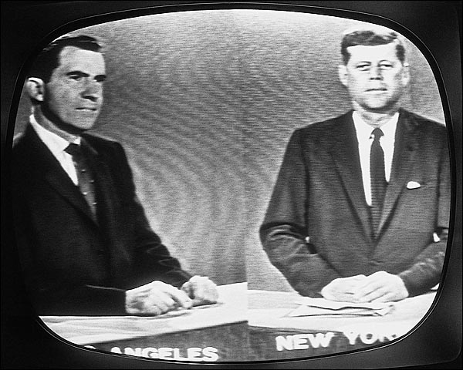
Election of 1960
Kennedy (D) v. Nixon (R)
his Catholicism worked against him
first televised Presidential debates – benefited Kennedy & probably swayed election in his favor

Slide 10
Kennedy’s Domestic Highlights
“New Frontier” – aimed at improving the economy, fighting racial discrimination, & exploring space
Peace Corps established in 1961- sends volunteers to provide technical, educational, & medical services in developing countries
Pushed for Civil Rights Act of 1964
Space Race – called for man on the moon by end of decade
Assassinated in 1963 by Lee Harvey Oswald – Warren Commission determined there was no conspiracy; VP Lyndon Johnson becomes President

Slide 11
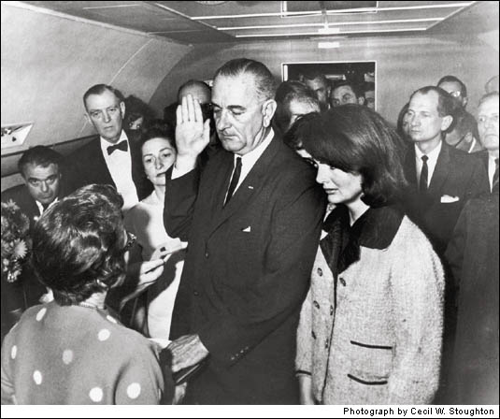

Slide 12
Kennedy’s Foreign Highlights
Bay of Pigs invasion (Apr ’61)
Cuban Missile Crisis (Oct ’62)
Increased # of American advisors in S. Vietnam
Berlin Crisis / Berlin Wall construction (’63)

Slide 13
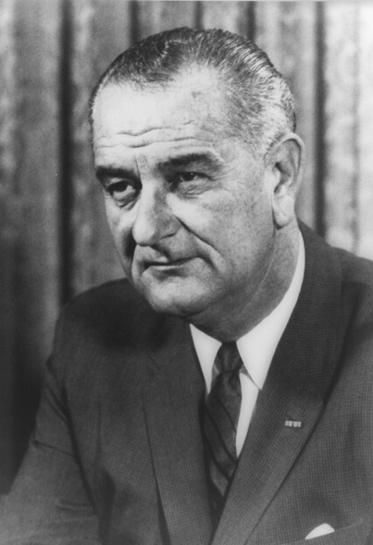
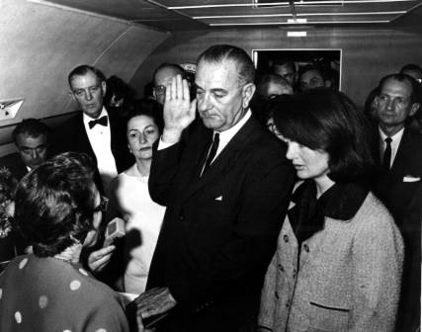
Election of 1964
L. Johnson (D) v. Goldwater (R)
did not seek
reelection in
‘68 due to
divisions over
Vietnam
Goldwater marks
rise of the
Conservative
movement

Slide 14
Johnson’s Domestic Highlights
“Great Society” – focused on health care, education, environment, discrimination, & poverty
Medicare (hospital insurance for people over 65) Medicaid (low-cost health insurance for poor)
“War on Poverty” declared – aimed at aiding country’s poor (education, job training, proper health care, & nutrition)
Civil Rights Act of 1964
Voting Rights Act of 1965

Slide 15
Johnson’s Foreign Highlights
Vietnam!
Tonkin Gulf Resolution (’64)
1st ground (combat) troops sent in ‘65
Tet Offensive (’68) – public opinion began to turn against war

Slide 16
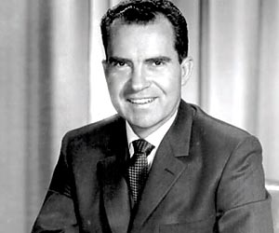
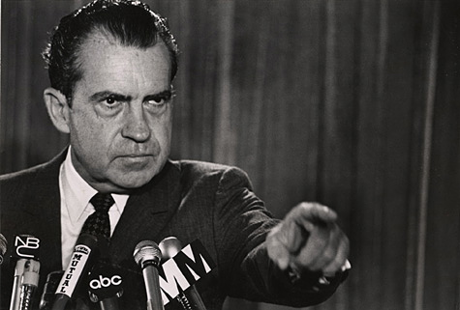
Elections of 1968 & ‘72
1968 Nixon (R)
v. Humphrey (D)
v. Wallace (Am Indep)
1972 Nixon (R) v. McGovern (D)
Watergate break-in occurred during reelection campaign

Slide 17
Nixon’s Domestic Highlights
EPA created (‘70)
No significant Civil Rights legislation
Anti-war (Vietnam) protests:
college campuses
Kent State – student protesters threw rocks & bottles at National Guard, fired into protesters killing 4
26th Amendment – 18 yr old vote (’71)
Watergate Scandal – attempted break-in of Dem. Party headquarters (Watergate complex) connected to Nixon; reelection committee tried to bug office & record conversations of political opponents
Nixon resigned in 1974; Ford became President and pardoned Nixon (unpopular – lost election in ‘76)

Slide 18
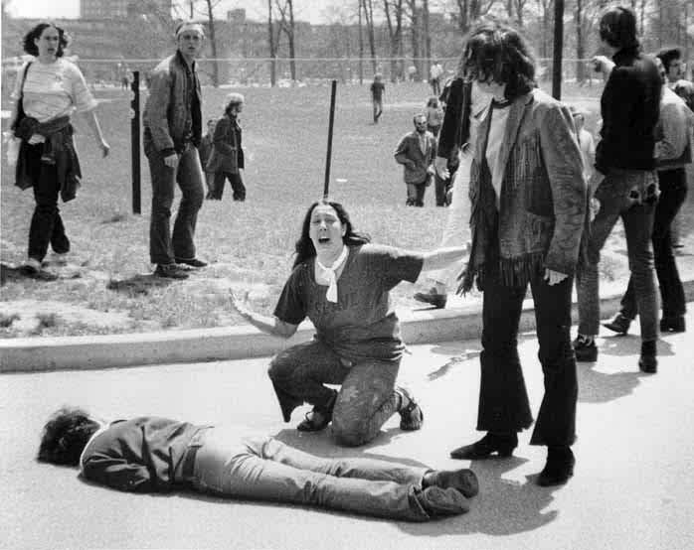
Violence at Kent State

Slide 19
Nixon’s Foreign Highlights
“Vietnamization”– turned responsibility for war over to South Vietnamese
Paris Peace Accords (‘73) – withdrew American troops from Vietnam
Détente w/ Soviet Union & China
Visited China (’72)
SALT I Treaty w/ Soviets (’72)

