Slide 1
AP HUG Course Review
Comprehensive Exam #1

Slide 2
Unit 1: Nature and Perspectives
The section makes up 5-10% of the questions on the AP Exam…4-8 questions
Statistically Speaking, there should not be an FRQ on Unit 1
Topics covered
Geography as a field of inquiry
Thinking Geographically
Describing Location
Space and Spatial Processes
Map Fundamentals
Application of Geography

Slide 3
Student Questions/Concerns
Friction of Distance: the concept that the length of the journey (distance), and the difficulty of the journey (friction) affects the time needed to complete the journey (time).
It can be expressed as follows: Distance + friction = time.
Historically, time has lessened because of the change in the friction of distance (difficulty of the journey) with advancing technology.
Example: jets reduce the friction of distance which allows them to cover longer distances in a shorter period of time compared to other means like ships, rail, and road transport.
Human activities tend to organize with respect to geographic location due to the friction of distance and the consequent competition for advantageous location
**Connections to distance decay and space time compression (slide 9)

Slide 4
Student Questions/Concerns
Changing Attributes of Space
What is Space?
Space refers to the physical gap or interval between two objects.
Space is abstract…but it is part of “Place”
What are attributes?
Features or characteristics ; an inherent part of something.
Spatial Thinking: Geographers think about the arrangement of objects (people and activities) in space
Where and Why?
Clustered, dispersed (concentration – extent of spread)
Density (frequency in space)

Slide 5
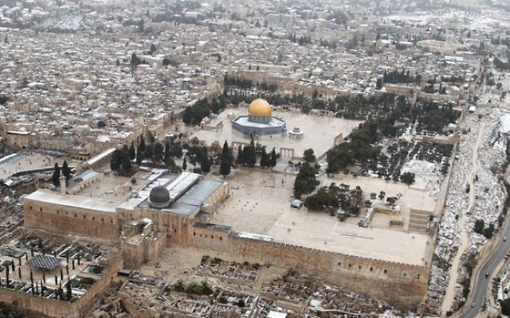
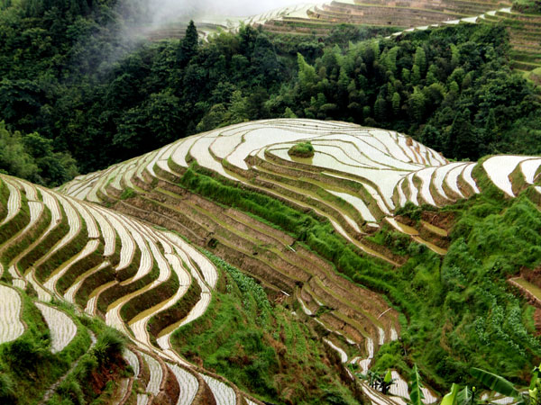
Student questions/concerns
Cultural Landscape
The visible human imprint on the landscape.
How humans use, alter and manipulate the land to express their identity
Mental Maps/Cognitive Maps
Maps drawn from memory.
Reflect the perceptions of the person who draws them.

Slide 6
Student Questions/Concerns
Township Range
Each township is identified with a township and range designation.
Township designations indicate the location north or south of the baseline.
Range designations indicate the location east or west of the Principal Meridian.
Menomonee Falls: T8N R20E

Slide 7
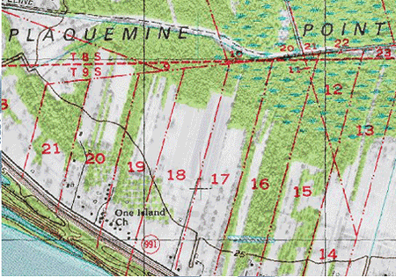
Student Questions/Concerns
French Long-lot
divisions are long narrow
French areas of the US
Land by waterways
Map Projections (slides 10-11)
Regions (slide 15)
Types of Maps (slides 12-13)

Slide 8
Important People
Carl Sauer: The Cultural Landscape
Complex interactions between humans and their environments…landscape is a combination of cultural features, economic features, and physical features.
Carl Ritter and Alexander von Humboldt: Environmental Determinism
The physical environment caused social development/human actions
Marshall Sahlins: Possibilism
The physical environment may limit some human actions, but people have the ability to adjust to their environment.

Slide 9
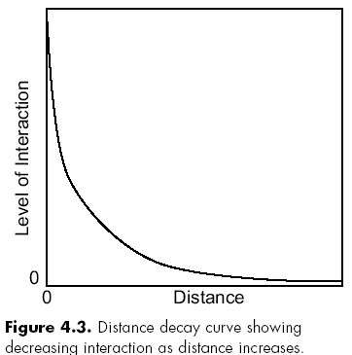
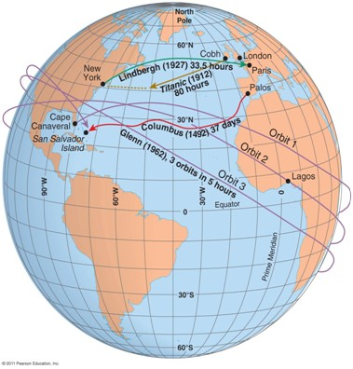
Important Models/Theories
Distance Decay
Level of interaction decreases as distance increases.
Space-Time Compression
The reduction in the time it takes to diffuse something to a distant place as a result of improved communication and transportation.

Slide 10
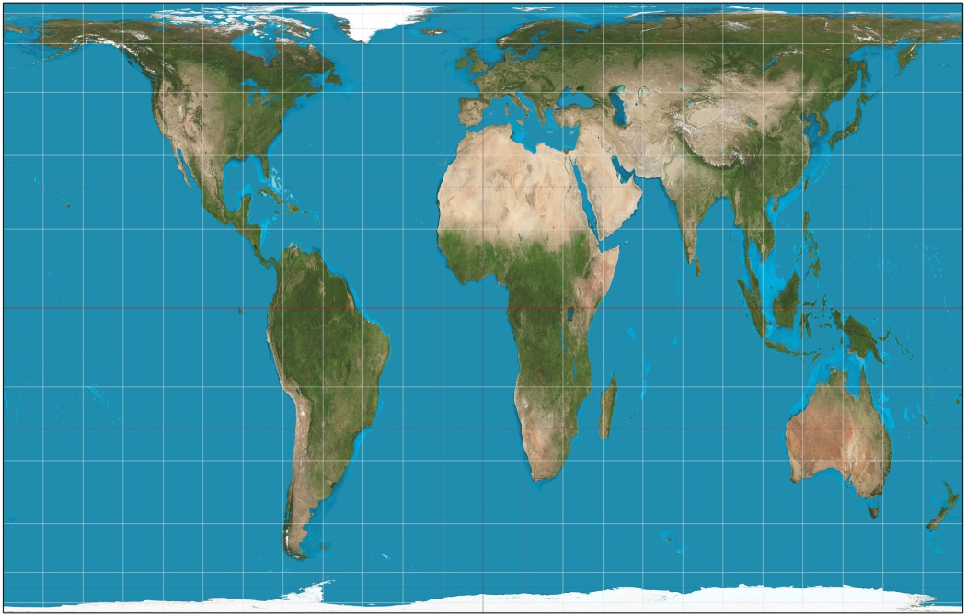
Important Map Projections and tools
Projections distort: Shape, distance, relative size, direction
Equal Area Projections: the relative size/area of the landmasses are the same as in reality
Gall-Peters projection
Goode Homolosine Projection
Notes:
Gall-Peters projection: focus is on Africa in an attempt to balance projection errors.

Slide 11
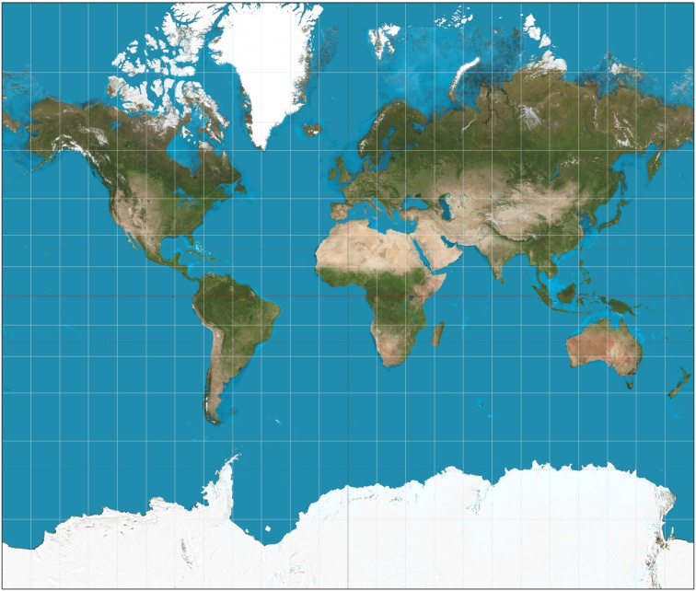
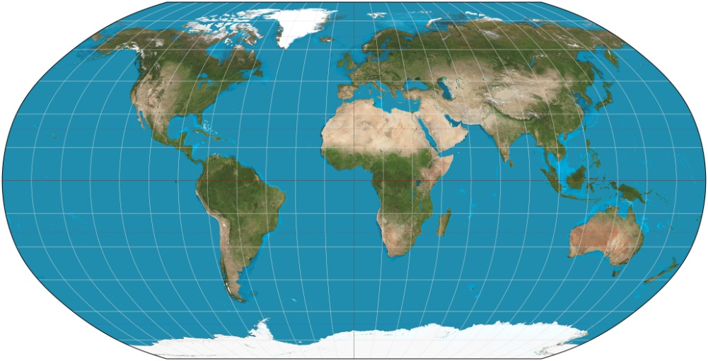
Important Map Projections and tools
Conformal Projections: accurately represents the shape of landforms, but distorts relative size
Mercator Projection
Compromise Projection: all four properties are distorted slightly but not drastically
Robinson Projection
Notes:
Mercator Projection: The meridians are equally spaced, parallel vertical lines, and the parallels of latitude are parallel, horizontal straight lines, spaced farther and farther apart as their distance from the Equator increases. This projection is widely used fornavigation charts, because any straight line on a Mercator-projection map is a line of constant true bearing that enables a navigator to plot a straight-line course. It is less practical for world maps because the scale is distorted; areas farther away from the equator appear disproportionately large. On a Mercator projection, for example, the landmass of Greenland appears to be greater than that of the continent of South America; in actual area, Greenland is smaller than the Arabian Peninsula.
Robinson:the Robinson projection which views the entire world at once and one that compromises both area and angles. The longitudinal lines are curved while the latitude lines remain horizontally straight. The Robinson is a compromised view of the Earth’s surface with greater amounts of distortion occurring at the poles.

Slide 12
Important Types of Maps and Mapping Tools
GIS
Computer program that stores geographic data and produces maps to show those data in space often through layering data patterns over each other
GPS
Accurately determines the precise location of something on Earth
Remote sensing
Refers to the collection of information from satellites and other long- distance methods.
Reference Maps
Show common features such as boundaries, roads and mountains
Thematic Maps
Display one feature or pattern, such as climate, city size.
Isoline thematic maps
Display lines that connect points of equal value, such as elevation levels
Choropleth thematic maps
Show patterns of some variable using colors or degrees of shading, such as population density

Slide 13
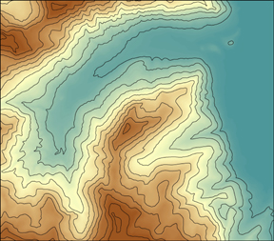
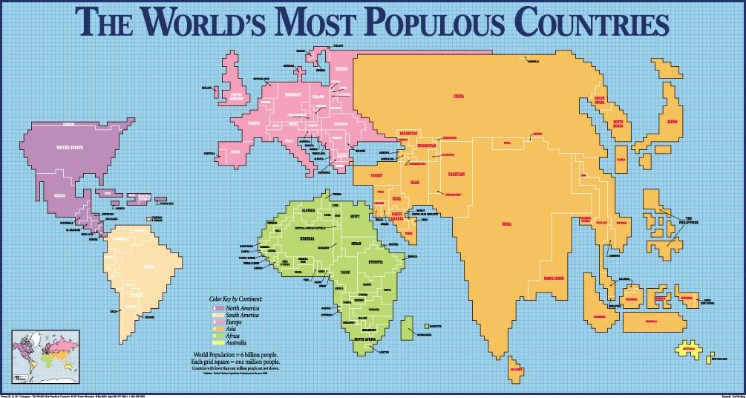
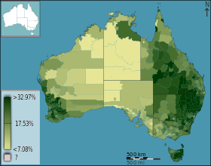
Isoline Map
Choropleth Map
Cartographic Map

Slide 14
Other Mapping Terms
Scale
Relationship between distance on the map and the actual measurement in the real world
The larger the area of space being represented on the map, the smaller the scale.
Globe would have the smallest scale.
Village or Town would have a large scale.
Longitude /Meridian
Arc drawn between the North and South Poles.
0° = Prime Meridian
180° = opposite side (International Date line)
0° -180° East or West
Latitude/Parallel
Circle drawn around the globe parallel to the equator at right angles to the meridians.
0° to 90° North or South
0° = Equator
90° N= North Pole
90° S= South Pole

Slide 15
Other Important Concepts and Terms
Diffusion
Relocation Diffusion
Expansion Diffusion
Hierarchical diffusion
Stimulus diffusion
Contagious diffusion
Distribution of features
Distribution: arrangement of a feature in space
Density: the frequency with which something occurs in space
Concentration: the extent of a features spread over space. (clustered vs. dispersed).
Pattern: the geometric arrangement of objects in space
5 Themes
Location
Site: Absolute location
Situation: Relative location
Region
Formal region/uniform region
Functional region/nodal region
Vernacular region/perceptual region
Place
Physical place
Human place
Toponym
Interaction
Human adaptation
Changes made by humans
Movement
Material things
Non material things

Slide 16
Review Questions
1. A ratio of the number of items within a defined unit of area measures
(A) dispersion
(B) direction
(C) pattern
(D) density
(E) diffusion
2. Which of the following best describes the site of Manhattan?
(A) A regional transportation hub for the northeastern United States.
(B) A midway point along an urban corridor stretching from Boston to Washington, D.C.
(C) An island bordered by the Hudson and East Rivers
(D) An important center for international trade and commerce
(E) An urban center located two hours northeast of Philadelphia by train
Notes:
(D) A ratio of the number of items within a defined unit of area measures density. For example, human population density is typically measured according to the number of inhabitants per square mile or square kilometer of land. Because it is a ratio of quantity per unit of area, density always expresses a relative value.
2. (C) The site of Manhattan is best described as an island bordered by the Hudson and East Rivers. Site refers to a place’s absolute location, often described in terms of its physical geography. Situation, on the other hand, refers to a place’s location relative to external social relations, systems, or networks. All other available choices describe Manhattan’s situation relative to other places.

Slide 17
Review Questions
3. Spatial coordinates of latitude and longitude express
(A) relative location
(B) absolute location
(C) relative direction
(D) absolute direction
(E) relative distance
4. Which of the following concepts refers to the spatial arrangement of items or features within a given area?
(A) Distribution
(B) Direction
(C) Accessibility
(D) Trajectory
(E) Scale
Notes:
3. (B) Spatial coordinates of latitude and longitude express absolute location. Absolute location identifies a place according to a standardized system of mathematical coordinates. Relative location, on the other hand, identifies a place in relation to some other place. For example, the absolute location of Chicago is 41° north and 87° west, while its location relative to Milwaukee, Wisconsin, would be 90 miles south on Interstate 94.
4. (A) Distribution refers to the spatial arrangement of items or features within a given area. For instance, a map indicating the location of each national park in the United States would demonstrate how these parks are spatially distributed throughout the country. Spatial arrangements of certain items or features can be described in terms of even or uneven distributions across space. In the case that many items are located close to one another, it is possible to say that these items are clustered together.

Slide 18
Review Questions
5. A method for representing the three-dimensional surface of the earth on the two-dimensional surface of a map is known as
(A) scale
(B) globalization
(C) proximity
(D) ethnography
(E) projection
6. A subjective image of an area informed by individual perceptions and experiences in that area is known as a
(A) thematic map
(B) reference map
(C) mental map
(D) contour map
(E) topographic map
Notes:
5. (E) A method for representing the three-dimensional surface of the earth on a two-dimensional map is known as projection. There are many different methods of map projection, including cylindrical, conical, and azimuthal projections. However, no single method of projection perfectly represents the three-dimensional surface of the earth.
6. (C) A subjective image of an area informed by individual perceptions and experiences in that area is known as a mental map. Unlike other kinds of maps, which are typically material representations shared by multiple users, mental maps are highly personal images about a place composed of subjective perceptions, memories, biases, and feelings.

Slide 19
Review Questions
7. The notion that the physical environment offers certain constraints and opportunities that influence cultural practices without entirely determining them is known as
(A) assimilation
(B) possibilism
(C) diffusion
(D) determinism
(E) divergence
8. During the process of mapmaking, in which the three-dimensional surface of the earth is projected onto a flat, two-dimensional surface, all of the following attributes can become distorted EXCEPT
(A) shape
(B) area
(C) distance
(D) direction
(E) relative location
Notes:
7. (B) The notion that the physical environment offers certain constraints and opportunities that influence cultural practices without entirely determining them is known as possibilism. This idea stands contrary to the antiquated theory of environmental determinism, which posited that the physical environment absolutely determines how cultural practices develop in a given place. Possibilism, on the other hand, suggests that the physical environment offers certain possibilities that influence how a culture develops without absolutely determining this course of development.
8. (E) During the process of mapmaking, shape, area, distance, and direction are all liable to become distorted. Unfortunately, there is no absolutely perfect way to project the three-dimensional surface of the earth onto a fl at, two-dimensional surface. With every projection, either shape, area, distance, direction, or a combination of these inevitably becomes distorted. However, the location of geographical features relative to one another should not be affected during the mapmaking process.

Slide 20
Review Questions
9. The Prime Meridian, which passes through Greenwich, England, is equivalent to which of the following lines of longitude?
(A) 0° longitude
(B) 45° longitude
(C) 90° longitude
(D) 180° longitude
(E) 270° longitude
10. Which of the following terms refers to a ratio between distances portrayed on a map and actual distances on the earth’s surface that correspond to this map?
(A) Chart
(B) Scale
(C) Contour
(D) Grid
(E) Projection
Notes:
9. (A) The Prime Meridian, which passes through Greenwich, England, is equivalent to the line of 0° longitude. This location of the Prime Meridian is purely an arbitrary social convention, established among the scientific community in the late 19th century, in order to create a standardized system for determining the absolute location of things on the earth’s surface.
10. (B) The term scale refers to a ratio between distances portrayed on a map and actual distances on the earth’s surface that correspond to this map. To be useful, every map must include a scale that provides a corresponding ratio between distance on the map and actual distance on the earth’s surface. An example of a map scale could be one inch on a map equals one mile on the actual surface of the earth.

Slide 21
Unit 2: Population and Migration
The section makes up 13-17% of the questions on the AP Exam…10-13 questions
There have been 11 FRQs on this unit.
Topics covered
Human Population
Population Parameters and Processes
Human Migration
Population Structures and Compositions
Population Sustainability

Slide 22
Student Questions/Concerns Population
Demographic Equations
Summarize the amount of growth or decline of a population over time.
Look at CBR, CDR, NRI and migration
Cohort
Group of people bound together…
Have similar characteristics like age, gender etc.
Used for statistics.

Slide 23
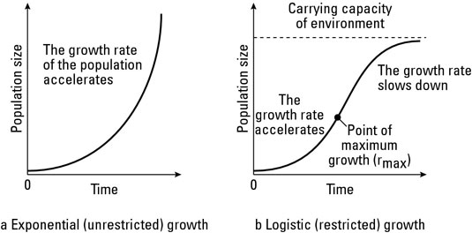
Student Questions/Concerns Population
What is an J Curve?
Shows exponential growth: Malthus’ prediction of population
What is a S Curve?
The leveling off of a J curve: seen in reality once population reaches carrying capacity.
Seen in Stage 4
Where would you find Zero Population growth?
Stage 4 countries see ZPG.
TFR at 2.1 to 2.5
CBR = CDR
Neo-Malthusian (slide 26)

Slide 24
People, Models and Theories: Population
Demographic Transition Model ( Warren Thompson)
Stage 1: high CBR and CDR (fluctuate)= low or no NRI
Stage 2: High CBR and declining CDR = high NRI
Stage 3: falling CBR and low CDR= moderate NRI
Stage 4: Low CBR and Low CDR=low NRI
Stage 5 (possible): CBR drop below CDR = negative NRI
Epidemiologic Transition Model (Abdel Omran)
Stage 1: Age of Pestilence and Famine
Stage 2: Age of Receding Pandemics
Stage 3: Age of Degenerative and Man-made Diseases
Stage 4: Age of Delayed Degenerative Diseases
Stage 5 (possible): Reemergence of infectious diseases.

Slide 25
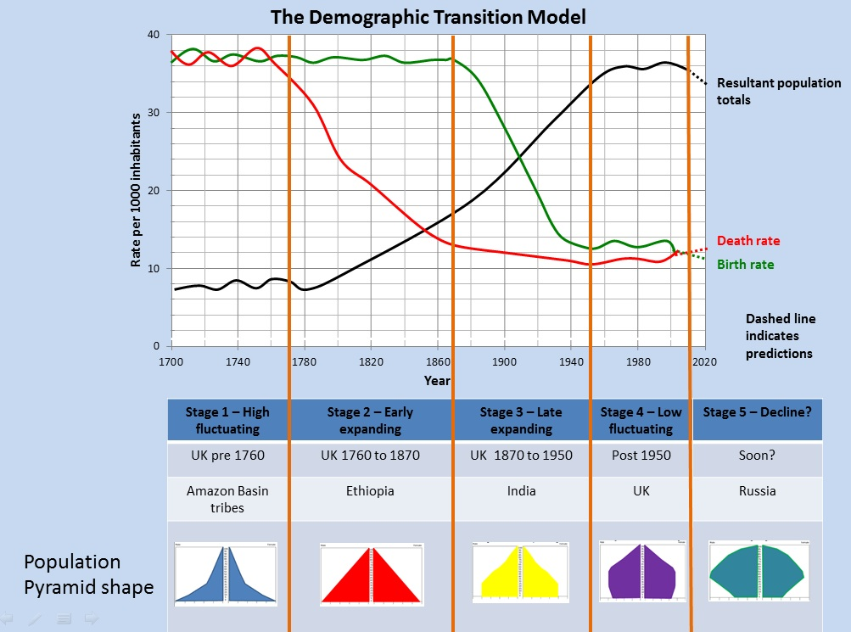

Slide 26
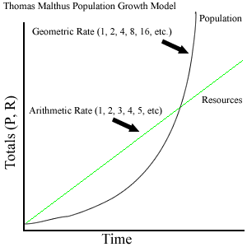
People, Models and Theories
Thomas Malthus
Population was growing exponentially (geometrically)
Food supply was growing arithmetically
Advocated positive checks on population growth
Negative checks on population: starvation and disease
Neo Malthusians
Not only run out of food, but other resources.
Call for regions not to exceed their carrying capacity
Opposition
Malthus failed to predict agricultural innovations
Resources are not fixed

Slide 27
Terms and Concepts: population density and distribution
Arithmetic Density
Total population/total land area
Highest in Asia, Europe, and Central America
Physiological Density
Population/arable land
Highest in Asia, Sub Sahara Africa and South America
Lowest in North America, Europe and South Pacific
Agricultural Density
Farmers/arable land
High in developing
Asia and Sub-Sahara Africa
Low in developed
Largest concentration of population found in East Asia.
Carrying Capacity: the number of people the area can sustain or support
Overpopulation: regions population outgrows it’s carrying capacity

Slide 28
Concepts and Terms: Population
Pro-natalist policies
Expansive
Tax breaks, daycare, extended maternity/paternity leave
Anti-natalist policies
Restrictive
Tax breaks, sterilization, one-child policy, eugenics
Dependency ratio
People to old or young to work compared to those in the workforce (15-64).
Demographic Momentum
Population continues to grow even after fertility rates decline
CBR: crude birth rate
CDR: crude death rate
NRI/RNI: Natural rate of increase
growth rate of population excluding immigration and emigration
IMR: infant mortality rate
TFR: total fertility rate
Replacement level: number of births needed to replace number of deaths.

Slide 29
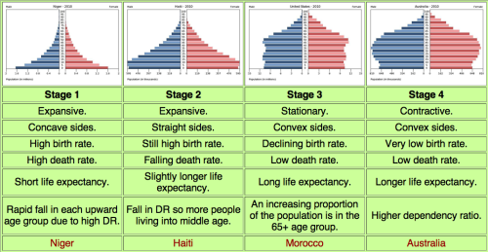
Population Pyramids
Population Pyramid
Used to display the percentages of each age group in a total population.
5 year increments
Male vs. Female

Slide 30
Student Questions/Concerns – Migration
History of Migration (slides) 31-32
Ravenstein’s laws of Migration (slide 33)
Cyclical Migration (slide: 34)
Chain migration (slide: 34)
Intervening Opportunity (slide 34)
Notes:
Gendered space
Demographic equation
Cohort
Chain migration
History of migration
Maladaptation
Cyclic Movement
Intervening Opportunity
Space-Time Prism
Transmigration

Slide 31
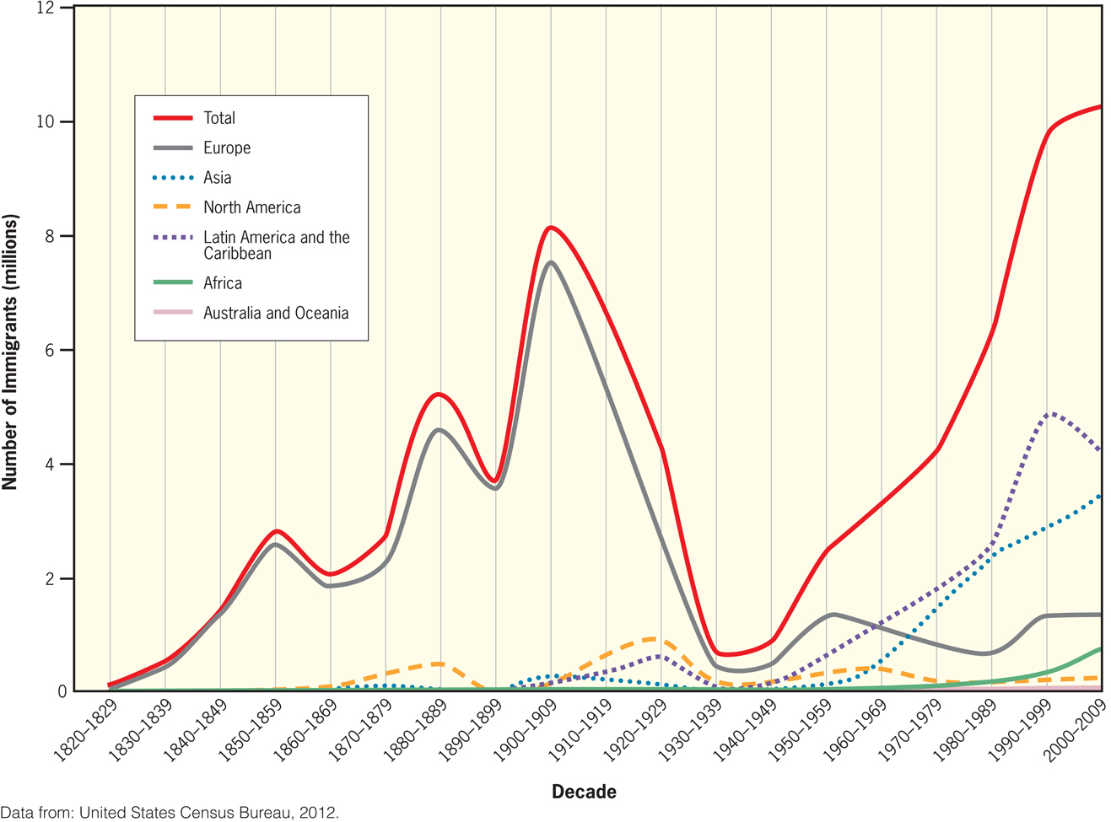
During the 1800’s the U.S. opened its doors to immigration
1st half: Northern and Western Europe
2nd half: Southern and Eastern Europe

Slide 33
People, Models and Theories: Migration
Ravenstein’s laws of Migration
The majority of migrants travel a short distance
Migration occurs in a series of steps.
Tend to move to large cities with economic opportunity.
Rural are more likely to migrate than urban.
Families are less likely to migrate across national borders than young adults (Men more than women)
Every migration stream creates a counter-stream
Gravity Model of Migration
Larger places attract more migrants than smaller places
Closer places attract more migrants than more distant places
Zelinksy’s Model of Migration Transition
Explains and predicts migration based on the demographic transition model
Stage 1: migrate on a local and seasonal basis – needs.
Stage 2: limited opportunities (because of high NRI) push people to migrate to more developed countries (international) or high interregional (rural to urban)
Stage 3 and 4: high international and intraregional (urban to suburban)

Slide 34
Concepts and Terms: Migration
Cyclic movement
Commuting
Seasonal movement
Snow birds
Migrant workers
Periodic movement
Military
College
Migration
Immigration: Movement of people to a place
Emigration: Movement of people away from a place
Chain Migration
Follow a migration flow – follow other migrants (family and friends
Can be seen with Ethnic neighborhoods.
Step Migration
Series of small moves to reach destination
Push-Pull factors
Intervening Opportunity or obstacles
Can change migratory path.
Voluntary vs. Forced Migration
Refuges
International Migration
Internal Migration
Interregional: moving from one region to another region
Rural to Urban
Urban to rural (counterurbanization)
Intraregional: moving within a region
Urban to suburban

Slide 35
Review Questions
1. An example of a country with a population pyramid that has a large base is
(A) Japan
(B) Germany
(C) Nigeria
(D) United States
(E) Russia
2. The demographic transition model suggests that as countries industrialize
(A) in-migration increases over time
(B) migration increases from rural to urban areas
(C) birth and death rates decrease over time
(D) life expectancy decreases over time
(E) fertility rates increase over time
Notes:
43: (C) Nigeria is a country experiencing rapid population growth and has a high percentage of young people approaching or at child-bearing age. The population pyramid with a wide base reflects the high percentage of young people. Japan, Germany, and Russia are all experiencing zero population growth, which would result in a narrow base on the population pyramid. The United States is experiencing slow population growth resulting in a slightly larger base that remains relatively constant throughout the ages until slightly decreasing at the top of the pyramid.
44:(C) According to the four stages of the demographic transition model, as countries industrialize, birth and death rates decrease over time due to increased access to health care, education (particularly among women), and other social changes.

Slide 36
Review Questions
3. Which of the following is not a contributing factor to the low birth rates in stage four of the demographic transition model?
(A) Less dependence on child labor
(B) Reliance on subsistence agriculture
(C) The education of women
(D) Availability of health care
(E) Increased sanitation
4. According to Thomas Malthus’s population theory, which of the following is a preventive check on population?
(A) Famine
(B) Disease
(C) War
(D) Moral restraint
(E) Disaster
Notes:
46. (B) Stage four of the demographic transition model experiences low birth rates since women are being educated and economies are not dependent on child labor. Subsistence agriculture requires children to work family farms and therefore would actually encourage high birth rates. Increased sanitation and availability of health care would have greater impacts on death rates than birth rates.
47. (D) Moral restraint is the only example of a preventive check. Disease, war, famine, and disasters are examples of positive checks. In general, preventive birth rates, while positive checks result in higher death rates.

Slide 37
Review Questions
5. Which of the following is not a result of overpopulation?
(A) Squatter settlements in Rio de Janeiro
(B) Low unemployment rates in Tokyo
(C) Deforestation in Madagascar
(D) Overcrowding in Mumbai
(E) Lack of access to food in Manila
6. The population of developed nations can be described as having
(A) higher fertility rates than undeveloped countries
(B) higher crude death rates than undeveloped countries
(C) higher crude birth rates than undeveloped countries
(D) lower natural increase than undeveloped countries
(E) lower life expectancy rates than undeveloped countries
Notes:
51. (B) A low unemployment rate is not a result of overpopulation, while insufficient housing, overcrowding, deforestation, and lack of resources are all consequences.
57. (D) Developed countries such as the United States, Australia, and France have a lower rate of natural increase than undeveloped countries such as Honduras, Bangladesh, and Chad. Rate of natural increase is the crude birth rate minus the crude death rate of a population. Undeveloped countries have higher crude birth rates, crude death rates, and fertility rates than developed countries.

Slide 38
Review Questions
7. For an emigrant, war in his or her homeland is an example of a
(A) push factor
(B) draw factor
(C) pull factor
(D) force factor
(E) driving factor
8. The gravity model predicts
(A) the number of people a city can support with available resources
(B) the rate at which intercontinental migration occurs
(C) the movement of people, goods, and ideas between two locations based on size and distance
(D) periods of population explosion in a certain geographic region
(E) the physiological density of a country
Notes:
63. (A) A push factor is any circumstance or event that would make someone want to leave his or her home country and migrate elsewhere. Examples include war, famine, disasters, and lack of jobs. Pull factors are the reasons immigrants want to settle in a new country, such as religious freedom or job opportunity.
77. (C) The gravity model uses the size and distance of two cities to determine how people and services will move between them. Larger cities that are closer together will have a higher exchange rate of people, ideas, and goods than smaller cities that are farther apart.

Slide 39
Review Questions
9. A person, typically 20–35 years old, who leaves his or her home country to work in another country is known as a
(A) guest worker
(B) temporary laborer
(C) host laborer
(D) interim worker
(E) provisional laborer
10. A J-curve on a population graph indicates
(A) exponential population growth
(B) cyclical population growth
(C) logarithmic population growth
(D) quadratic function
(E) linear population growth
Notes:
90. (A) A guest worker is someone who leaves his or her country to work in another country without the intent to settle permanently. Typically, the labor is physical, and young people are best suited for the work.
95. (A) A J-curve suggests that population projections indicate exponential growth. The population line mimics the shape of the letter J, where population growth is initially slow then increases dramatically.

Slide 40
Review Questions
11. All of the following are examples of forced migration EXCEPT
(A) the Trail of Tears in the early 19th century
(B) the Atlantic slave trade
(C) the California gold rush in the mid-19th century
(D) the Irish Potato Famine from 1846 to 1850
(E) the Japanese internment camps during World War II
12. Which of the following is not one of Ravenstein’s migration laws?
(A) Most migration is rural to urban.
(B) Migrants traveling long distances will likely settle in a big city.
(C) People in rural areas are more migratory than city dwellers.
(D) Most international migrants are young women
(E) Most migration is step migration.
Notes:
102(C) A forced migration is the result of religious or political persecution, war, natural disasters, forced labor, or famine. The California gold rush was not a forced migration, as people moved to the American West looking for gold and new opportunity.
100 (D) According to Ravenstein’s migration laws, most international migrants are young males, while women are more likely to migrate within their own country.

Slide 41
Unit 3: Culture
The section makes up 13-17% of the questions on the AP Exam…10-13 questions.
There have only been 5 FRQs on this unit…I predict there will be one on this AP Test.
Folk vs Pop; Universalizing vs Ethnic???
Topics covered
Cultural Basics
Popular vs. Folk Culture
Language
Religion
Gender
Ethnicity

Slide 42
Terms and Concepts: Religion
Universalizing: Try to have a universal appeal and attract all people
Christianity
Islam
Buddhism
Baha’i
Sikhism
Ethnic: appeal to only one group, one place, one ethnicity
Hinduism
Judaism
Monotheistic: Belief in one supreme being
Christianity, Islam, Judaism, Baha’i, Sikhism
Polytheistic: belief in more than one supreme being
Hinduism?
Animism: objects have divine spirits
Secularism: movement away from control of life by religion
Theocracy: government run by a religion
Iran

Slide 43
Student Questions/Concerns
Distribution of Religions
Notes:
Gendered space
Demographic equation
Cohort
Chain migration
History of migration
Maladaptation
Cyclic Movement
Intervening Opportunity
Space-Time Prism
Transmigration

Slide 44
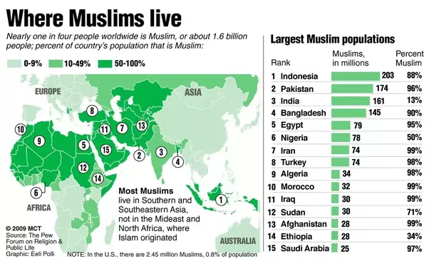

Slide 45
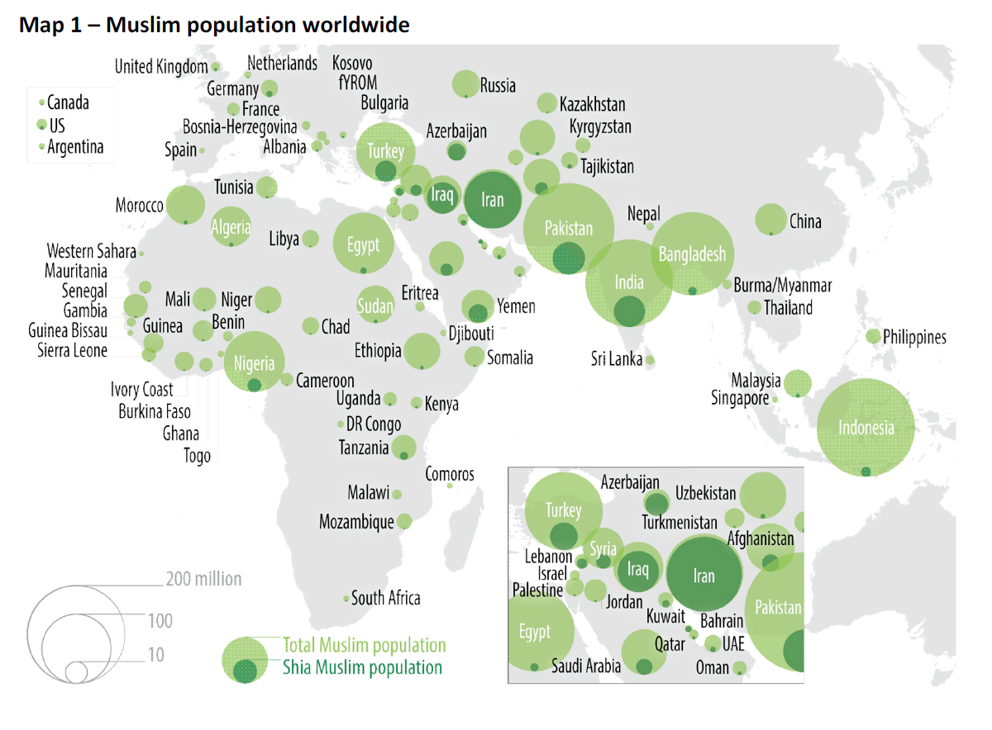

Slide 46
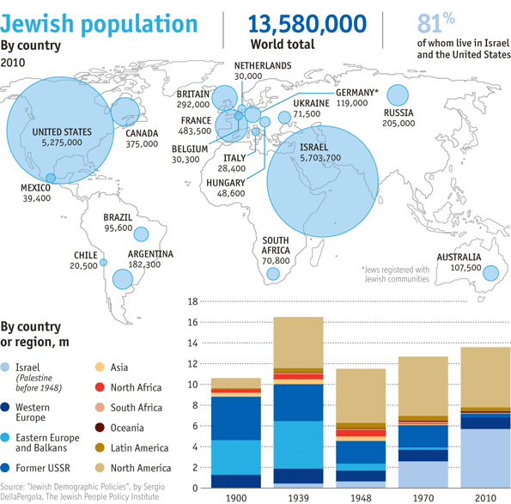

Slide 47
Student Questions/concerns
Sects, denominations, branches (Christianity)
Branches: Roman Catholic, Eastern Orthodox, Protestants.
Denominations: the offshoots of a branch
i.e. Baptist, Methodist, Lutheran
Sects: the offshoots of a denomination
i.e. Evangelical Lutherans

Slide 48
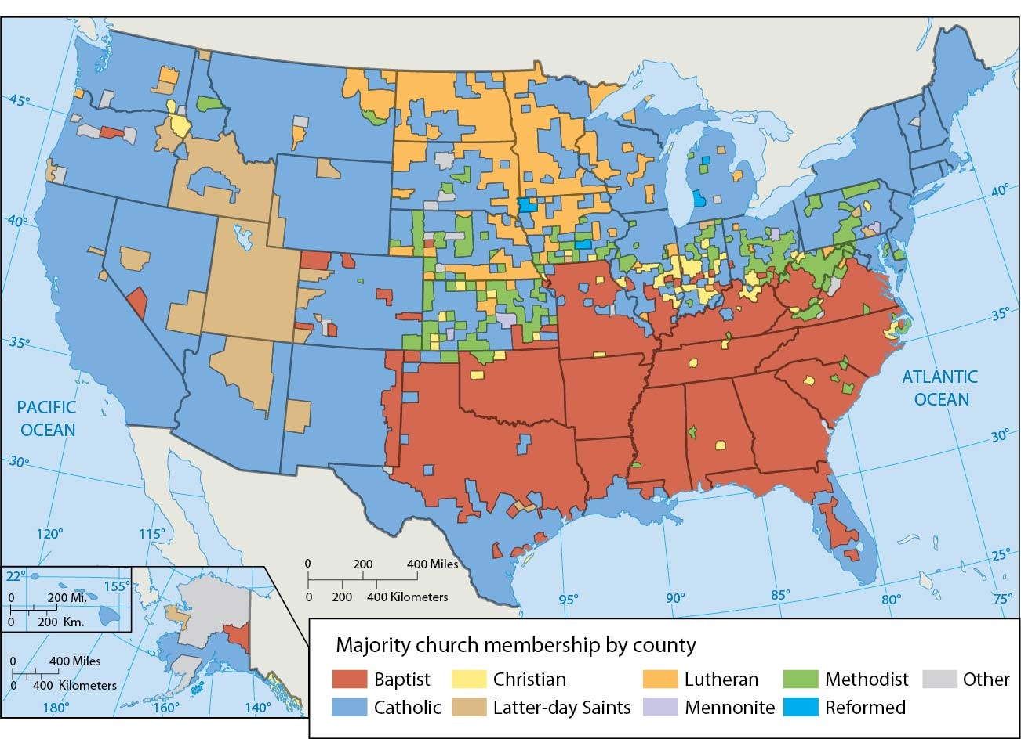

Slide 49
Terms and Concepts: Language
Language Family, branches, groups, language, dialects
Indo-European (most speakers)
Sino-Tibetan (2nd)
Mandarin Chinese (most speakers)
Spanish (2nd)
English (3rd)
Lingua Franca: a language used to facilitate trade among groups speaking different languages
English
Pidgin: simplified version of a language
Creole: language that results from the mixing of the “colonizer’s” language with the indigenous
French Creole - Haiti

Slide 50
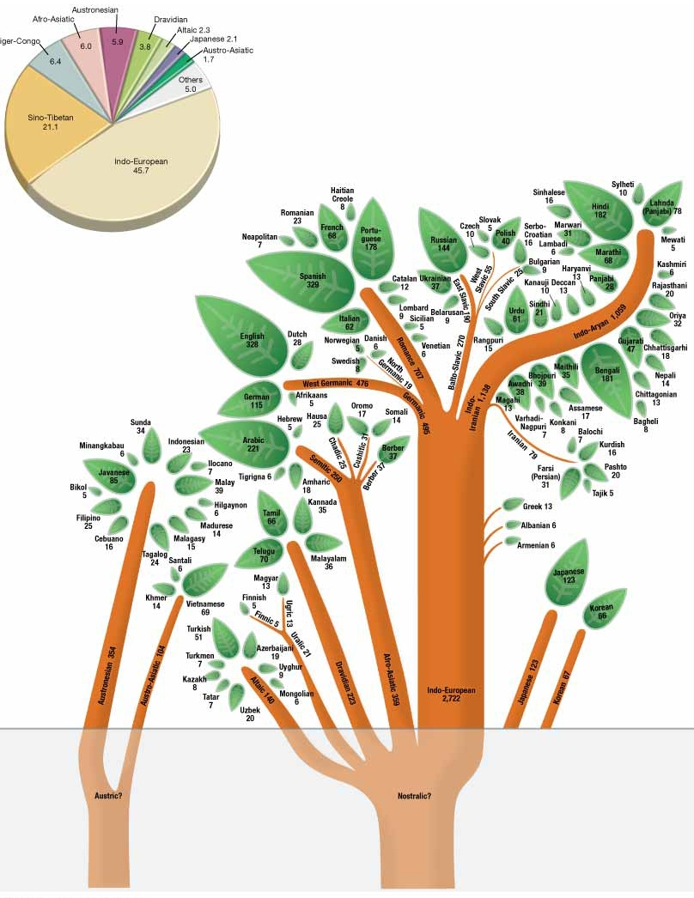

Slide 51
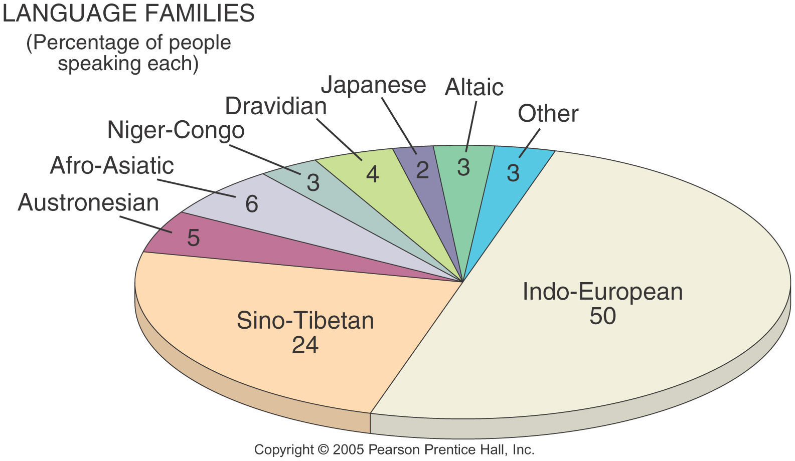

Slide 52
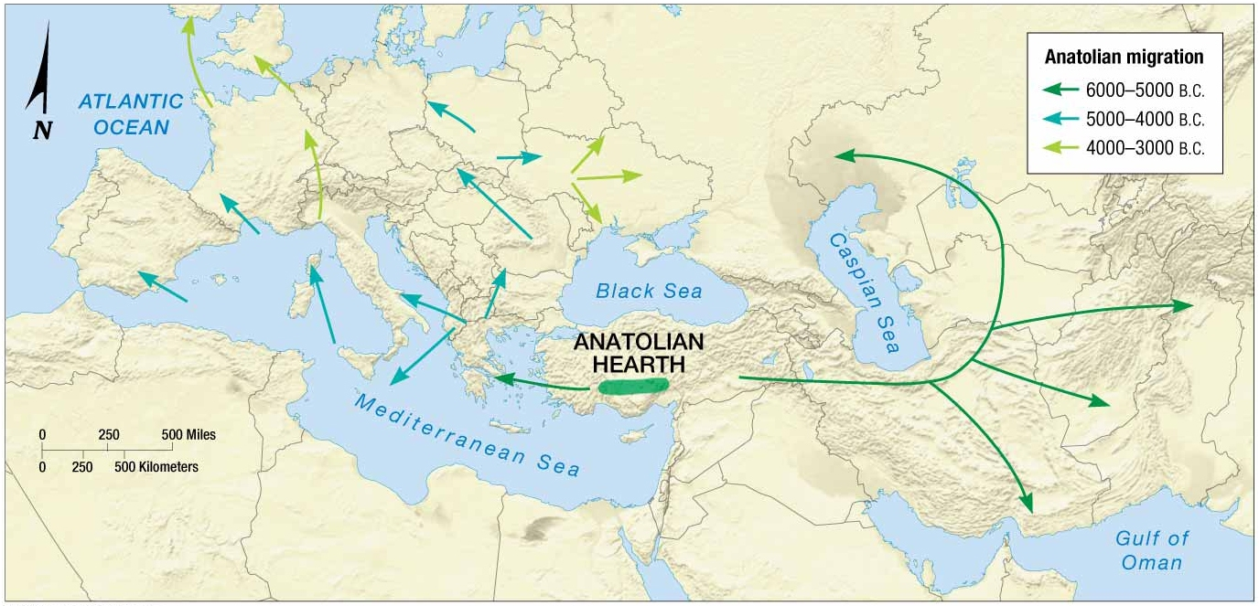
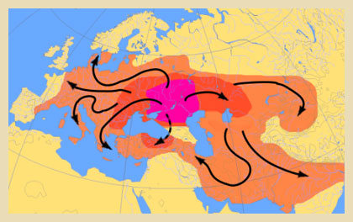
Student Question/concern: Origin and diffusion of language: Indo European Hearth?
Origin 6000 to 4500 BCE
Not sure of origin, but close to snow and not sea…therefore Anatolia
Agricultural theory
Diffusion started in a farming community spread with the diffusion of agriculture. (Anatolia)
Kurgan Conquest theory
Diffusion started with Empire-building from Central Asia

Slide 53
Terms and Concepts: Folk vs. Popular Culture
Cultural Hearths
Acculturation
Two cultures come into contact with one another and the weaker of the two adopts traits from the more dominant culture
Assimilation
When the original trait of the weaker culture are completely replaced by the traits of the more dominant culture
Folk Culture: limited to a smaller region and smaller group
Amish
Spreads through relocation diffusion
Popular Culture: mass culture that diffuses rapidly
Expansion diffusion
Uniform landscape
Environmental consequences
Threatens or strengthens folk culture

Slide 54
Student Questions/Concerns
Food Taboos
a prohibition against consuming certain foods
i.e. Pork, Beef etc.
Might be out of concern for the environment
Might be religious
Might be because of social values

Slide 55
Terms and Concepts: Ethnicity etc.
Race: classification system based on biology i.e. skin color
Ethnicity: relates to a set of norms people create to define their group (actual or perceived shared cultural traits)
Ethnic Cleansing
Genocide
Ethnic Clustering
S.W. US: Hispanic clustering
S. E. US: African American Clustering
West: Asian Cluster
Urban areas
Ethnic neighborhoods

Slide 56
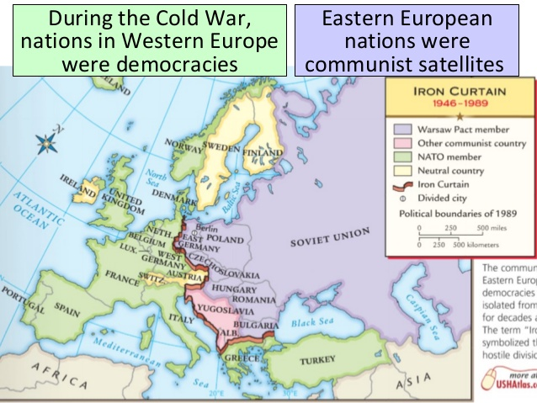
Student Question/Concerns
Shatterbelt Region
A region caught between stronger colliding external cultural-political forces, under persistent stress, and often fragmented by aggressive rivals.
Regions classified as shatterbelts are characterized by states or territories that have a large degree of ethnic, linguistic, and/or religious diversity, and a history of antagonism and hostility between the groups living there
Examples
Israel
Kashmir
Eastern Europe (during the Cold War Era)
The Balkans

Slide 57
Review Questions
1. Which of the following terms best describes the geographical boundary of one particular linguistic feature?
(A) Language border
(B) Toponym
(C) Choropleth interval
(D) Linguistic hearth
(E) Isogloss
2. Which of the following sacred places is most closely associated with animism?
(A) Hagia Sophia
(B) Ayers Rock
(C) Sistine Chapel
(D) Mecca
(E) The Western Wall
Notes:
124. (E) An isogloss is a geographical boundary that indicates the outer limit of one particular linguistic feature, such as a word’s pronunciation, spelling, or meaning. Unlike language borders, isoglosses indicate linguistic differences that can occur both within and between language regions.
125. (B) Ayers Rock, located in Australia, is the only selection associated with a traditional, or tribal, religion in which the local natural formations are regarded as embodying, rather than symbolizing, spiritual beings.

Slide 58
Review Questions
3. Compared to popular cultures, folk cultures are
(A) more cosmopolitan
(B) more homogeneous
(C) more diff use
(D) more transitory
(E) more contagious
4. A new fashion trend originating in New York City that diff uses to Los Angeles, Paris, and Tokyo before reaching rural areas of New York state would be an example of which of the following kinds of diffusion?
(A) Contagious
(B) Hierarchical
(C) Uniform
(D) Relocation
(E) Stimulus
Notes:
131. (B) Folk cultures are more homogeneous than popular cultures because they belong to smaller groups of individuals who share a common local environment, a common history, and common values. Unlike popular cultures, folk cultures are more insulated, less exposed to outside influences, and less liable to frequent changes over time.
137. (B) A trend or innovation that diff uses to major nodes before diff using to smaller nodes, regardless of their distances in relation to the point of origin, is an example of hierarchical diffusion. Unlike expansion diffusion, which spreads uniformly through space, hierarchical diffusion spreads non uniformly through space. In this case, for instance, a new fashion trend diff uses to other world cities more quickly than it does to less urbanized areas, even though the latter is closer in distance to the point of origin than the former. The answer is not relocation diffusion because a fashion trend does not migrate, but rather spreads hierarchically while also remaining in place at the point of origin.

Slide 59
Review Questions
5. An immigrant who selectively adopts certain customs of the dominant host society in order to advance socioeconomically, while still retaining much of his or her native customs, practices, and beliefs, best illustrates the concept of
(A) acculturation
(B) maladaptive behavior
(C) assimilation
(D) ethnocentrism
(E) all of the above
6. A highly simplified language developed between linguistically heterogeneous groups for the purposes of basic intergroup communication is known as which of the following?
(A) Creole
(B) Pidgin
(C) Lingua franca
(D) Bilingualism
(E) Standard dialect
Notes:
139. (A) An immigrant who selectively adopts only certain customs of the dominant host society while retaining much of his or her native culture is an example of acculturation. Unlike assimilation, which implies a process that culminates in the full adoption of the dominant host society’s customs, acculturation implies a more selective and less complete process of adjustment in which one’s native culture does not become fully displaced by the host culture.
140. (B) Pidgin is a highly simplified language created among linguistically diverse groups in order to facilitate basic communications between these groups. By definition, pidgin is not the first language of any of its speakers, as its express purpose is to facilitate communication between speakers whose native tongues are dissimilar. Once a pidgin language develops into a native language for a certain group of speakers, it becomes a Creole language.

Slide 60
Review Questions
7. Which of the following regions is characterized as a zone of conflict between Muslim and Hindu ethnic groups?
(A) Kurdistan
(B) Chechnya
(C) Kashmir
(D) East Timor
(E) The West Bank
8. All of the following are examples of iconic, secular landscapes EXCEPT
(A) the Eiffel Tower
(B) Yosemite Valley
(C) the Lincoln Memorial
(D) the Great Wall of China
(E) the Dome of the Rock
Notes:
144. (C) Kashmir, a region that occupies parts of northern India, eastern Pakistan, and western China, is characterized as a zone of conflict between the Muslim and Hindu ethnic groups of Pakistan and India, respectively. During the latter half of the 20th century several wars were fought between Pakistan and India for control of this disputed territory. Chechnya, Kurdistan, East Timor, and the West Bank are also zones of ethnic-religious conflict. However, the first three areas of conflict are primarily between Muslim and Christian ethnic groups, while the latter is between Muslim and Jewish ethnic groups.
145. (E) A secular landscape is one that does not have explicit associations to any particular religion. The only iconic landscape among the choices that is not explicitly secular is Dome of the Rock, a religious mosque in Jerusalem that represents an important symbol of Islam.

Slide 61
Review Questions
9. In which of the following countries are inhabitants subject to Sharia law?
(A) Saudi Arabia
(B) Venezuela
(C) Ethiopia
(D) Turkey
(E) North Korea
10. The predominance of English as the preferred language spoken at many international business meetings and political summits could be cited to support the claim that English is a popular
(A) Creole language
(B) pidgin language
(C) language branch
(D) dialect
(E) lingua franca
Notes:
148. (A) Sharia law is an Islamic code of conduct that regulates personal conduct and social aff airs in a particular territory. It is enforced, to varying degrees, in Islamic states such as Saudi Arabia, Iran, Yemen, and Somalia, to name a few. Turkey, despite a majority Muslim population, has a secular government and does not subscribe to Sharia law.
149(E) A lingua franca is an established language adopted by speakers in a particular place or context in order to facilitate communication among a linguistically diverse group. It is typically a second language shared by a group of speakers whose native tongues are mutually unintelligible. Unlike pidgin, which is a primitive language created for the purpose of communication between linguistically diverse speakers, a lingua franca is an already developed language that is adopted by speakers as a second language.

