Slide 1
EOCT Review U.S. History
Everything you need to know to excel on the EOCT

Slide 2
Colonial America
Two major reasons for British settlement of North America.
1. Economic ______________
2. Religious _______________

Slide 3
Virginia
______________ founded by the __________ Company
Wanted to make $$$$
Led by Captain John _______________
Tenuous relationship with Chief _______________ of the Algonquian Indians
Created the House of ___________– 1st representative body
Nathaniel Bacon revolts because of the “Indian Problem” (_______________ Rebellion)
The colony was saved by _______________!!!
This led to the development of slavery

Slide 4
New England Colonies Massachusetts , Connecticut, New Hampshire, Rhode Island
Created for religious _______________. (The Puritans)
Settlements destroyed by Indians
led to King ______________ War (Chief Metacom)
Mayflower ___________ = 1st form of self government.
Roger Williams founded Rhode Island on the principle of “separation of church and state”
The _________ - ________ Covenant provided partial church membership. (Needed more followers)
Twenty people hung during Salem Witch __________

Slide 5
Middle Colonies – New York, Delaware, Pennsylvania, New Jersey
Centered around ____________________
Dutch named New _________________________
Renamed New York after English takeover
William Penn founded Pennsylvania as home for the ____________________

Slide 6
French Settlement
Wanted to find a __________ __________= water route to Asia.
Settled mostly in Canada
Based on ______________ trade
Quebec founded by Samuel de _________________.

Slide 7
Mercantilism
Gold and Silver = wealth
Establish colonies for _____________
Resources brought back to England
Resources sold for gold and ______________.
**** shifted the BALANCE of _________ in England’s favor

Slide 8
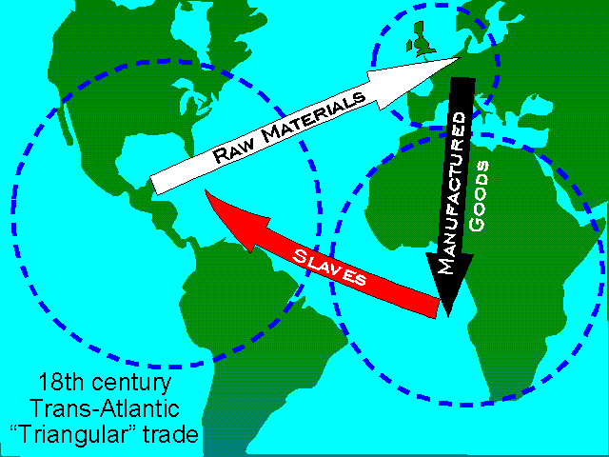
Trans-Atlantic Trade (Tri-angular Trade)
Trade route established between ___________, Africa, and the Americas.
Africa to the Americas: _______________
The Americas to Europe: raw materials
Europe to Africa: manufactured __________

Slide 9
African-Americans
Brought by way of the_____________ ______________
More colonist = more slaves
New culture: language, singing, gospel, oral history, basket weaving

Slide 10
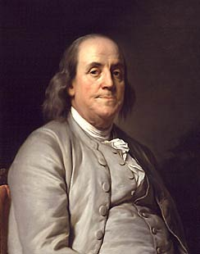
Benjamin Franklin
_________________ Man (inspired by Enlightenment ideas)
Author, scientist, inventor, and statesmen. (lightening rod and ______________ eyeglasses)
One of our founding fathers.

Slide 11
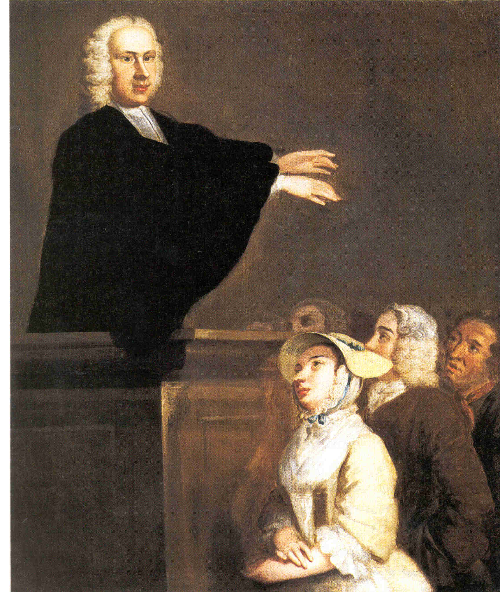
The Great Awakening (1720’s-1760’s)
spiritual movement led by George __________________
Rejected ideas of the _______________________
Important because
1. Led to the formation of many new _______________
2. People became more tolerant of one another

Slide 12
The French/Indian War (the 7 years War)
French fight British for control of the America’s
Indians fight on French side
Starts when George ____________ attacks a French fort
Ends with 1763 Treaty of ________________
Importance
British in control of Americas
Colonist will be ___________ to pay for the war
Native Americans weakened

Slide 13
The American Revolution
Causes
Proclamation of ___________ – colonists can’t move west of Appalachians – (no more conflict w/Indians)
Taxes – Stamp Act, Quartering Act, Sugar Act, ___________ Acts (colonies could no longer self-govern)
Colonial Response
Ignore Proclamation of 1763
Boycott, Protests, Riots in response to taxes
Sons and Daughters of ___________________ formed
Thomas Paine writes __________ _ ______________– calls for independence from Britain.

Slide 14
Declaration of Independence
Written on July 4, 1776 by Thomas_____________
Inspired by Baron de Montesquieu of France and John Locke of England
Basic principles = natural rights to life, liberty, and _________________
Good governments protect these rights.
Could _______________ government if it violated these rights.

Slide 15
French Alliance – join after Battle of ______________. Supported the “American Cause” and wanted to weaken Britain
Ben Franklin
Leading American negotiator in Paris
Convinced __________ to join the Americans.
Marquis de Lafayette
French general who provided military expertise to the Americans.
Key strategist in Battle of _________________

Slide 16
George Washington – as a military leader
General of the Continental _____________
Crossing the Delaware – Defeats the _____________in the Battle of _________________
Valley _______________ – Soldiers have little food or supplies during winter of 1777. Washington keeps them together and soldiers become more disciplined.
Led by example and inspiration

Slide 17
End of the War
Battle of ________________ – British surrender after being surrounded (U.S. forces by land, French by sea).
Treaty of _________________ – (Ben Franklin negotiates)
America recognized as an independent nation.
Gain more land
French left out
Lord ________________________
General of the British Army – (Red Coats)
Forced to surrender at Yorktown

Slide 18
Articles of Confederation – 1st constitution of U.S.
To ____________ because it created a government that had __________ power to tax, regulate commerce, or establish a national currency.
States had _____________ power than the federal government.

Slide 19
Daniel Shays Rebellion
Farmers in debt tried to secure weapons from a Federal Armory.
States wanted federal help to put down the rebellion, but government did not have the $$$ to raise an army.
****Rebellion illustrated the ________________ for a _____________________federal government.

Slide 20
Federalist vs. Anti-Federalist
Federalist
Anti-Federalist
Strong central government
___________ the constitution
Included George Washington, Alexander Hamilton, and James Madison
Wanted a Bill of __________
Constitution would give the government too much _______________.
Included Samuel Adams and John Hancock

Slide 21
The Federalist Papers
Written by Alexander Hamilton and James Madison
Argued __________ the ratification of the Constitution
Need for a _______________ central government
Benefits of a union between the states
Problems with the Confederation as it stood

Slide 22
George Washington – the President
1st president of the U.S.
Non-Intervention in Europe
DON’T make alliances, they lead to war
Did NOT want to side with France against Great Britain
England forgives pre-revolutionary debts and drops trade restrictions
Imposed the _______________ Tax to help pay for the Revolutionary War
Warned of the dangers of __________________ parties
Would __________________ the nation

Slide 23
The Whiskey Rebellion
Opposed Washington’s whiskey tax
Farmers frightened and attacked tax collectors
Washington sends a large ______________ to put down the rebellion
Important because it illustrates the power of the federal government under the new ________________________.

Slide 24
Formation of Political Parties
Federalist
Democratic Republicans
Led by Alexander Hamilton and John Adams
Favored by _______________
Supported use of force to end whisky rebellion
Instrumental in ___________ the constitution
1st two presidents (Washington and Adams) were federalist
Led by Thomas Jefferson and James Madison
Favored by _______________, especially farmers
Opposed the overuse of force to end whisky rebellion
Opposed the constitution and big __________________

Slide 25
John Adam’s Presidency
Marked by controversy
_____________Affair – French were seizing American ships. Sends diplomats to negotiate peace. Met by three men code named X,Y, and Z who demanded $250,000 in bribes. Angers Americans
Imposes unpopular taxes to expand the military
___________ Act – could arrest and deport immigrants who criticized the federal government
________________ Act – Made it a crime for citizens to discredit the government
Both acts violated the constitution (freedom of speech and right to due process).

Slide 26
The Louisiana Purchase
Thomas ________________ buys New Orleans and the Louisiana territory from France for $15 million.
James Monroe negotiates the purchase
France needs $$$ for war (Napoleon)
Doubles the size of the U.S.
Leads to the ___________ and ___________expedition
Chart trails, map rivers, document new plants and animals, studied Native Americans

Slide 27
War of 1812
Causes
Results
British forces capturing American sailors and forcing them to serve in British navy (________________________)
British trying to prevent U.S. from trading with France
Americans want British out of North America
Americans become more nationalistic (_______________________)
End of American/British hostilities
America viewed as a military force
Andrew Jackson becomes a war hero after Battle of ________ ________________

Slide 28
Industrialization
Eli Whitey introduces the _____________ __________
Reduces the cost of processing cotton
Need for more slaves
New technologies speed up production
Assembly Line
__________________ Parts = could be replaced without disposing of the entire machine

Slide 29
Westward Growth
3 Major Reasons for moving west
1. The desire to own ______________
2. Discovery of _________________ and other resources
3. Manifest _____________________– Belief that it was America’s destiny to occupy the land from the Atlantic to the Pacific (“sea to shining sea”)

Slide 30
The Abolitionist Movement
William Lloyd Garrison – published the “___________” an anti-slavery newspaper
Frederick ____________ – escaped slave who wrote and gave speeches on behalf of equality for African-Americans, women, Native Americans, and immigrants. (“Narrative of the Life of Frederick Douglass”)
The ___________ Sisters – Sarah and Angelina Grimke worked to arouse moral outrage against slavery
Nat _______________ Rebellion – leads a slave revolt in which nearly 60 people are killed. South enforces stricter rules on slaves

Slide 31
The Mexican-American War
U.S. decides to annex _______________.
U.S. wins the war and is given Texas, New Mexico, and California in exchange for leaving Mexico (Treaty of Guadalupe _________________)
The ___________________ Proviso
Proposed that New Mexico and California would enter as free states
Never passed in the Senate
__________________ tensions between North and South

Slide 32
Events leading up to the Civil War
Kansas-___________________ Act
Repealed the Missouri ________________________ of 1820– states above 36⁰30’ N would be free, below would be slave
People would decide if they would be a free or slave state (popular sovereignty)
_________________ Scott Decision
Sued for his freedom and lost. Supreme Court ruled no African-American could ever be a citizen
John ____________________
Fought slavery with violence. Led a raid on pro-slavery settlers in Kansas, killing five men
Led the Harpers Ferry Raid – seized ammunitions and planned to deliver them to slaves. Eventually hung

Slide 33
Major Battles of the Civil War
Antietam (Maryland)– Robert E. Lee goes on the attack. Deadliest one-day battle in the war (26,000 casualties). Afterwards, Lincoln issues the Emancipation _____________________________ freeing the slaves
______________________ (Pennsylvania) – Deadliest battle of the war (51,000 dead). Union could have ended the war but chose not to pursue. Four months later Lincoln delivers the Gettysburg Address
Vicksburg (Mississippi) – Ulysses S. Grant gains control of the __________________________River. It is a 7 week siege that becomes the turning point of the war.
Atlanta – William T _______________ burns Atlanta to the ground then continues to Savannah on his March to the _____________.
Appomattox – Lee surrenders his army to Grant at Appomattox ________________ House on April 9, 1865.

Slide 34
Reconstruction – the rebuilding of America after the war
Black ________________ – laws written to control the lives of freed slaves and make them feel inferior to whites
Deprived voting rights
Legal discrimination
KKK
Fight against reconstruction
Used violence, __________________, and angry protests

Slide 35
Railroads and Westward Expansion
Needed to connect the east and west (__________________________ railroad)
Used Chinese laborers
Accepted lower pay
Many died due to explosive blast or rock slides
________________________ Act – gave up to 160 acres of free land to help develop the west
Moved in ___________trains

Slide 36
Impact on Native Americans
Often forced from homes
Trail of ________________ – Many died on journey to Oklahoma due to starvation, disease, and exposure
The Sioux
Gold discovered in the Dakotas
Had singed a treaty that no white persons would settle there
Sitting ____________ takes on the U.S. army, eventually flees to Canada then surrenders
____________________ Knee – Many Native Americans slaughtered while trying to surrender

Slide 37
U.S. in Latin America
Roosevelt ___________________ – President “Teddy” Roosevelt announces that only the U.S. has the right to intervene in Latin America (extension of the Monroe ______________________)
Panama _____________________
Faster sea route from Atlanta to Pacifica
Biggest engineering project of its time

Slide 38
Important Supreme Court Cases
Marbury v. ______________ – establishment of judical review
Plessy v. Ferguson – “Separate but __________” legal
_______________ v. Board of Education – Overturns separate but equal
Roe v. _________________ – Makes abortion legal
Miranda v. Arizona – Self-___________________/due process. (Miranda rights)
Bush v. ________________ – resolves 2000 election, recount stands

Slide 39
The Great Depression
Causes
Reduced regulation of corporations
Buying on _________________ (credit)
Stock Market _________________
Banks go bankrupt
Results
25% unemployment rate
____________________________ - shanty towns built by homeless people during the Great Depression. Named after Herbert Hoover, the President of the United
FDR and the New Deal

Slide 40
The New Deal
______________________ Valley Authority (T.V.A.) – new deal program intended to create jobs and provide electricity, dams, and flood control to rural southern regions.
The ______________________ Act – protected workers rights such as collective bargaining rights, the right to strike, and the right to join a union.
Social ____________________ Act- purpose to create a retirement program for elderly, offer disability insurance, and health insurance to needy and elderly (Medicare/Medicade) (part of 2nd New Deal)

Slide 41
Opposition to the New Deal
Court ___________________ Bill
What was it? An attempt by FDR to add more justices to the supreme court
Purpose: to obtain favorable rulings regarding New Deal legislation that had been previously ruled ____________________________________.
Outcome: Failed, people thought it gave the President too much power.
Huey ____________________ – Louisiana senator who strongly opposed many New Deal programs and the court packing bill – Believed they were unconstitutional

Slide 42
The Dust Bowl (1930-1936)
Severe dust storms caused by __________________and poor farming practices.
Devastated southern farmers
Many families known as “____________________” were forced to migrate to California and other states.
Added to an already terrible economic climate during the Great Depression.

Slide 43
Eleanor Roosevelt
1st lady to Franklin Roosevelt
Played a critical role in the women’s ________________
Encouraged women to play an active role in politics
Was instrumental in shaping the White House’s ______________________ policy during FDR’s tenure.

Slide 44
Phillip Randolph's Almost March on Washington
Randolph organizes an African-American march on Washington to protest __________________________ in defense industries.
FDR issues Executive Order _______________, barring discrimination in defense industries. (March is cancelled)
Later urges Harry Truman to issue Executive Order 9981, ending __________________ in the armed forces.

Slide 45
Pearl Harbor
December 7, _______________
Japanese surprise attacks U.S. naval base at Pearl Harbor, Hawaii
America is drawn into ___________________
Japanese Americans on the west coast are placed in ________________________ camps

Slide 46
Major Events of WWII (1939-1945)
Lend-_______________________ Act – Supplied allies (British and French) with military supplies and aid.
Battle of __________________ – Turning point of war in the Pacific. Stop Japanese advance.
D-Day- Massive allied invasion headed by Dwight Eisenhower. Storm the beaches of ________________.
Battle of the Bulge – Last gasp by Hitler, _____________________ German army.
Battle of ___________________ – Last major battle in Europe, leads to V.E. Day (Victory in Europe)

Slide 47
The War at Home
War _____________________ were sold to raise $$$ for the war
Women and minorities worked in the factories to produce war goods.
The public was asked to conserve or ___________________ food and resources.
The war effort _________________every aspect of American society
Work
Home
Conversations
Sports – (many players were drafted or volunteered for the war).

Slide 48
The Manhattan Project
Purpose: to develop the Atomic ____________
Overseen by Robert ____________________________
Los ________________: site where the bomb was built (New Mexico)
Dropping the bomb: Harry Truman gives the order
1st bomb dropped on ____________________
2nd bomb on Nagasaki
Brings an end to _______________________________ (V.J. Day – Victory in Japan)

Slide 49
The Cold War
_________________ Plan – provided economic aid and supplies to worn-torn Europe (helped rebuild Europe)
Truman __________________ – established the policy of containment (to keep communism from spreading)
The Red ____________ – Aimed at finding communist trying to infiltrate America – (namely in the government)
Led by Senator Joseph _______________ (McCarthyism)

Slide 50
Communism Spreads
China has a revolution led by Mao _______________
China becomes a communist country
This intensifies Americans fear of _________________
Government willing to engage in war to stop communism from spreading further
Example – _______________ War (1950-1953) – Side with South Korea to keep it from falling to communist North Korea.

Slide 51
The Cuban Revolution
Fidel _________________ leads an uprising and Cuba becomes communist
Cuba is supported by the _________________ Union
Bay of ____________ – CIA led mission to help Cuban revolutionaries overthrow Castro
JFK backs out and revolutionaries are crushed
Cuban ________________ Crisis – occurs when Soviet Union begins placing nuclear missile sites in Cuba
Ends after a 13 day standoff between the U.S. and Russia

Slide 52
The Vietnam War
U.S. first becomes involved during Eisenhower’s administration (1950’s)
Goal: to keep South ____________________ from falling to communist North Vietnam
Escalates to an all-out war during Lyndon Johnson’s (LBJ) presidency
Tet ____________________: North Vietnam ignores a cease fire and goes on the attack in South Vietnam
Anti-War ___________________________: protests, songs, marches (more and more people turn against the war as it drags on)
Last U.S. troops pull out in 1973 during Richard Nixon’s presidency.
1975 – North Vietnam _________________ South Vietnam

Slide 53
The Space Race
1957- Soviet Union launches __________________ into space.
Satellites could be used to spy on other countries
Eisenhower and the rest of America realize they are behind technologically to Soviet Union.
Schools quickly adapt instruction to meet demands in science and math
National Defense __________________ Act created to provide $$$ for scholarships and scientific equipment in schools
1969- Neil Armstrong becomes the 1st man to walk on the moon

Slide 54
The Baby Boom
After WWII, the U.S. saw a spike in the # of babies being born.
Became known as baby ___________________
____________________- the 1st mass-produced suburb
Founded by William Levitt
Set the standard for post war suburbs (Quick and cheap)
Interstate _______________________ Act – intended to connect urban areas with suburban areas
Largest pubic works program of its time

Slide 55
The Role of Television
Played a critical role in the election of ______________
Kennedy came off much better than Nixon on television
Played a critical role in the Civil Rights ____________
People saw first hand how African Americans were beating treated
Became _____________________________ to the cause

Slide 56
New Technology
New technology such as ______________________ and ______________ _______________ made it easier to stay connected to the world
Internet – Instant _________________ to information
Cell phones – get in touch of anyone, anytime
Record, take pictures, text, music

Slide 57
Martin Luther King Jr.
Letter from ___________________________ Jail
written to convince 8 Alabama clergymen of the need to use non-violent protest as a means to achieve civil rights - "Injustice anywhere is a threat to justice _________________________”
I have a Dream Speech
Given in 1963 during the March on __________________ (Lincoln Memorial)
Defining moment in the Civil Rights Movement – (widely considered the ____________ speech of all time)

Slide 58
The Civil Rights Movement
1948 - Harry Truman issues _________________ Order 9981
Ends segregation in the armed forces
1954 – Brown v. Board of Education
ends segregation in schools
Opposition to the ruling
Governor Orval __________________ of Arkansas - Little Rock Nine – National guard called in by Eisenhower
Governor George Wallace of Alabama – “Stand in the _______________________Door”
Riots, protests, unwillingness to comply

Slide 59
Civil Rights Legislation
Civil _____________________ Act of 1964
Initiated by JFK, passed by LBJ
outlawed major forms of discrimination against blacks and women, including racial _______________________.
ended unequal application of voter __________________ requirements and racial segregation in schools, at the workplace and by facilities that served the general public
_________________________ Rights Act of 1965
outlawed discriminatory voting practices against African-Americans
Provided federal guidelines for setting up voting ________________________

Slide 60
The Warren Court
Supreme Court led by justice Earl _________________ (1953-1969)
Expanded civil right and civil _____________________
Helped bring an end to racial discrimination
Expansion of individual rights
Example – Miranda v Arizona - 1966

Slide 61
Lyndon Johnson’s Great Society
TWO main goals = elimination of _________________ and racial __________________________.
Created new major spending programs that addressed education, medical care, urban problems, and transportation
Medicare/_________________________

Slide 62
Turmoil in 1968
MLK is assassinated by James Earl Ray
Robert Kennedy is assassinated by Sirhan ___________
Democratic _______________________ Convention – outraged by the assassinations protesters show up at the convention being held in Chicago.
“The ____________________ Riot” – violence erupts between the Chicago Police Department and the protesters

Slide 63
Civil Rights Organizations
Student Non-Violent Coordinating Committee (SNCC)
Southern Christian Leadership Conference (SCLC)
Created on the campus of Shaw university
Major form of protest was ___________ - _________
Organized ________________ Rides to check if the south was following civil rights legislation
Often met with violence, further aided the civil rights cause
Founded by MLK in response to the ____________________ Bus Boycott
Played a large role in the civil rights movement
Worked closely with churches
Used ____________________, organized marches, and other forms of non-violent protest
Established _________________ Schools to help adults learn to read

Slide 64
National Organization for Women (NOW)
Organized in 1966 as a women’s __________________ organization
Equal rights for all
Employment opportunities
Sex _____________________________
Gay and lesbian rights

Slide 65
Cesar Chavez and the United Farm Workers Union
Chavez was a Mexican-American who founded the United Farm Workers ________________________
Fought for the rights of _________________________ workers
Used strikes and boycotts
Focused on grape pickers and lettuce growers
Wanted _____________________ immigration
Better __________________________ for immigrants

Slide 66
The Environmentalist Movement
Rachel Carson – wrote “Silent ___________________” – a book about the environmental problems associated with chemicals being dumped into the water.
_________________ Day – created to inspire awareness and appreciation in the earth’s natural environment.
Environmental _________________________ Agency (EPA) Government agency created to monitor and enforce environmental laws. Also working for a cleaner, healthier environment for the American people.

Slide 67
The Conservative Movement
Began in the 1950’s in opposition to the liberal movement.
Must attack communism _____________________ contain it.
Smaller government
Less ___________, less taxes, less _______________________ intervention in business
Barry _______________________ – Up and coming Senator who brings light to the Conservative cause. Defeated by Lyndon Johnson in 1964 election.
Ronald _____________________ – Wins the 1980 election. Conservatism is here to stay.
____________________________________
1. Reduce Growth of Government spending.
2. Reduce Income Tax and Capital Gains Tax.
3. Reduce Government regulation.
4. Control the money supply to reduce inflation

Slide 68
Richard Nixon (1969-1974)
Wins election of 1968
Ends war in _____________________________
1972 – Becomes the 1st President to visit the People’s Republic of ___________________ (communist China)
Opens up dialogue between the two countries, which eventually leads to trade
1973 – Forced to resign because of the ______________________________ Scandal
Gerald ___________________ takes over as President. ____________________Nixon. Helps guide the nation through a recession.

Slide 69
Affirmative Action
The _________________________ Decision
1978 - Regents of the University of California v. Bakke
Ruled that affirmative action is legal, however, invalidated the use of racial _________________________ in college admissions and hiring practices. (reverse discrimination)
Affirmative ____________________ – policies that take factors including "race, color, religion, gender , or national origin into account in programs ranging from employment and education to public contracting and health programs

Slide 70
Jimmy Carter (1977-1981)
Camp David _____________________________ - 1978
Carter negotiates a peace treaty between Egypt and Israel.
Iranian ______________________________________
The Shah (who is backed by the U.S.) is thrown out a power and replaced by the Ayatollah. Flees to the U.S.
Iran-___________________________________ Crisis
1981- The U.S. embassy in Iran is overthrown
Claims U.S. has been trying to stop the revolution
Wanted the U.S. to return the Shah to Iran and be placed on trial
52 U.S. citizens are held captive for _____________ days
After a failed rescue attempt in 1980, they are finally released in 1981

Slide 71
Iran-Contra Scandal
Occurs during Ronald Regan’s presidency
U.S. is secretly selling weapons to _________________
There is an arms embargo against Iran
Hoping to receive hostages in return
Money from weapons sales was going to fund a controversial revolutionary group in Nicaragua known as the ______________________________.

Slide 72
Bill Clinton (1993-2001)
Creates the North America Free Trade Agreement (__________________________)
Positive - Opens up trade between the U.S., Canada, and _____________________________
Negative – Many companies send _________________ to Canada or Mexico because it is cheaper
Clinton is impeached by House of Representatives for lying under ___________________________ about his relationship with Monica Lewinski
Is ________________________________ by the Senate

Slide 73
2000 Election
George Bush (republican) vs. Al Gore (democrat)
The news initially projects Al Gore as the winner, but _______________________ is won by Bush (not Gore).
Gore ask for a hand _______________________ of four major counties in Florida
Voting machines had rejected many of the ballots
Supreme ________________________ eventually rules a hand recount is unconstitutional and Bush wins the election.

Slide 74
9/11
September 11, 2001
4 planes are hijacked by _________-____________ terrorist
2 crash into the twin towers, 1 into the pentagon, the last one is brought down by the passengers
Plan is masterminded by ___________________ Bin Laden
War is declared on Afghanistan
Leads to the War on Terror and the Iraqi War (Weapons of Mass Destruction (WMD’s)
The _________________________________ Act
Reduced restrictions on law enforcement agencies' ability to search telephone, e-mail communications, medical, financial, and other records; Also, eased restrictions on foreign intelligence gathering

