Slide 1
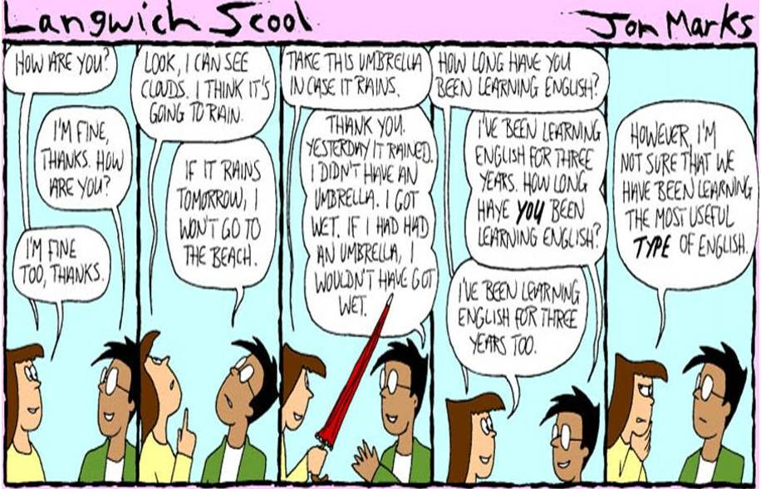


Start
Here!
AP Human Geography
Language Vocab Tutorial
“Language is the roadmap of a culture. It tells you where its people come from and where they are going.”
-Rita Mae Brown
NARRATOR
OBJECTIVE: To teach definitions and multiple examples of cultural vocabulary terms related to language and improve student scores on the unit vocabulary quiz.
FIRST TIME?
SKIP
INTRO
INTRODUCTION

Slide 2
INTRODUCTION
Tutorial Navigation
NARRATOR
BEGIN – Explore any concept from the CONTENTS Slide
  1st - Explore the multimedia examples of the concept by clicking on pictures or video to expand and/or play each
    USE SPACE BAR to proceed to each example on slide
  2nd – Click on “Try Me! – Sample ?” Arrow to answer a test question to check your understanding (Don’t use space bar!)
  3rd – If incorrect, explore an additional example on the next slide
  4th – Take the 5-question vocabulary quiz to see what you’ve learned!
Return to CONTENTS from any concept!
BEGIN! *CONCEPTS

Slide 3
TUTORIAL CONCEPTS
Click on any of the following language concepts to explore its meaning and several important examples!
Return after each to explore or re-visit in any order you would like!
DIALECT
LINGUA FRANCA
OFFICIAL LANGUAGE
PIDGIN-CREOLE
ISOGLOSS
VOCAB QUIZ
TITLE
INSTRUCTIONS
SOURCES

Slide 4
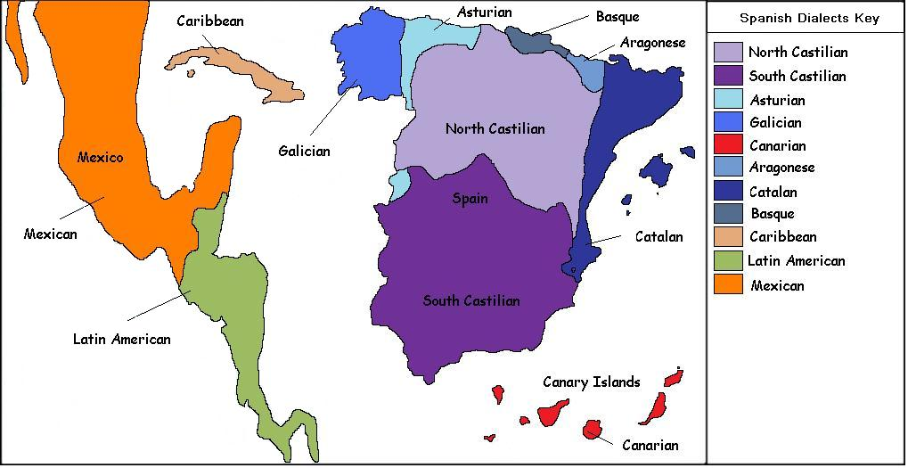

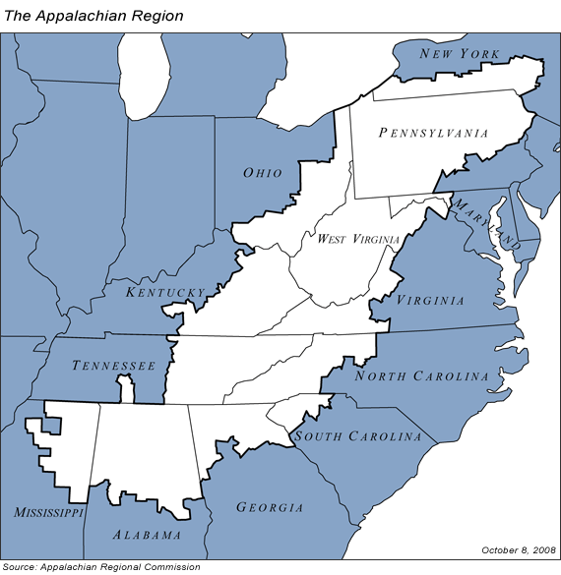
REGIONAL
VOCABULARY
ENGLISH
Which type of Spanish do you know?
British
American
chips
patience
solitaire
lorry
truck
DIALECT
PRONUNCIATION
GRAMMAR
Regional Dialect Meme
Appalachian Dialect
Say these words:
Aunt, Route, Wash, Oil, Theater, Iron, Salmon, Caramel, Fire, Water, Sure, Data, Ruin,
Crayon, Toilet, New Orleans, Pecan, Both, Again, Probably, Spitting image, Alabama,
Lawyer, Coupon, Mayonnaise, Syrup, Pajamas, Caught
Now answer these questions:
What is it called when you throw toilet paper on a house? Meme Video
What is the bug that when you touch it, it curls into a ball?
What is the bubbly carbonated drink called?
What do you call gym shoes?
What do you say to address a group of people?
What do you call the kind of spider that has an oval-shaped body and extremely long legs?
What do you call your grandparents?
What do you call the wheeled contraption in which you carry groceries at the supermarket?
What do you call it when rain falls while the sun is shining?
What is the thing you change the TV channel with?
“I done it already.”
“He don’t know no better.”
“They was there.”
Try Me! - Sample ?

Slide 5
TRUE or false?
If you encounter a speaker of a different dialect of your language, you will generally be unable to communicate with them if you have never encountered the dialect previously.
TRUE
FALSE

Slide 6
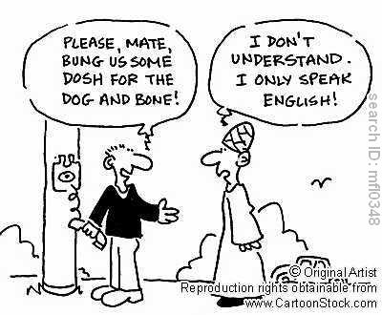
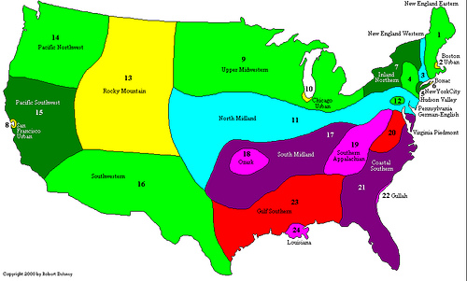
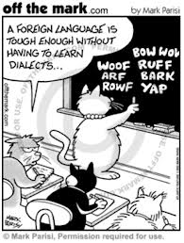
DIALECT REVISITED
NARRATOR
Which type of English
do you speak?
Will they get this figured out?
Just for fun!
Do you feel confident you can travel the entire United States and communicate everywhere?
Back to CONCEPTS

Slide 7
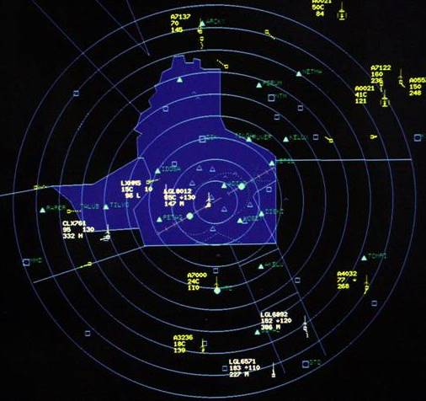
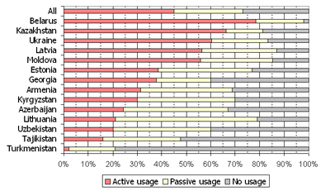
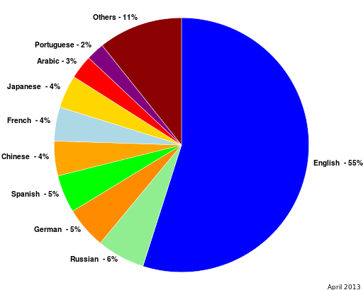
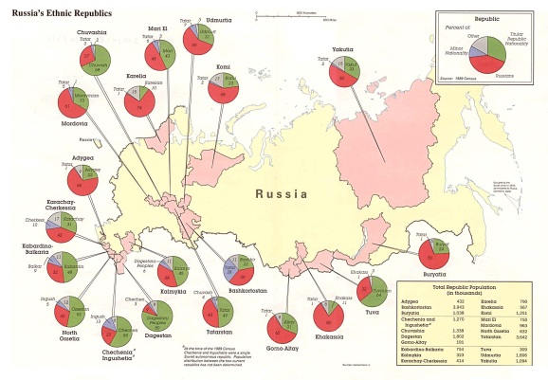
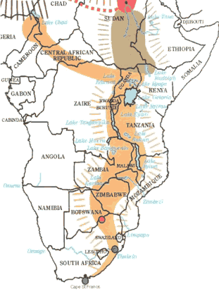

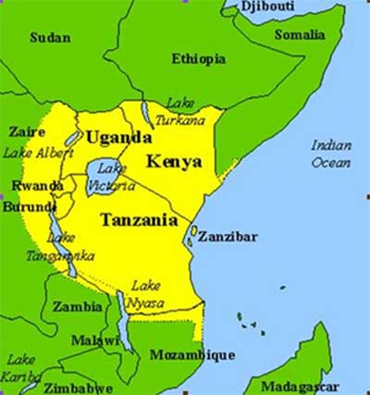
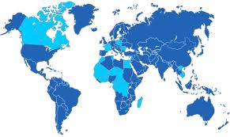

How can a French pilot land a plane in Moscow, Russia?
RUSSIAN
International
Online
Communication
How would businessmen in Kazakhstan and Kyrgyzstan negotiate contracts?
ENGLISH
LINGUA FRANCA
S
W
A
H
I
L
I
+
=
FRENCH
International
Language of
Diplomacy
Bantu
migration
Arabic &
Islam
Swahili!
Official language
33 countries!
90% of Tanzanians speak Swahili
In addition to their first language!
Try Me! - Sample ?

Slide 8
TRUE or false?
Traveling is easier for Americans and Britons since English is one of the most common lingua francas in the 21st century due to the globalization of communication via the Internet.
TRUE
FALSE

Slide 9
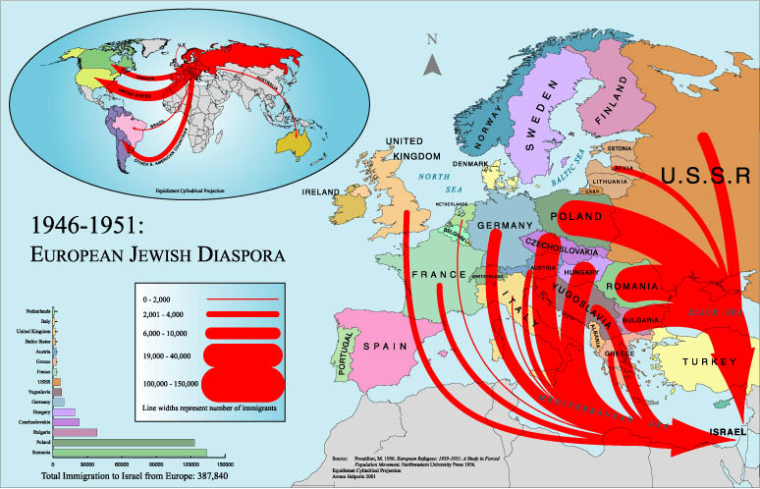
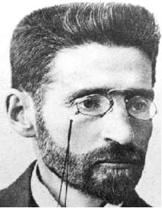
LINGUA FRANCA REVISITED
HEBREW
PROBLEM
SOLUTION
Update Hebrew after centuries of religious-only use by Jews everywhere!
Arrived from Lithuania – 1881
Main force behind
revival of MODERN
Hebrew!
BEN YEHUDA
Back to CONCEPTS

Slide 10
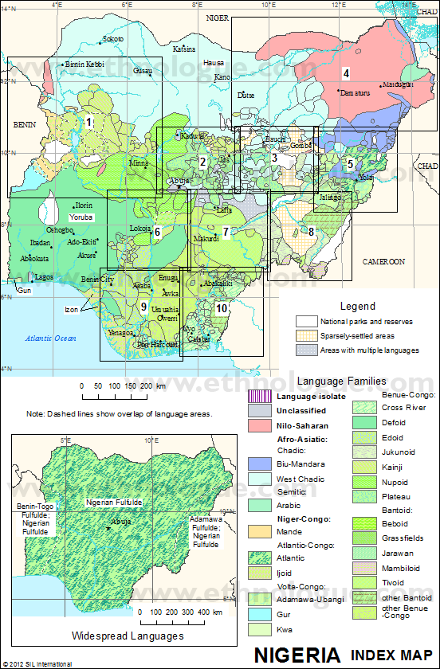

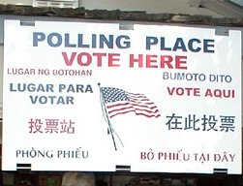
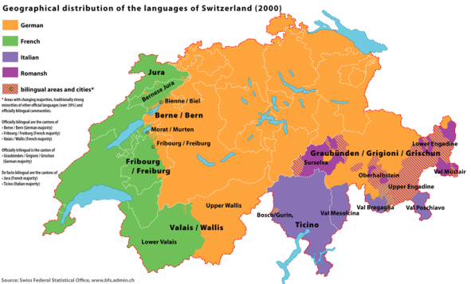
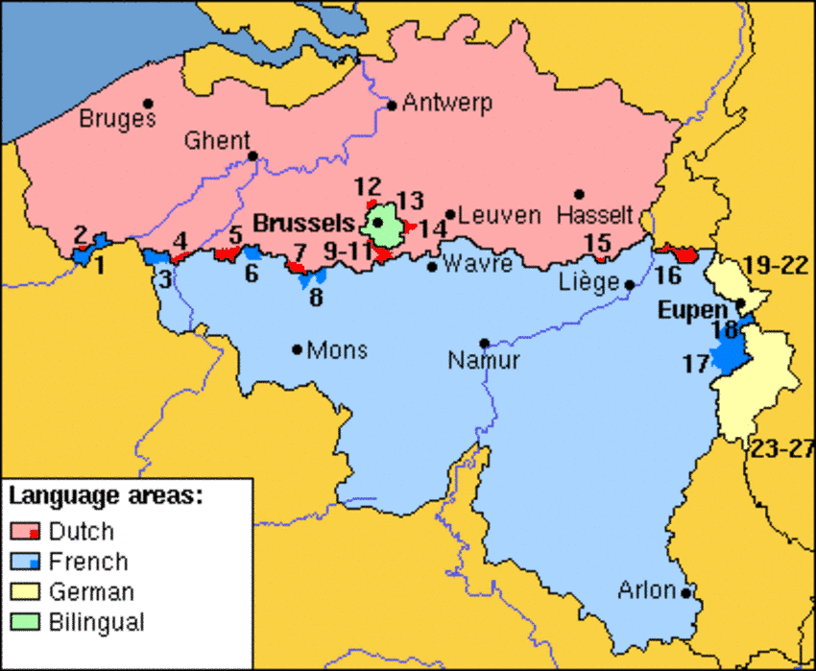
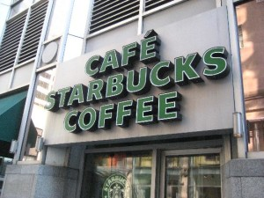

UNITED STATES
NIGERIA
PROBLEM
Linguistic OVER diversity!
529 languages! (Ethnologue)
VS
SOLUTION
ENGLISH! (former colony)
Only small % of urban
Nigerians can speak though!
OFFICIAL LANGUAGE
EUROPEAN
DIVERSITY
QUEBEC
American Companies Adjust to Sign Laws!
Switzerland
4 Official Languages
Belgium
Separated by 2!
Try Me! - Sample ?

Slide 11
TRUE or false?
The official language of a country is the language spoken by the largest percentage of the population and used most frequently in the media.
TRUE
FALSE

Slide 12


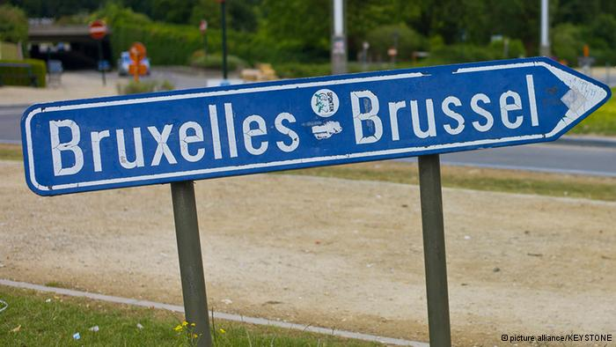



OFFICAL LANGUAGE REVISITED
BELGIUM
U.S.A
RECORD 535 Days
With NO Government!
READ MORE!
Back to CONCEPTS

Slide 13


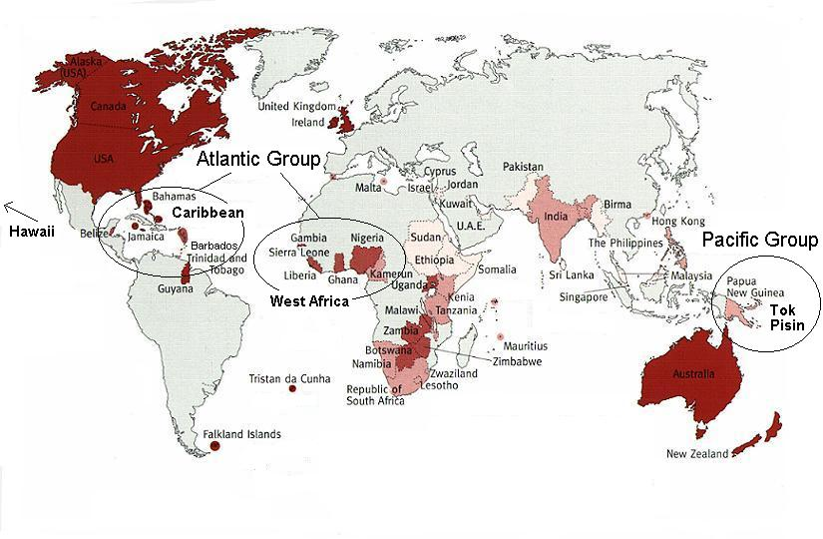
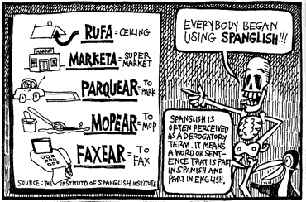

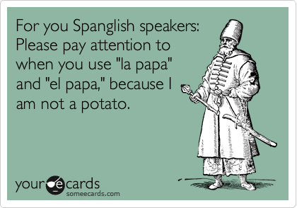
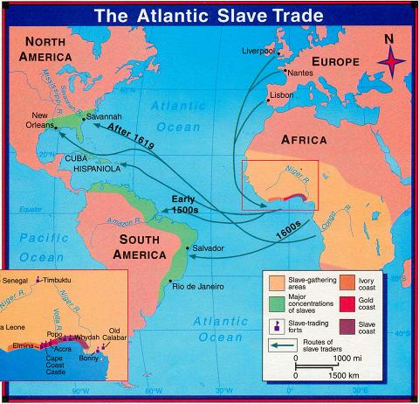
SPANGLISH
WAPE
West African Pidgin English
Hear about it!
Many forms
Local languages + English
“Me? Put poison for master? Nevertheless!” said the cook, side-stepping to avoid a heavy blow from the Minister. . . . Why I go kill my master? . . . Abi my head no correct? And even if to say I de craze why I no go go jump for inside lagoon instead to kill my master?" (a servant, in [Chinua] Achebe's A Man of the People, p. 39)d
PIDGIN
To
CREOLE
HAITIAN
ENGLISH | HAITIAN CREOLE | FRENCH
Marie’s chair | Chez Marie | La chaise de Marie
Jean’s father’s friend | Zanmi papa Jean | Lami du pere de Jean
Official language alongside French since 1961
Taught in all schools
Newspapers, radio, and television broadcasts
World Pidgin Map
French + West African
Try Me! - Sample ?

Slide 14
TRUE or false?
Pidgin languages are frequently official languages and have widespread use among the country’s population and media outlets.
TRUE
FALSE

Slide 15

PIDGIN to CREOLE REVISITED
Hawaiian Pidgin English
Official Languages of Hawaii: English & Hawaiian
EXAMPLE PHRASES:
Aloha Fridays – casual Fridays
hanabata days – “back when I was a kid”
da kine – phrase used when trying to explain something you can’t think of in words
Back to CONCEPTS

Slide 16
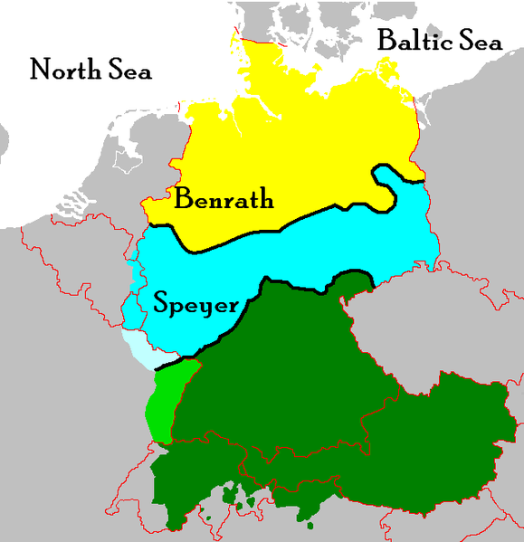
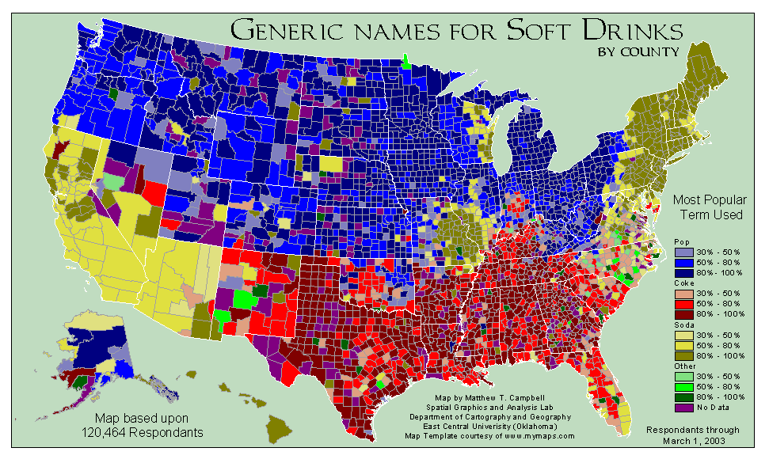
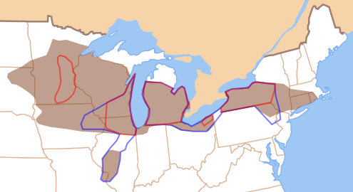
German Dialects
Pop, Soda, or ???
ISOGLOSS
North-Midland
Try Me! - Sample ?

Slide 17
TRUE or false?
Geographers frequently create an isogloss when trying to visually display the spatial arrangement of a linguistic phenomenon like dialect.
TRUE
FALSE

Slide 18
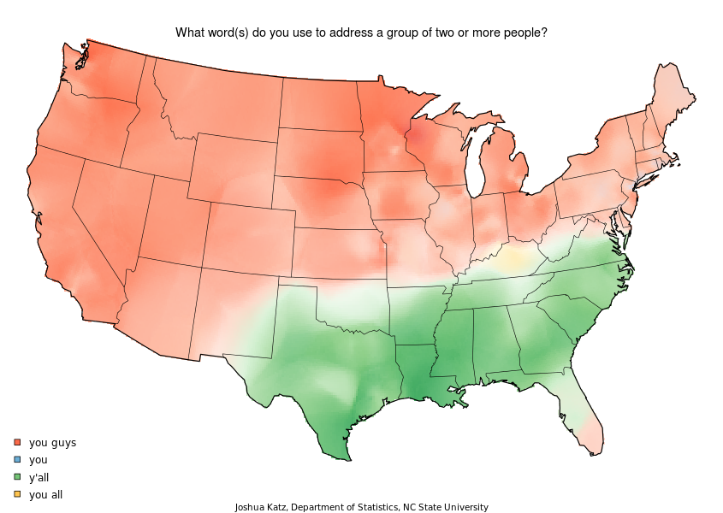
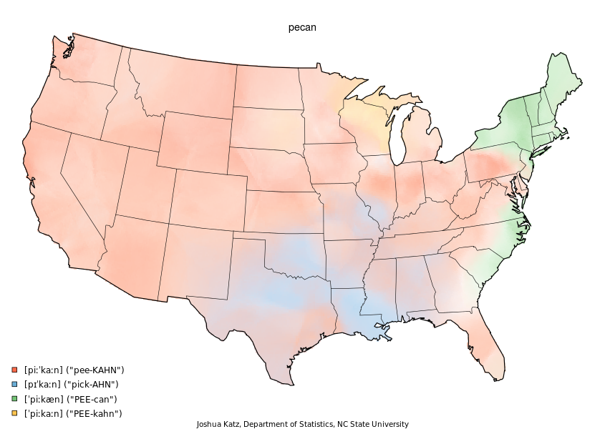
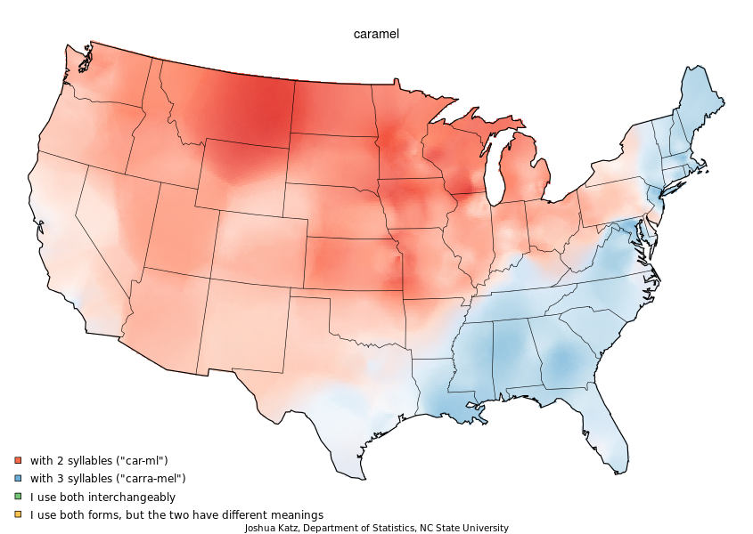
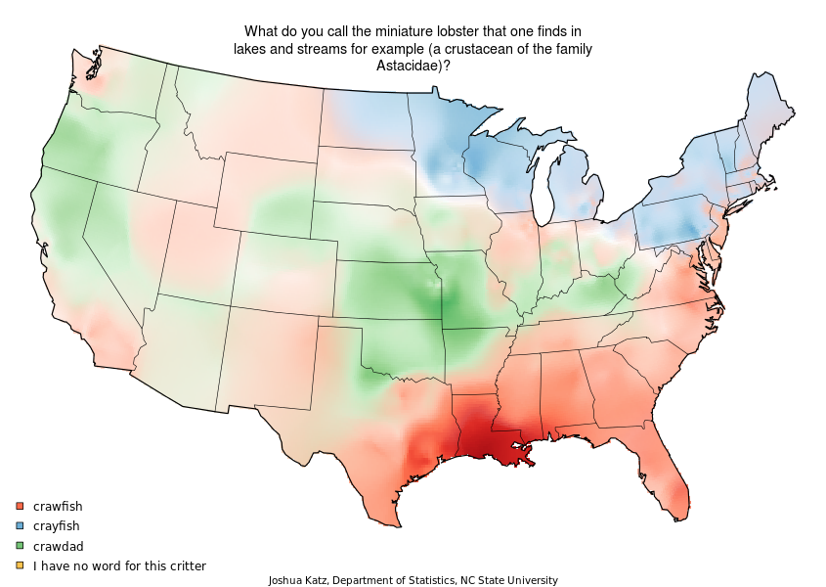
ISOGLOSS REVISITED
Maps Reveal Spatial Differences!
What
do
you
say?
Back to CONCEPTS

Slide 19

Question One
_______________ are also known as trade languages since they are often used in the business community as “second” languages among people whose first languages are different.
A. Pidgin languages
B. Official languages
C. Creole languages
D. Lingua francas
E. Dialects
NEXT QUESTION!

Slide 20
Question TWO
Informally, _______________ develop over time to orally bridge the communication gap that exists between people who frequently interact but speak different languages.
A. dialects
B. Creole languages
C. lingua francas
D. isoglosses
E. pidgin languages
NEXT QUESTION!

Slide 21
Question THREE
_______________ reveal interesting spatial differences within or between languages in terms of vocabulary or pronunciation.
A. Dialects
B. Isoglosses
C. Lingua francas
D. Pidgin languages
E. Creole languages
NEXT QUESTION!

Slide 22
Question FOUR
In multicultural countries, movements to create a/an
_______________ can cause conflicts stemming from groups who feel excluded from important functions and opportunities.
A. official language
B. pidgin language
C. Creole language
D. dialect
E. isogloss
NEXT QUESTION!

Slide 23
Question FIVE
American students who don’t understand differences in _______________ may get themselves into some rather interesting, and potentially problematic, situations when visiting the United Kingdom.
A. lingua francas
B. pidgin languages
C. Creole languages
D. dialects
E. official languages
Back to CONCEPTS

