Slide 1
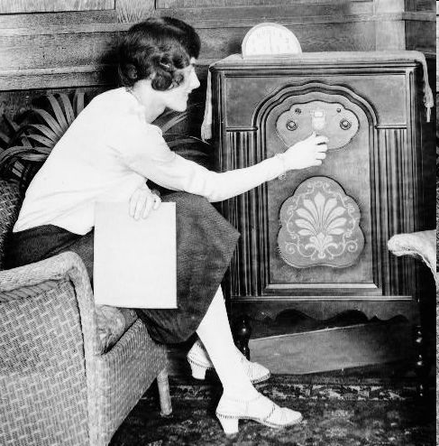
Radio
1920s radios became widespread
news & entertainment broadcasts began
increased the speed with which people gained information
increased national unity

Slide 2
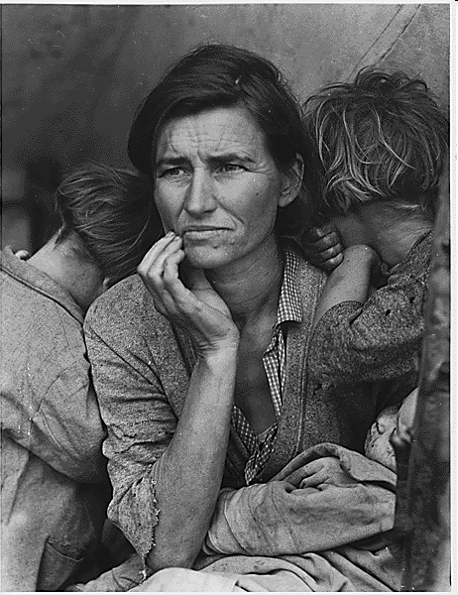
The Great Depression
1929 - 1941
Chapter 21

Slide 3
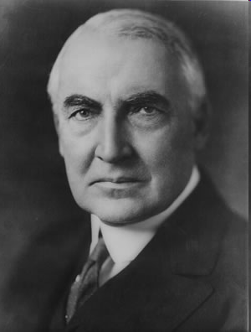
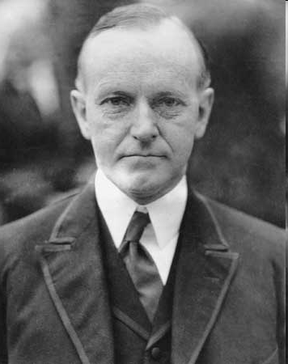
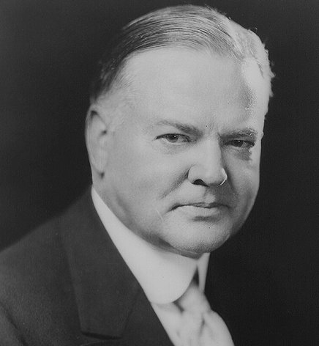
Republican Presidents of the 1920s
  1920 – Warren G. Harding
1924 – Calvin Coolidge
  1928 – Herbert Hoover
Review:
Under Harding & Coolidge country
grew prosperous
bull market – rising stock prices
Republicans took credit for the prosperity

Slide 4
Causes of the Depression
Under Consumption
Stock Market Speculation
Overproduction
The Great Depression

Slide 5
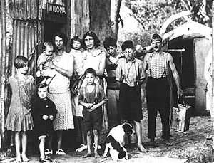
Causes of the Depression
Overproduction
Agricultural depression began in 1920s
Farmers produced more food than consumers needed
New technologies increased productivity
Prices fell after WWI & many farmers had to declare bankruptcy

Slide 6
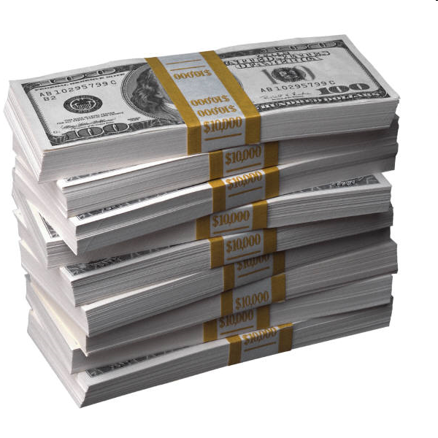
Causes of the Depression
Under Consumption
  farmers, minorities & industrial workers did not share in 20s prosperity
  caused under consumption of goods – rich did not buy enough to keep the economy going

Slide 7
Causes of the Depression
Stock Market Speculation
buying stock “on margin” (loan system) inflated the market
  speculation – making high-risk investments in the hopes of obtaining large profits; stock prices driven by speculation instead of corporate performance & profits
  stock market not regulated by gov’t & many companies lied about profits
  stock prices rose too high & a correction was inevitable: Stock Market Crash of 1929

Slide 8
Stock Market Crash
Black Tuesday Oct 29, 1929 —16.4 million shares sold, compared to average of 4 million
collapse of the stock market known as the Great Crash

Slide 9
Results of the Stock Market Crash
Stock Market Crash of 1929
Bank runs – people ran to the bank in huge numbers and withdrew all their money at once; many banks had to close
Businesses closed because consumers didn’t have the money to purchase their products
Workers lost jobs & unemployment increased dramatically

Slide 10
Impact on Americans
Unemployment soared – 25-30% of work force
Bank failures – ¼ of nation’s banks
Business failures – 85,000
Homelessness, hunger widespread
  fed in breadlines, received assistance from charities
  evicted from homes & formed Hoovervilles – makeshift shantytowns of tents & shacks built on public land or vacant lots
Farm foreclosures

Slide 11
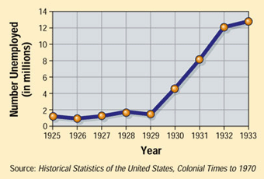
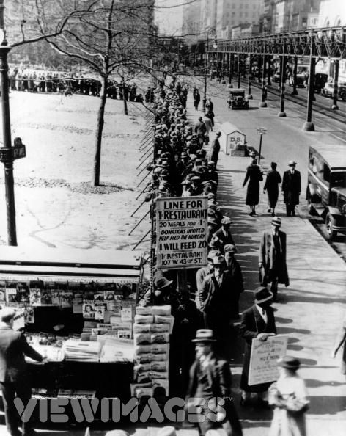
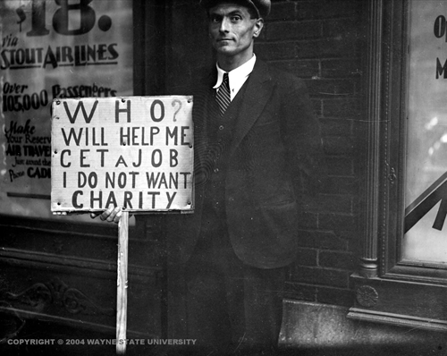
Searching for a Job and a Meal

Slide 12
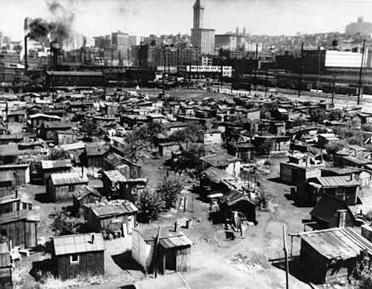
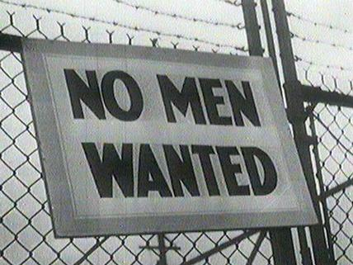
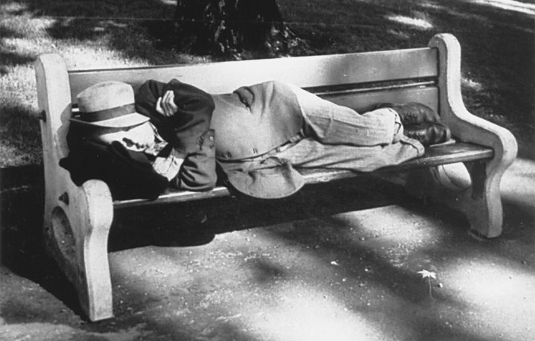
Looking for a Place to Live
Hoovervilles

Slide 13
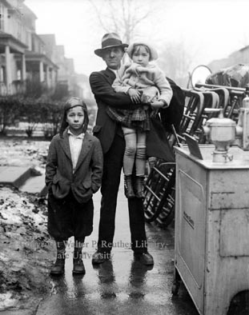
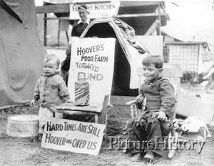
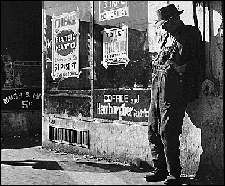
The Depression Attacks Family Life
Evicted family with belongings on street, December 14, 1929.

Slide 14
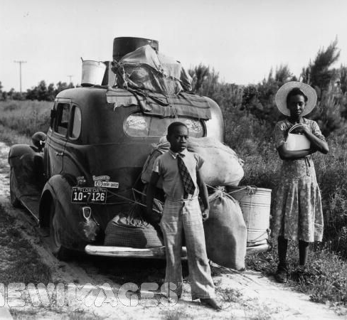
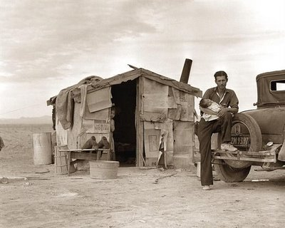
Minorities Suffer Hardships
This picture shows a Mexican migrant farm worker in 1937.
African American family leaving Florida during the Great Depression.

Slide 15
Wednesday April 13, 2016
What did the Roosevelt Corollary extend? AND What part of the world would the United States police?
A. Constitution / Europe
B. Monroe Doctrine / North America
C. Monroe Doctrine / the Western Hemisphere
D. Versailles Treaty / 14 Points
What part of Woodrow Wilson’s “Fourteen Points” was the most controversial and was rejected by the United States Senate?
A. the creation of nine new states in Europe
B. Germany’s acknowledgement of the “War Guilt Clause”
C. a League of Nations to promote peace between nations
D. the re-drawing of national boundaries in Europe

Slide 16
Hoover’s Response to the Depression
Ways of dealing with the depression:
Hands off (unpopular) – believed strong businesses could survive depression w/ government help
Volunteerism (unsuccessful) - asked business & industry leaders to keep employment, wages, prices at current levels
Localism (unsuccessful) - asked state & local gov’ts to provide more jobs & relief measures

Slide 17
The Dust Bowl
Dust Bowl – central & southern Great Plains during 1930s when region suffered dust storms
Causes:
  Severe drought
  Over farming - farmers plowed the plains & eliminated protective layer of grass
  High winds - layers of top soil blown away, leaving dunes of grit & sand

Slide 18
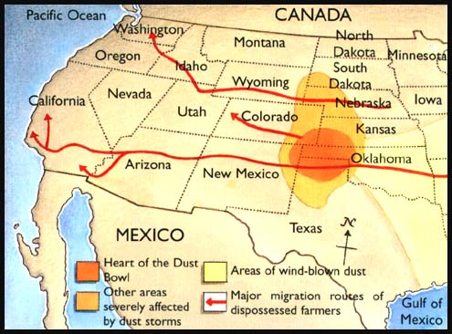
The Dust Bowl
Areas Affected:
  Great Plains
Results:
  Dust storms caused people to leave
  Dust Bowl refugees known as “Okies”
  Results of the migration: rural states lost population, large cities gained more people

Slide 19
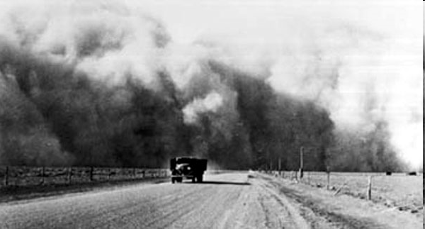
The Dust Bowl
Storms killed cattle birds, blanketed rivers, and suffocated fish.
Some dust clouds blew east as far as the Atlantic Ocean.
Dust storms displaced twice as much dirt as Americans had scooped out to build the Panama Canal.

Slide 20
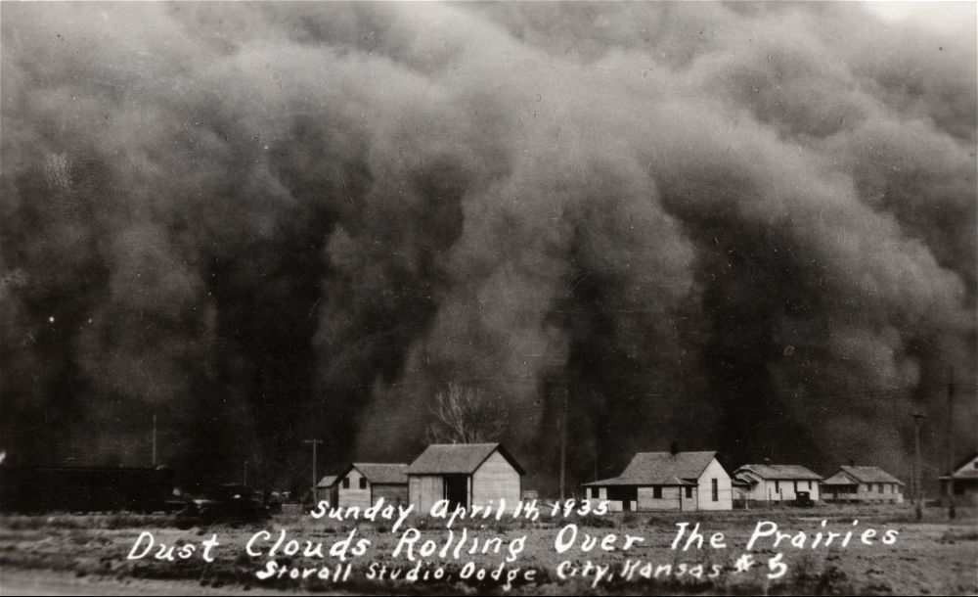
A Dust Storm in Kansas

Slide 21
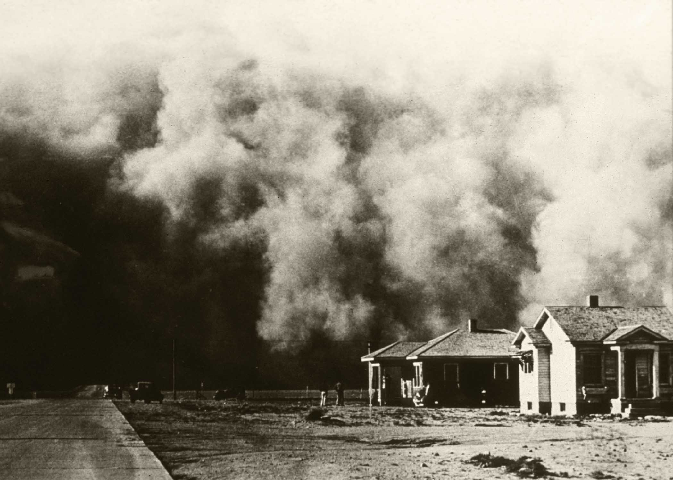
The Dust Bowl

Slide 22
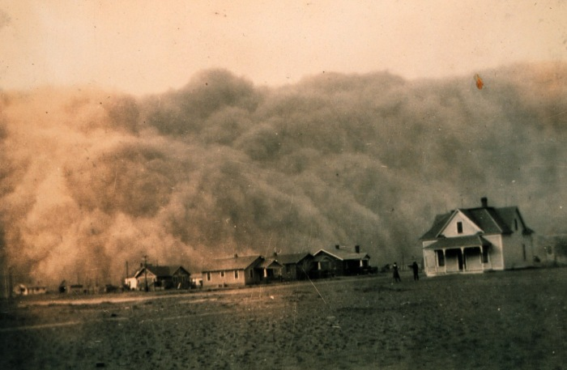
Another Dust Storm

Slide 23
A father & two sons seek shelter from a dust storm

Slide 24
Sand covering a farm after a dust storm

Slide 25
An abandoned farm in Kansas

Slide 26
A collage of newspaper headlines from the Dust Bowl

Slide 27
A man in the midst of a dust storm

Slide 28
A family in a “lean-to” tent

Slide 29
Another mother and her child living in a lean-to tent

Slide 30
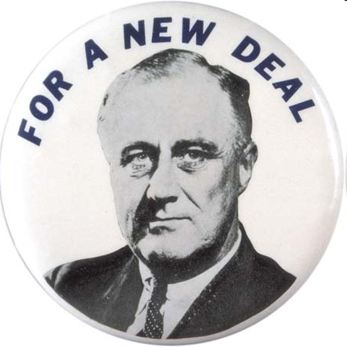
The New Deal
1932 - 1941
Chapter 22

Slide 31
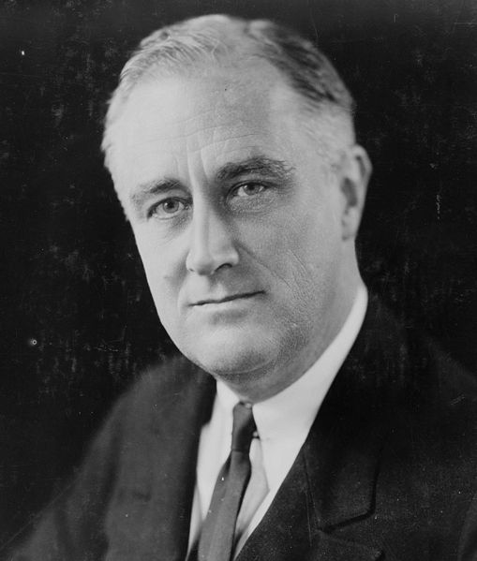
Election of 1932
Franklin D. Roosevelt (D)
called for a “New Deal” - aggressive federal gov’t action to address the depression
Herbert Hoover (R)
“prosperity is just around the corner”
FDR Wins

Slide 32
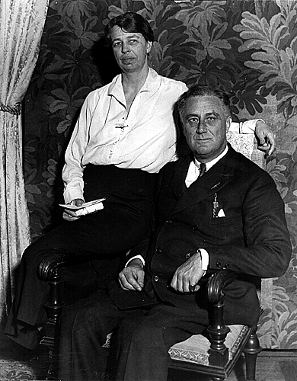
Franklin Delano Roosevelt
born in New York 1882
attended Harvard (studied History!) & Columbia Law School
St. Patrick's Day, 1905, married Eleanor Roosevelt (distant cousin
& Teddy’s niece)

Slide 33
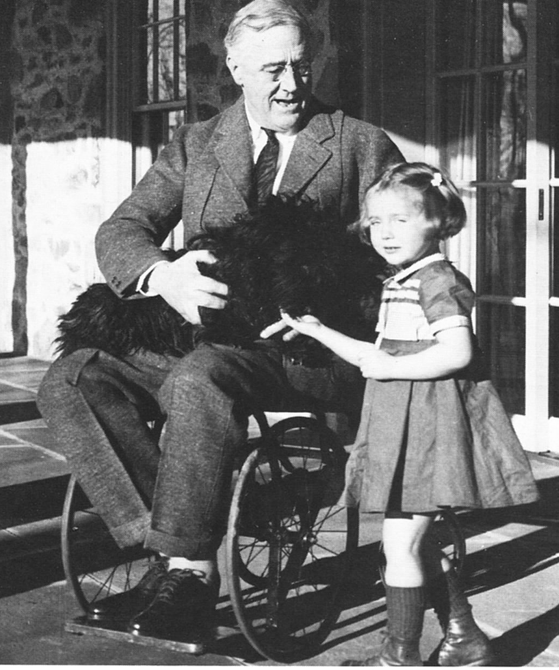
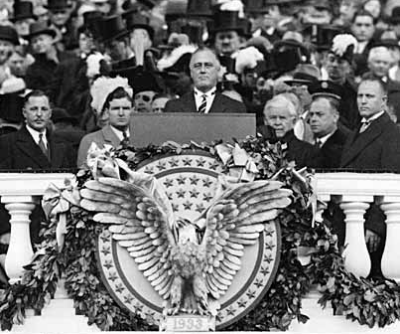
Franklin D. Roosevelt
In 1921 (age 39) was diagnosed with polio - never fully recovered the use of his legs
So how’s he doing that?

Slide 34
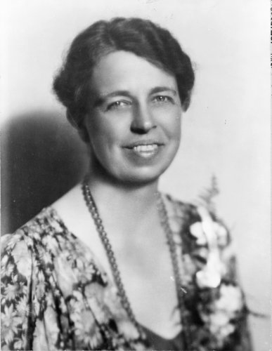
FDR & Eleanor
FDR depended on Eleanor
She traveled & interacted w/ American people serving as FDR’s “eyes & ears”
1933 Bonus Army incident; FDR sends Eleanor instead of army

Slide 35
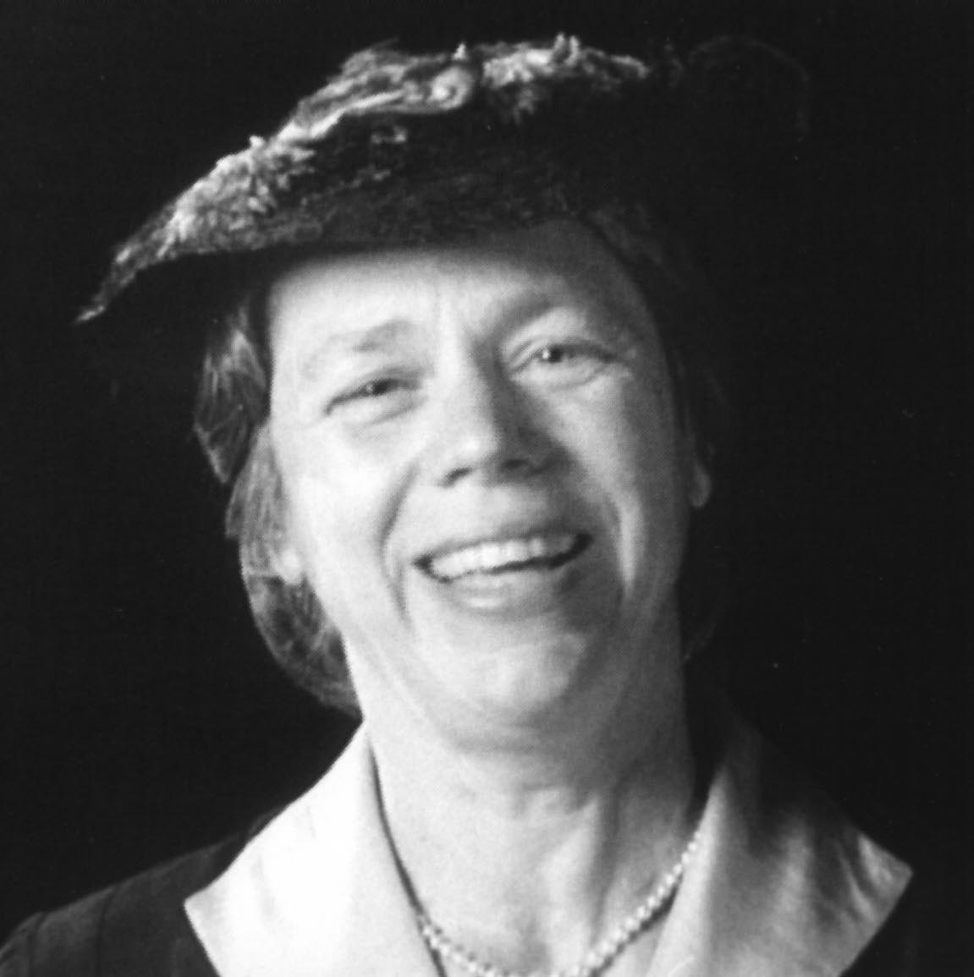

Eleanor
offered advice on policy issues
advocated public health & education, promoted arts, addressed flood control
gave money she earned to charity
Eleanor changed the office of First Lady from a ceremonial role to a position of action & involvement.

Slide 36
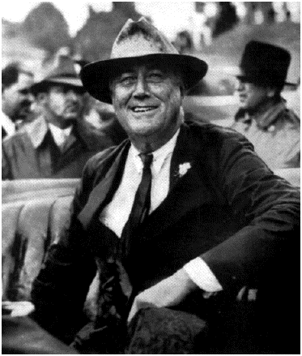
FDR’s thoughts about ending the Depression…
“The country needs and, unless I mistake its temper, the country demands bold, persistent experimentation. It is common sense to take a method and to try it. If it fails, admit it frankly and try another. But above all, try something!”
- FDR 5/22/1932

Slide 37
What was the New Deal?
FDR’s programs & legislation that promoted economic recovery and social reform
3 Goals of the New Deal
  Relief (for the unemployed)
  Recovery (of business & agriculture)
  Reform (to prevent future depressions)

Slide 38

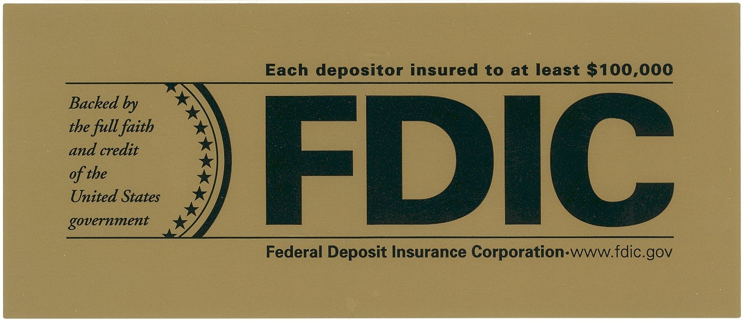
FDIC
(1933)
Name: Federal Deposit Insurance Corporation
Description: insured bank deposits – if bank failed, depositor would get money back; helped end bank runs & restored public’s confidence in banking industry

Slide 39

SEC
(1934)
Name: Securities & Exchange Commission
Description: regulates stock exchanges; given power to tell companies what info must be included in financial statements

Slide 40
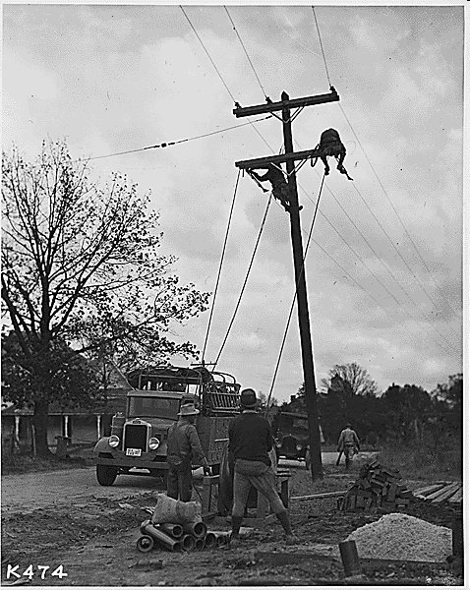
TVA
(1933)
Name: Tennessee Valley Authority
Description:
  built dams on TN River to provide hydroelectric power, flood control, & prevent soil erosion
  created jobs & provided cheap electricity for rural areas
  still functioning today

Slide 41
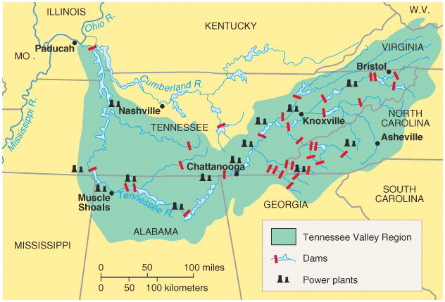
Tennessee Valley Authority

Slide 42

CCC
(1933)
Name: Civilian Conservation Corps
Description:
  provided jobs for more than 2 million young men (18-25)
  replanted forests, built trails, dug irrigation ditches & fought fires
  paid wages (portion was sent home to family)

Slide 43
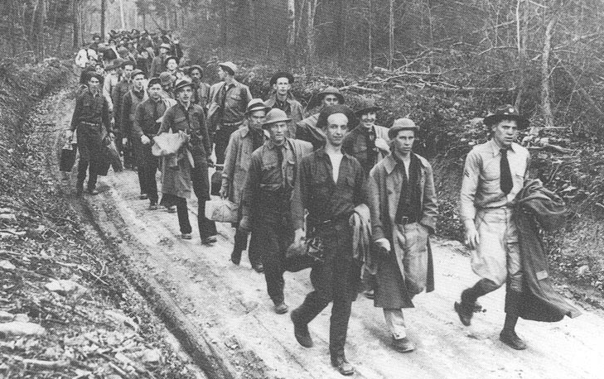
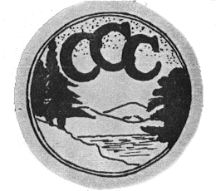
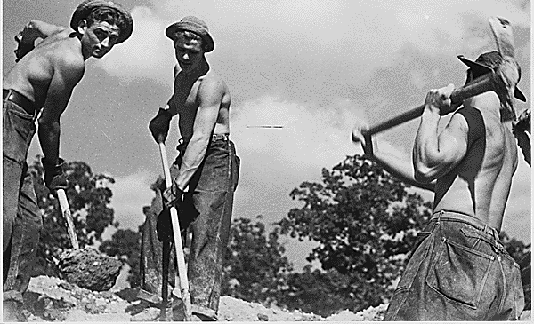

Slide 44
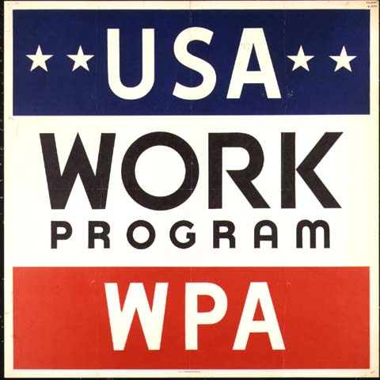
WPA
(1935)
Name: Works Progress
Administration
Description:
  headed by Harry Hopkins
  employed 8.5 mill. people constructing public works such as roads, bridges, schools, courthouses, libraries, hospitals, playgrounds, airfields, etc.
  largest New Deal program
  included Federal Art, Writers’& Theatre Projects

Slide 45
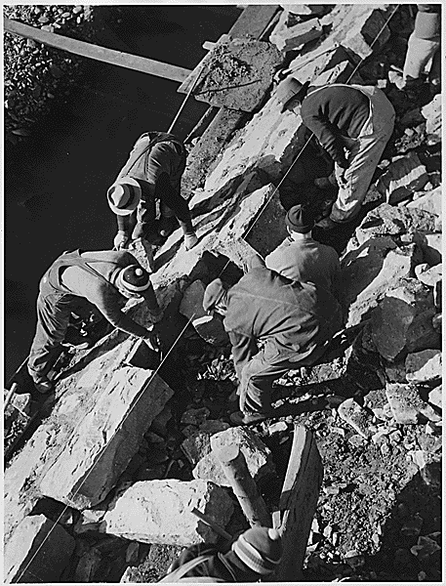
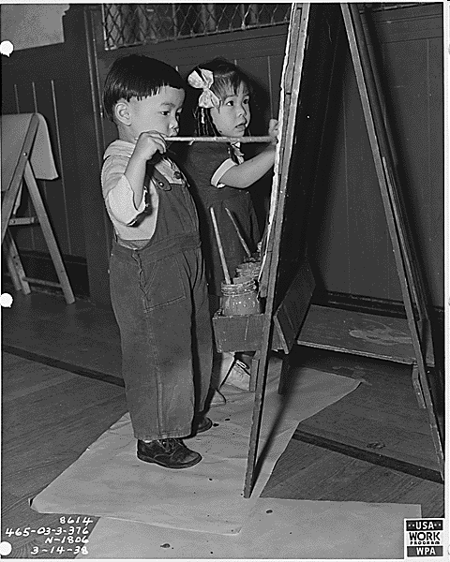
Works Progress Administration
Eleanor Roosevelt's visit to a WPA Chinese Nursery School in San Francisco, California

Slide 46
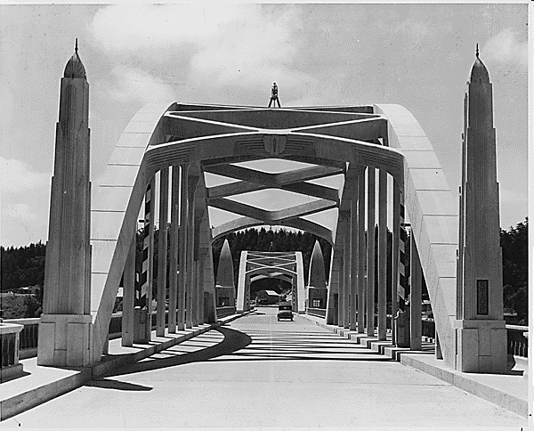
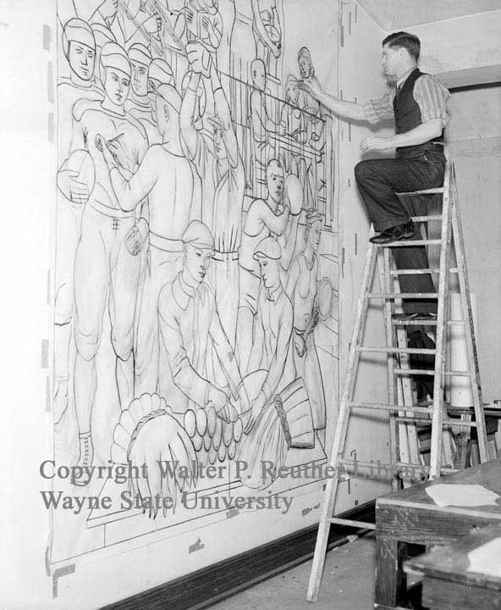
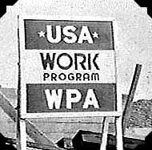

Slide 47
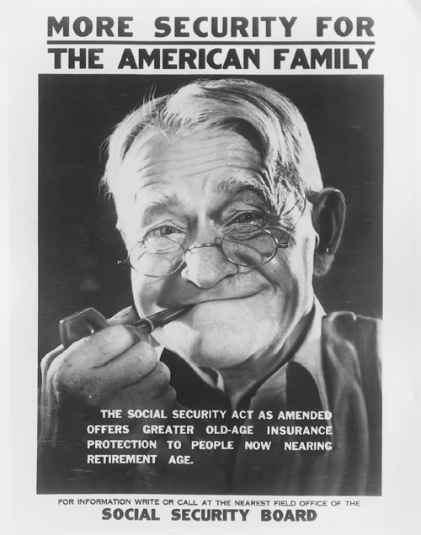
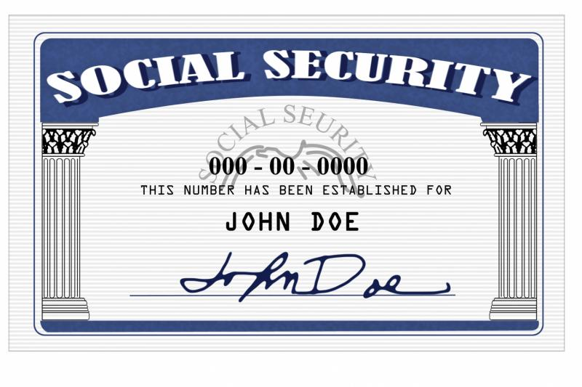
SSA
(1935)
Name: Social Security Act
Description:
  provide security in the form of regular payments to people who could not support themselves
  funded by payroll tax
  3 types of payments:
        old-age pensions
        unemployment insurance
        aid for dependent children & disabled

Slide 48
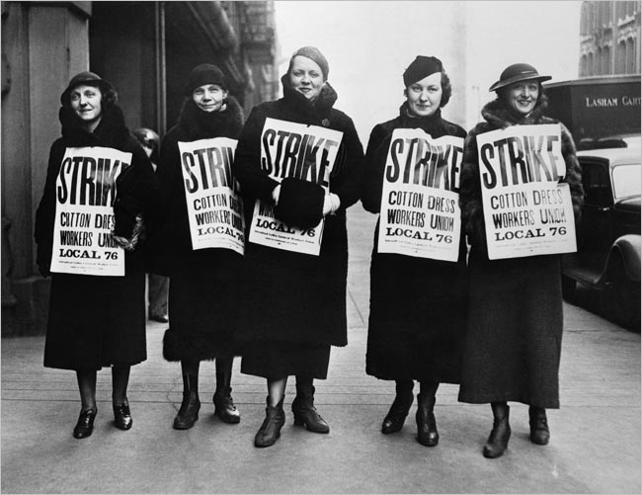
Wagner Act
(1935)
guaranteed unions collective bargaining rights
outlawed discrimination against workers due to union membership/activities
set up NLRB to enforce law’s provisions

Slide 49
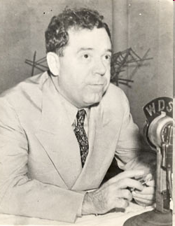
Challenges to Roosevelt’s “New Deal”
LA Senator Huey P. Long criticized New Deal - wanted more help for poor
proposed “Share Our Wealth” program - high taxes on wealthy & large corporations; redistribute their income to poor
made enemies because he ruled state of LA like he owned it – 1935 political enemy assassinated him

Slide 50
FDR’s “Court Packing Bill”
Supreme Court challenges the New Deal:
FDR upset by Supreme Court striking down New Deal programs (AAA)
Roosevelt proposes “packing the court”:
asked Congress to increase size of Supreme Court (6 more members) – why?
stated reason: many justices elderly & overworked; relieve the burden on them
unstated reason: app’t more liberal justices who would support the New Deal & sway court in FDR’s favor

Slide 51
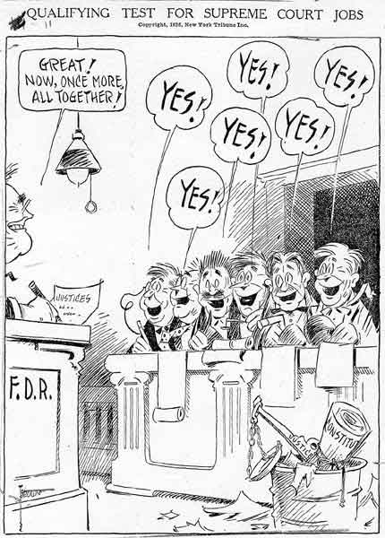
Why might people criticize FDR’s plan?

Slide 52
Reaction to FDR’s Plan
Critics react to Roosevelt’s plan:
negative public reaction; bill did not pass
Accused FDR of trying to increase Pres power & upset balance (separation) of powers
FDR is weakened politically:
FDR lost political support; public less willing to accept new programs
In long run, Court became more accepting of New Deal

