Slide 2
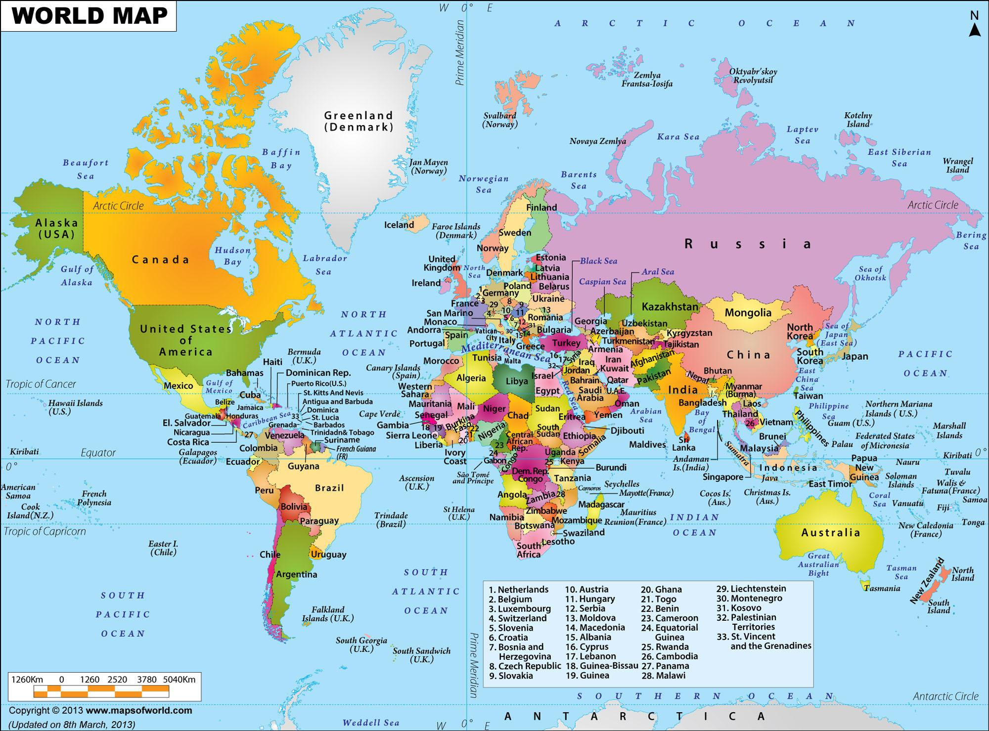
PART B: TERRITORIALITY AND POWER
UNIT 4: THE POLITICAL ORGANIZATION OF SPACE
Notes:
Sources
2017 AMSCO/Palmer chapter 10 Territory, Power and Boundaries
2015 Articulation

Slide 3
Notes:
2013world map retrieved July 2017

Slide 4
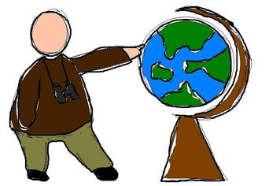
ENDURING UNDERSTANDING :(4.B)
By the end of this section, you will understand that Spatial patterns reflect ideas of territoriality and power at a variety of scales.
Notes:
Enduring understanding and learning objectives taken directly from 2015 APHUG Course Articulation pages 31-33

Slide 5
LEARNING OBJECTIVES – ESSENTIAL KNOWLEDGE (4.B)
By the end of this section, you will be able to discuss the concepts of political power and territoriality by discussing
Control of resources: Heartland, Rimland, and Organic theories.
Territoriality is how people connect to the land culturally and economically.
How boundaries are defined, delimited, demarcated and administered.

Slide 6
LEARNING OBJECTIVES – ESSENTIAL KNOWLEDGE (4.B)
By the end of this section, you will be able to discuss the concepts of political power and territoriality by discussing
International boundaries and exchanges
The Law of the Sea
Voting districts, redistricting and gerrymandering
Political boundaries can complicate issues of language, etc.
Unitary states and federal states and which countries are which
State morphology: compact, elongated, perforated, fragmented, prorupted
Subnational forms of governance and control

Slide 7
ESSENTIAL QUESTION
How do boundaries reflect ideas of territoriality and political power on various scales?

Slide 8
REMEMBER – SPACE IS ORGANIZED POLITICALLY ON MANY SCALES!
Notes:
Remind them of the importance of scale

Slide 9
WHY ARE SOME STATES POWERFUL WHILE OTHERS ARE WEAK? PICK A THEORY AND DEFEND YOUR CHOICE.
C. States gain power by ruling the seas
and strategic ports.
A. Some states are
Born great
B. The secret to great power is in
the land and the geography of the land
Notes:
OPTIONAL SLIDE:
1. Ask students to THEORIZE about why some states are great and some are not.
2. ASK Students to choose the theory that most appeals to them and DEFEND it by
giving historical and geographic details.
3. Quick presentations of theories/debate.

Slide 10
THEORIES ABOUT THE DISTRIBUTION OF POWER
A… Some states are born great ORGANIC THEORY
C. …the seas and ports Rimland theory
B.…
the geography of the land: HEARTLAND THEORY
Notes:
OPTIONAL SLIDE:
1. Ask students to THEORIZE about why some states are great and some are not.
2. ASK Students to choose the theory that most appeals to them and DEFEND it by
giving historical and geographic details.
3. Quick presentations of theories/debate.

Slide 11
https://www.youtube.com/watch?v=rF1BvsTMxqU&fbclid=IwAR0XCp2K_W7HeeSSHH-XPykFd6MSm4k0JWyTcVkTGfyWMJL63NYluwxulS8

Slide 12
Theory of Power | Theorist | Concept | Support for theory
Organic Theory | Friedrich Ratzel | States are like living organisms; influenced by Darwin States thrive by annexing living space or LEBENSRAUM | * US Westward expansion * Nazi Land grab from Czechoslovakia and Poland leading to WWII.
Heartland Theory | Sir Halford Mackinder | Transportation, land far from water is protected, coal and resources in heartland; Influenced COLD WAR and both World Wars | * Control Eastern Europe * Heartland: Eastern Europe plus Russia and Central Asia *World Island: Eurasia plus Africa
Rimland Theory | Nicolas Spykman | SEA POWER! NATO reflects this thinking | “Who rules the Rimland rules Eurasia” And thus the world.

Slide 13
THE AGRICULTURAL AND RESOURCE HEARTLAND IS SURROUNDED BY RIMLAND.

Slide 14
Robert Kaplan Video clip 3:40
The Geography of China
Which theory is Robert Kaplan
using as he discusses China?
Notes:
Answer: RIMLAND THEORY
Published in 2013, retrieved August 2017
Transcript: : “China has a good geographic scenario and a negative geographic scenario. Its positive geographic scenario is that China is set to expand in search of strategic minerals, metals, and resources like timber and hydropower, into the Russian Far East, into Central Asia especially, and to retain control of Tibet. China is at its maximum point geographically since the high Qing Dynasty over 200 years ago.
But here's China's dilemma. The ethnic Han core of China [90 percent of Chinese] is mainly a function of central China and coastal China. To the north, China finds ethnic Inner Mongolians. To the west, it finds Muslim Turkic Uighurs. To the southwest, it finds Tibet. The Dalai Lama may be a spiritual figure for Western elites, but he's really a geopolitical factor. He's a geopolitical factor because Tibet controls more water than maybe any other place on the earth. It controls…the river systems that provide water for West Bengal in India, for Bangladesh, and for much of China.
If you take away Tibet from China, you're left with a rump [piece of] China…without water. So this ethnic Han core [has to] look to these high plateau and grasslands in Inner Mongolia, Xinjiang province in the west, Tibet in the southwest, where there are ethnic groups who have had difficult historical relations with the Hans.
So the Chinese leadership says, ‘The West wants us to liberalize? Are they crazy? We're not going to give up central control, because if we start allowing more individual freedoms, we'll have ethnic insurgencies up and running [by the groups that control the water].’ This is China's geographically based dilemma.”

Slide 15
TERMINOLOGY - STATE
Territory is always connected to economics.
Let’s take the example of the Spratly Islands.
Notes:
Kaplan pages 155-156 also discusses Shia and Sunni Islam.

Slide 16
SPRATLY ISLANDS
Notes:
Claimed by Brunei, Malaysia, Vietnam, Taiwan, China and the Phillipines

Slide 17
SPRATLY ISLANDS
Notes:
Claimed by Brunei, Malaysia, Vietnam, Taiwan, China and the Phillipines

Slide 18
SPRATLY ISLANDS – WHY THE CONFLICT?
Largely economic
Notes:
ECONOMIC CONFLICT: PETROLEUM, FISHING, SHIPPING
Claimed by Brunei, Malaysia, Vietnam, Taiwan, China and the Philippines
Petroleum reserves unconfirmed but probably according to 2017 AMSCO

Slide 19
SPRATLY ISLANDS – NAME THOSE SIX COUNTRIES!?
Largely economic
Notes:
Claimed by Brunei, Malaysia, Vietnam, Taiwan, China and the Philippines

Slide 20
BOUNDARIES HAVE A VERTICAL PLANE THAT EXTENDS ABOVE AND BELOW A STATE’S BOUNDARY
Boundaries exist to add clarity.
Boundaries signal to people what territory is theirs to administer.
There are many categories of boundaries (we are about to learn them)
How a boundary is defined can cause disputes.
Boundaries influence identity, interaction and exchange
The Law of the Sea is about boundaries
In the US, the census, reapportionment, redistricting and (unfortunately) gerrymandering are used to maintain a fair voting system.

Slide 21
BOUNDARIES – LET’S USE THE U.S. TO ILLUSTRATE THESE POINTS
Boundaries represent changes in the use of space as one crosses from one side to the other.
When moving across a formal, national or local boundary, these rules are referred to as laws.
Some influential boundaries are, nevertheless, informal and unclear.
Phillies vs. Mets fan area
Street gangs

Slide 22
BOUNDARIES – VARIOUS KINDS
A defined boundary – legally documented.
Treaty
Homeowners property line.
A delimited boundary:
a line on a map.
A demarcated boundary:
physical objects placed on a landscape

Slide 23
Delimited boundary Defined boundary Demarcated boundary | Line on a map Treaty Disabled parking sign Traffic cone Mortgage for a home/home survey A sign indicting a Drug Free School Zone Gang graffiti Fence Wall Law establishing a Drug free School zone
Notes:
Delimited boundary – line on a map, A
Defined boundary – legal document, B, E, J
Demarcated boundary – physical objects, C, D, F, G, H, I

Slide 24
Delimited boundary Defined boundary Demarcated boundary Delimited boundary – line on a map, A Defined boundary – legal document, B, E, J Demarcated boundary – physical objects, C, D, F, G, H, I | Line on a map Treaty Disabled parking sign Traffic cone Mortgage for a home/home survey A sign indicting a Drug Free School Zone Gang graffiti Fence Wall Law establishing a Drug free School zone
Notes:
Delimited boundary – line on a map, A
Defined boundary – legal document, B, E, J
Demarcated boundary – physical objects, C, D, F, G, H, I

Slide 25
RECALL - TERMINOLOGY - STATE
To be a State:
Have a defined BOUNDARY!
Contain a permanent ____________________
Be ______________ by other states
Maintain _____________ over its domestic and international affairs

Slide 26
CURRENT EVENTS AND BOUNDARIES AUGUST 2017
China Takes a Hard Line pdf

Slide 27
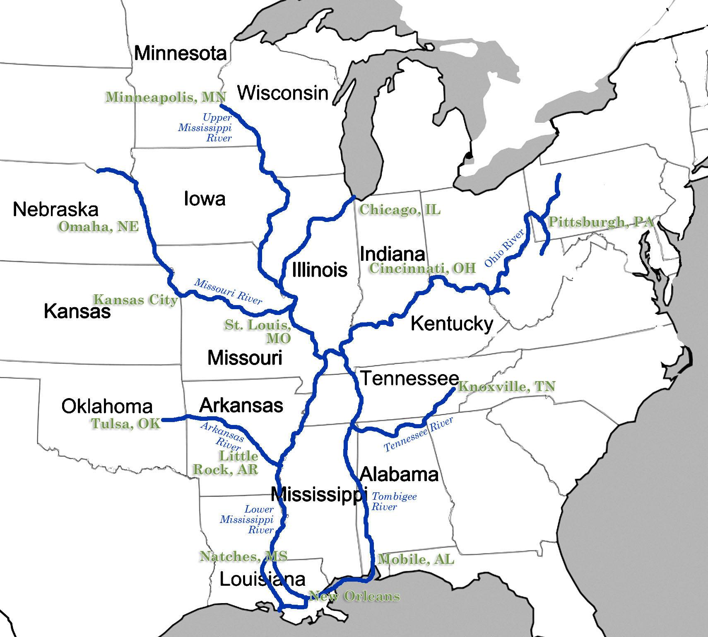
natural
Political boundaries
Notes:
Amsco 2017

Slide 28
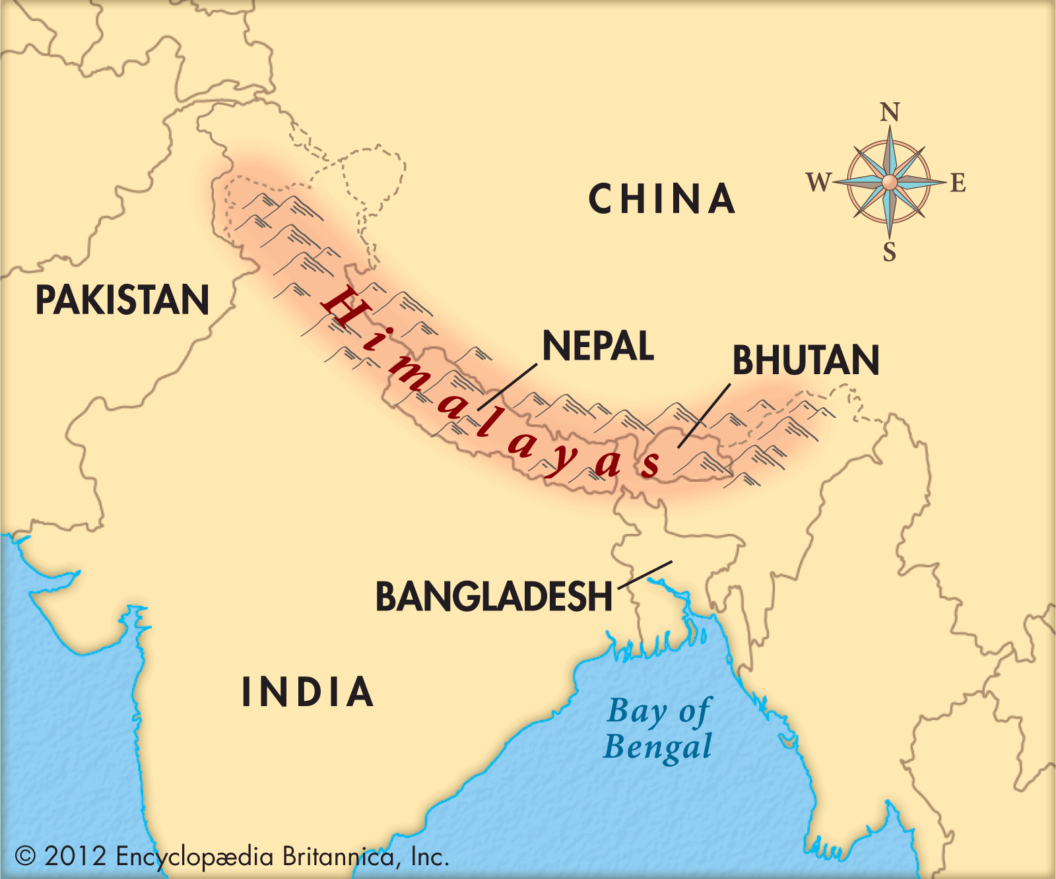
natural
Political boundaries
Notes:
Amsco 2017

Slide 29
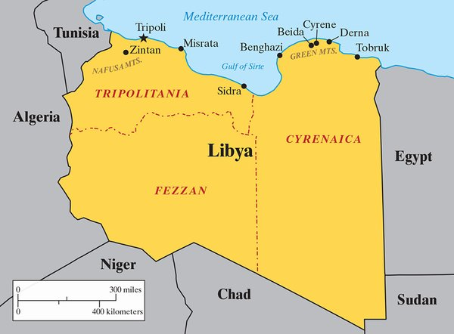
Political boundaries
geometric
Libya and Egypt
Notes:
Amsco 2017

Slide 30
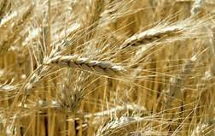
Cultural boundaries
Notes:
Amsco 2017, p. 157
WHEAT is grown and consumed in Northern China; rice in the south
But the change is gradual and there is overlap.
A CULTURAL boundary

Slide 31
LIMITED SOVEREIGNTY AND INTERNATIONAL BOUNDARY DISPUTES
Four types of boundary disputes.
Definitional – cannot agree on map interpretation of boundaries
Locational 🡪 Germany disagreed with the location of the boundary with Poland after WWI. This led to a type of expansionism called IRREDENTISM 🡪
Operational – problems with how a boundary functions.
Allocational – boundary divides natural resources – in 1990, Iraq invaded Kuwait, claiming Kuwait drilled too many wells, obliquely extracting oil from Iraq’s land.
Notes:
CLICK ON BOX FOR DEFINITION OF IRREDENTISM (as below)
IRREDENTISM
the attempt to bring all
the members of a
nation and the
territories they inhabit
into
a single state,
commonly a nationstate.

Slide 32
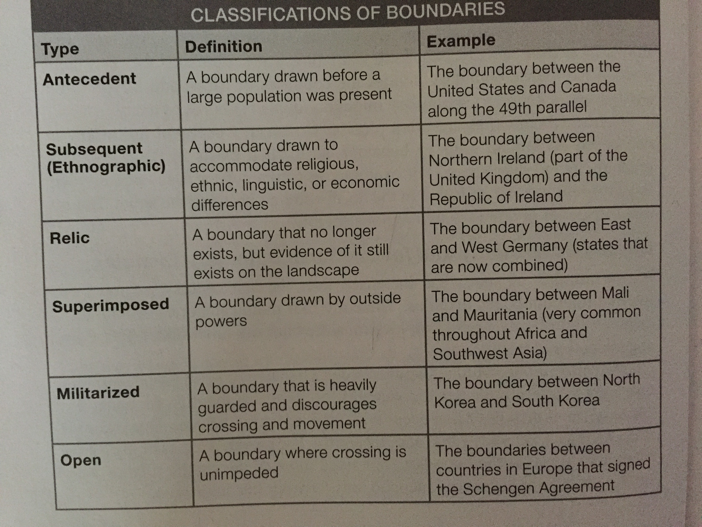

Slide 33
Boundaries Influence Identity, Interaction and Exchange
This can be positive – After WWII, The European Union relaxed the borders
between European states and their neighbors. With a freer flow of people and goods, there was less conflict.
This can be negative – The DMZ in Korea in 1953 – created two countries with little communication.

Slide 34
The Law of the Sea

Slide 35
The Law of the Sea
If the vertical plane determines airspace and subterranean borders on land, how do we deal with borders at sea?

Slide 36
The Law of the Sea
Only in the last half of the twentieth century were
water boundaries addressed systematically!!

Slide 37
The Law of the Sea
The united nations convention of the law of the sea
Signed by over 150 countries between 1973 and 1982

Slide 38
The Law of the Sea
If 2 coastal states are less than 24 nautical miles apart?
Split it.
20 miles apart?
Each takes 10.

Slide 39
The Law of the Sea
If coastal states has islands?
The E.E.Z. extends 200 nautical miles beyond them.
The U.S. has water rights far out into the bering sea (Alaska), for example.

Slide 40
The Law of the Sea
Not everyone behaves.
Libyan dictator muammar gaddafi tried to claim the entire gulf of sidra. He claimed there was a ‘line of death’ that was not to be crossed. in 1981, 86 and 89, he instigated several incidents.

Slide 41
The Law of the Sea
Not everyone behaves.
Libyan dictator muammar gaddafi tried to claim the entire gulf of sidra. He claimed there was a ‘line of death’ that was not to be crossed. in 1981, 86 and 89, he instigated several incidents.

