Slide 1
The Law of the Sea
HOW MARITIME LAW WORKS - THE 4 ZONES (5 minutes)

Slide 2
The UN Convention of the law of the sea established 4 zones
TERRITORIAL SEA | Up to 12 nautical miles of sovereignty | Commercial vessels may pass, but govt vessels may be challenged
CONTIGUOUS ZONE | Coastal states Limited sovereignty for up to 24 nautical miles | Within 24 miles they can enforce laws on customs, immigration and sanitation
EXCLUSIVE ECONOMIC ZONE (EEZ) | Coastal states can explore, extract minerals, an manage up to 200 nautical miles.
HIGH SEAS | Water beyond the EEZ (200 miles) is open to all states.

Slide 3
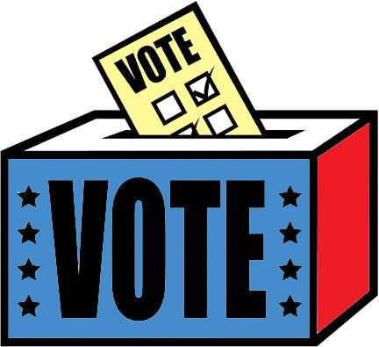
This are international boundaries….
WHAT ABOUT INTERNAL BOUNDARIES?

Slide 5
Who is
Elbridge
Gerry
and why
does he have
such a bad name?

Slide 6
Keywords coming up:
Representative democracy
Electorate
Census
Reapportionment
Redistricting
Gerrymandering

Slide 7
Representative democracy
In representative democracies,
citizens vote for leaders to govern on their behalf.

Slide 8
Electorate
In representative democracies,
these leaders represent citizens. The citizens are known as the electorate. The representatives reflect what the electorate thinks in defined districts with distinct boundaries.

Slide 9
To fairly represent the electorate, districts should have close to the same number of people.
So, HOW COULD WE DETERMINE THE
NUMBER OF PEOPLE LIVING
IN AN AREA?

Slide 10
That’s right,
take a
CENSUS

Slide 11
United states CENSUS
Count the people.
Every 10 years.
The next census is in 2020.
How old were you during the last census?

Slide 12
Reapportionment
Federal government then reapportions the number of Representatives in the U.S. House of Representatives.
SINCE 1912 – the total size of the House has been 435 Representatives. Each state does get at least 1 Representative.

Slide 13
Reapportionment
Federal government 🡪
# of PEOPLE representing
each state.

Slide 14
THEN!!! State Government…
Redistricting
State government Re-draws district boundaries so that each district contains
about the same number of people.

Slide 15
Reapportionment happens first
Federal government 🡪
# of REPRESENTATIVES
Then Redistricting
State government 🡪
BALANCE
THE NUMBER OF PEOPLE (electorate)
IN EACH VOTING DISTRICT
Notes:
Review – these are hard to keep straight and is an important AP test concept
The word Reapportionment comes before redistricting alphabetically.

Slide 16
What could go wrong????
Gerrymandering!

Slide 17
What could go wrong????
Gerrymandering:
State legislatures and local elections.

Slide 18
Review
Representative democracy
Electorate
Census
Reapportionment
Redistricting
Gerrymandering

Slide 19
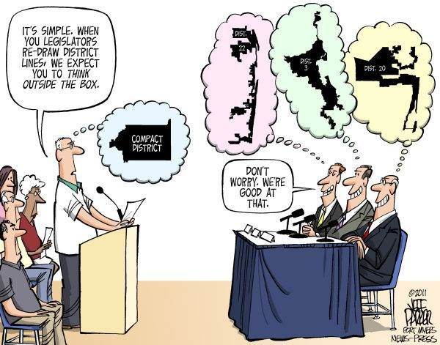

Slide 20
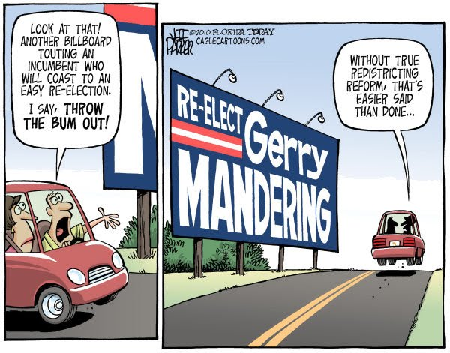

Slide 21
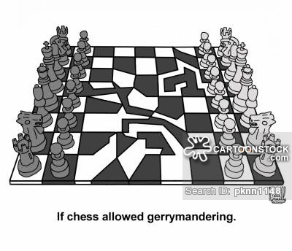

Slide 22
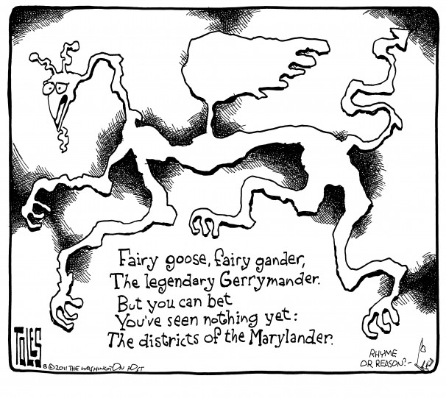

Slide 23
GERRYMANDERING VIDEO 2.5 minutes
Notes:
Washington post article
http://wapo.st/1EXVUv6?tid=ss_mail&utm_term=.03051e4cd181

Slide 24
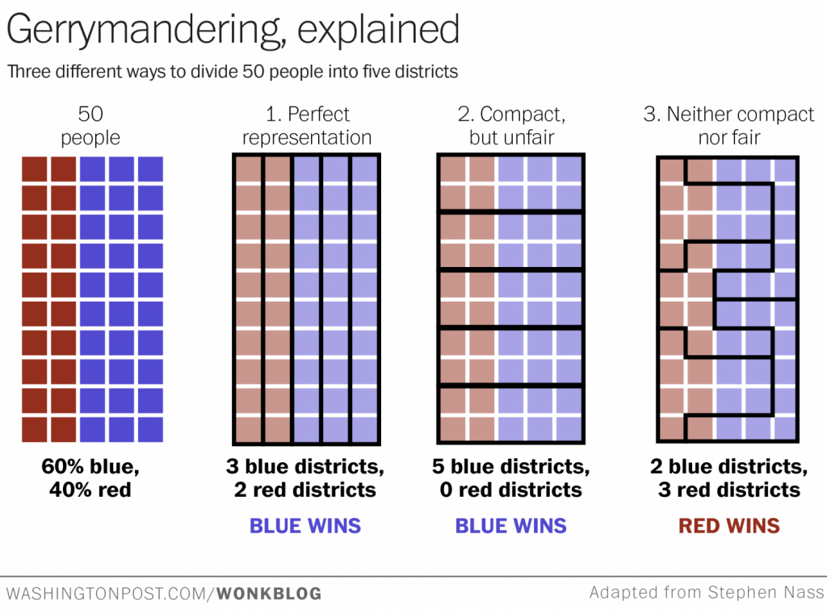
Notes:
Washington post article
http://wapo.st/1EXVUv6?tid=ss_mail&utm_term=.03051e4cd181

Slide 25
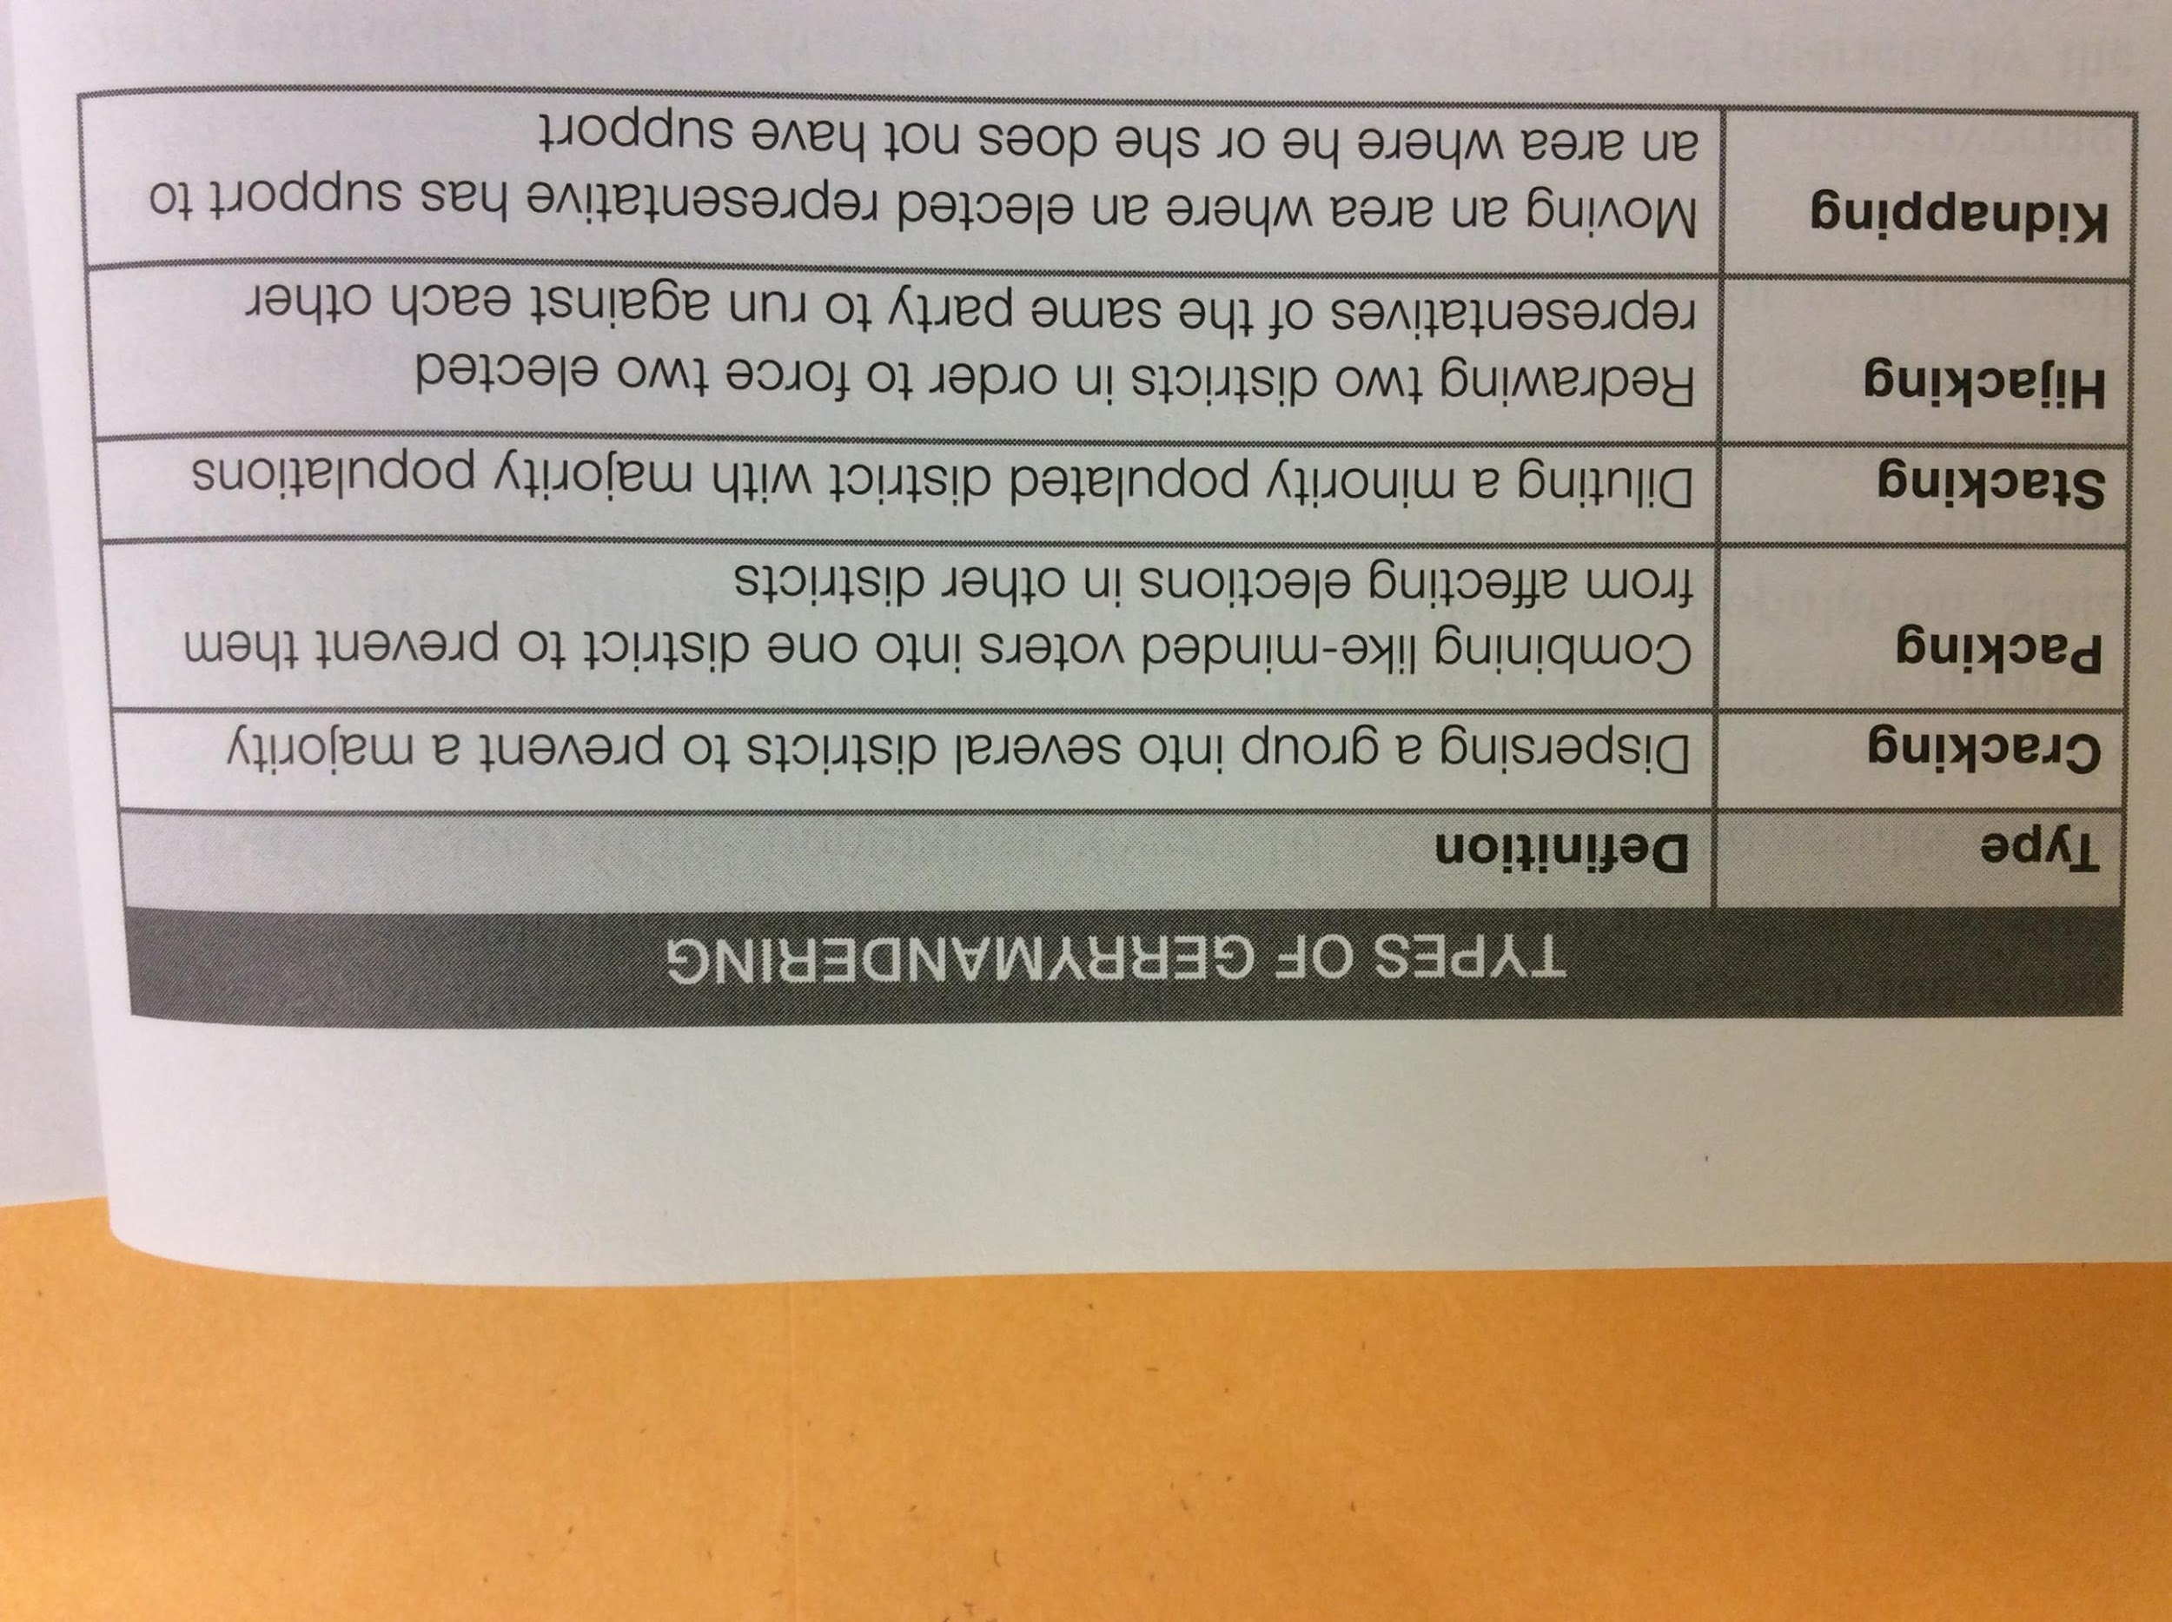

Slide 26
BOUNDARIES
They’re complicated
Notes:
www.visuwords.com boundary
http://www.visuwords.com/boundary

Slide 27
BOUNDARIES
They’re complicated
Boundaries often do not follow cultural
and economic landscapes.
Sometimes boundaries put people together who have little in common.
Sometimes boundaries separate people who have everything in common.
Sometimes people are caught in the middle.

Slide 28
Boundaries often do not follow cultural
and economic landscapes.
Boundaries can put people together who have little in common.
Conflict between majority-Hindus and Muslims in India
People in Italy are still only loosely bound together, even after being a nation for 150 years, due to varying dialects.
Conflict between Tamils and Sinhalese in Sri Lanka
Catholics and Protestants fought in Northern Ireland
Hutus and Tutsis in Rwanda
Boundaries can separate people who have everything in common.
Catholics in Northern Ireland were separated from Catholics in the Republic.
Sometimes nations are caught in the middle, between other, very different states 🡪 shatterbelts

Slide 29
AP HUG Teachers
Pages 162-163 in AMSCO (2015) are dense with examples. I suggest this would be a good area for students to do brief research on any of the following:
India - current events and religion
How does the culture of Sicily relate to the mainland?
Anne Applebam’s writing on Eastern Europe between the world wars The History of Rwanda
The evolution of South Sudan
The Troubles in Ireland (1917-2000), pick your timeframe
The Tamil Tigers
Kashmir and India/China
Tibet and India/China
Bhutan and India/China
Notes:
Unhide this slide if you want to use it to make assignments to students

Slide 30
SHATTERBELTS: COUNTIRES
CAUGHT BETWEEN
VERY DIFFERENT STATES.
EASTERN EUROPE
THE CAUCASUS
THE SUDAN
Notes:
P. 162 AMSCO, 2017
WESTERN EUROPE – ROMAN CATHOLIC OR PROTESTANT AND CAPITALIST
EASTERN EUROPE IN BETWEEN
RUSSIA – ORTHODOX & COMMUNISTS

Slide 31
(shatterbelt)
a region caught between stronger colliding external cultural-political forces, under persistent stress, and often fragmented by aggressive rivals (e.g., Israel or Kashmir today; Eastern Europe during the Cold War
THE EFFECTS of BOUNDARIES

Slide 32
Shatterbelt: a region caught between stronger colliding external cultural-political forces, under persistent stress, and often fragmented by aggressive rivals (e.g., Israel or Kashmir today; Eastern Europe during the Cold War,…).
Notes:
www.visuwords.com boundary
http://www.visuwords.com/boundary

Slide 33
THE EFFECTS of BOUNDARIES
People can be united and divided by many things, including…Language and Religion, Ethnicity, Nationality and Economy
Notes:
www.visuwords.com boundary
http://www.visuwords.com/boundary

Slide 34
Different forms of governance:
Countries are governed on more than one level
How much power is at each level depends upon the form of governance.
Is it a FEDERAL GOVERNMENT or a
UNITARY GOVERNMENT?

Slide 35
Wait – aren’t they similar?:
Why, yes they are!
FEDERAL GOVERNMENT and
UNITARY GOVERNMENTs
Both administer the day-to-day operations of governance with sovereignty
the national government is the final authority for both
Local divisions of government have some degree of power.

Slide 36
Wait – but the differences are
also important
FEDERAL GOVERNMENT and
UNITARY GOVERNMENTs

Slide 37
FEDERAL VS. UNITARY STATES
TRAIT | FEDERAL | UNITARY
AUTHORITY OF THE GOVERNMENT | SHARED BETWEEN CENTRAL AND PROVINCIAL, STATE, LOCAL GOVERNMENTS | CENTRAL GOVERNMENT DOMINATES
HIERARCHY OF POWER | MULTIPLE LEVELS OF POWER; POWER IS DIFFUSED | NO HIERARCHY OF SOVEREIGN POWERS
TYPE OF COUNTRY WHERE COMMONLY USED | MULTIPLE ETHNIC GROUPS WITH SIGNIFICANT MINORITIES | FEW CULTURAL DIFFERENCES AND SMALL MINTORITIES

Slide 38
FEDERAL VS. UNITARY STATES: examples, tendencies and exceptions to the rules
TRAIT | FEDERAL | UNITARY
SIZE OF COUNTRY – typical rule | Large: USA, Canada, Russia | Small: Japan, Egypt, Spain
HOWEVER! | BELGIUM: accommodates Walloon and Flemish citizens | CHINA!

Slide 39
What do Japan, Egypt, Spain, China,
Saudi Arabia, France and Indonesia
have in common?
They are all UNITARY STATES.

Slide 40
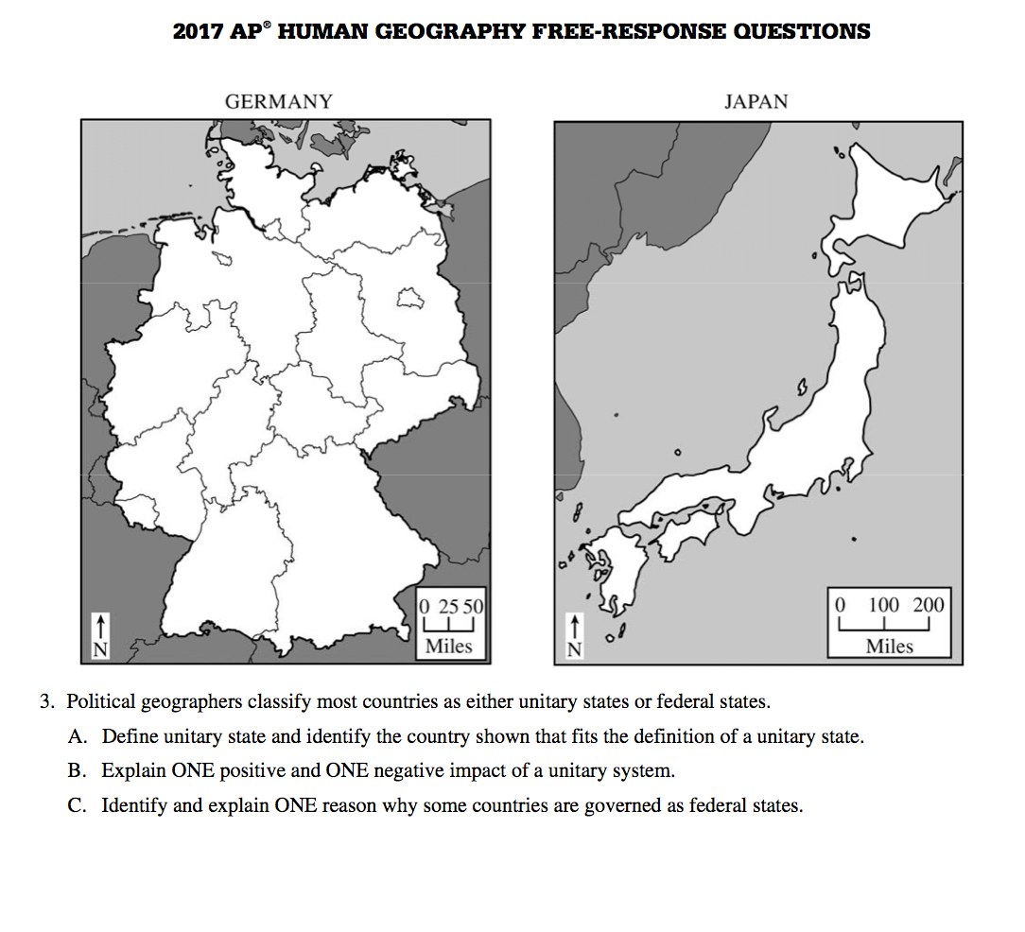

Slide 41
What should the legend say?
Notes:
BLUE IS UNITARY
GREEN IS FEDERAL

Slide 42
Different forms of governance:
THREE BIG IDEAS
- Federal and unitary states
- Local powers Vary by Government
- The Effects of State Morphology (shape)

Slide 43
MORPHOLOGY = SHAPE

Slide 44
Brainstorm – what are some
possible effects of
state morphology?
Positive & negative…

Slide 45
Notes:
Also romania
I retrieved these 5 slides online – they were perfect.
I would like to ask permission, but was unable to determine source.

Slide 47
Notes:
Also malawi

Slide 48
Also sometimes called a PROTRUDED state.
Notes:
India, democratic republic of congo

Slide 49
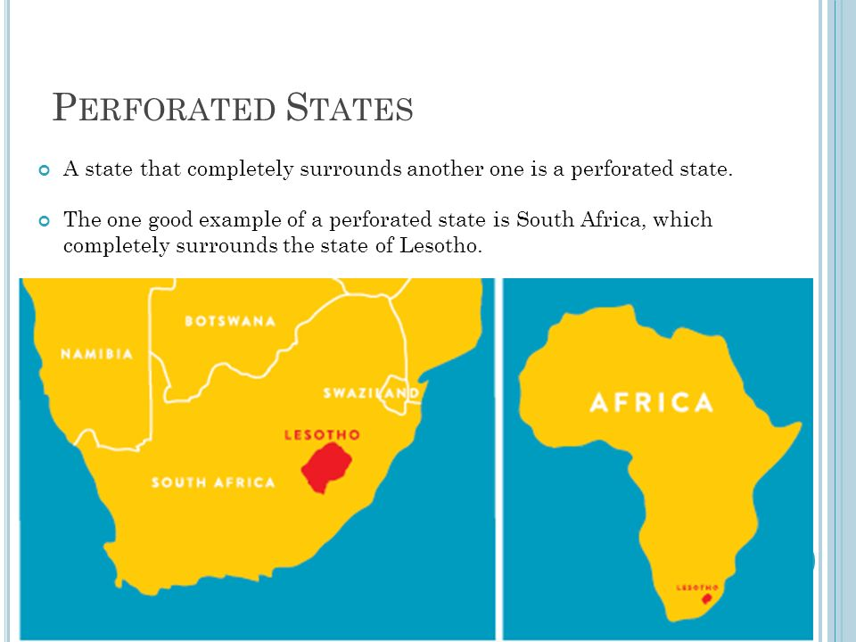
#5.
Notes:
Also, Italy with Vatican City and the Republic of San Marino

Slide 50
Patterns of Local and Metropolitan Governance are SUBNATIONAL
For most people, forms of governance overlap.
List your governments:
State (or commonwealth or territory or province)
County or (in Louisiana, Parish)
City
Township
School district
Police/fire district

Slide 51
Watch this promo for Arizona’s Distracted Driving Law
Example: Arizona Laws – state and
county, regarding Distracted Driving
Time 1:25 minutes
Notes:
August 2017

Slide 52
One way the number of UNITS of government changes from year to year is through annexation or incorporation.
For example, a city might annex nearby suburbs to increase the tax base (number of people paying taxes.)
But what if these people do not want to be annexed? They may incorporate their own town…thus adding a new UNIT of government.
Notes:
I added incorporation

