Slide 1
What's already in my mind?
Write down 8 facts that you remember from yesterday on The New Deal.
Think about the topics we have discussed THIS WEEK!!

Slide 3
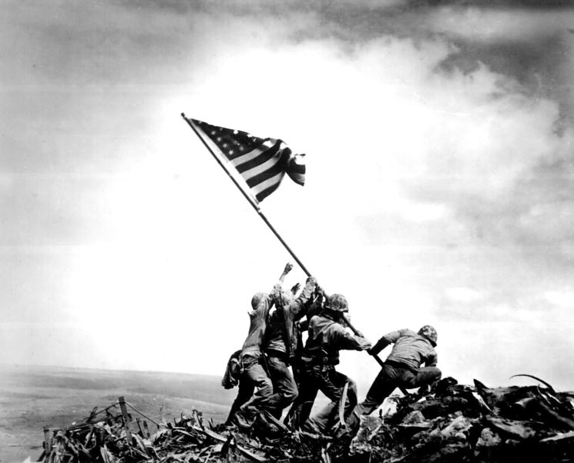
World War II
Chapters 23 & 24

Slide 4
How did WWI lead to WWII?
Treaty of Versailles
Germans resented “war guilt clause,” reparations, reduction of military, loss of their lands
Italy & Japan resented – expected more land for their sacrifices

Slide 5
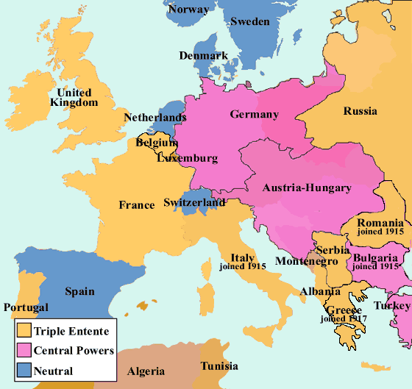
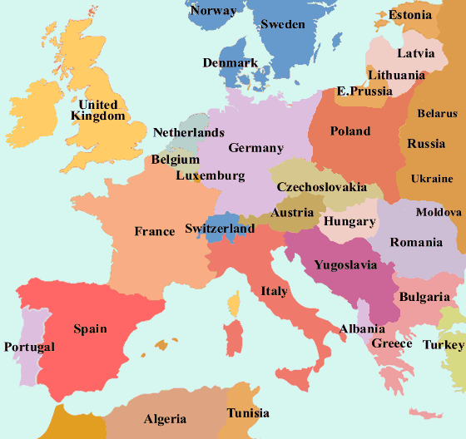
Europe 1914
Europe 1919

Slide 6
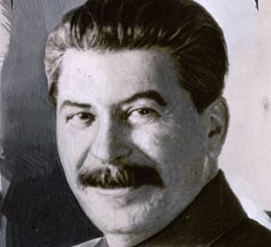
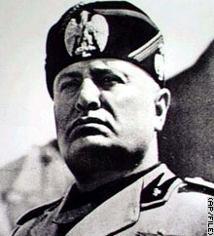
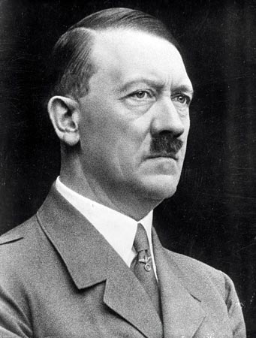
Totalitarian Leaders Take Control in Europe
totalitarianism – type of gov’t where a single party or leader controls the economic, social, & cultural lives of people
Russia – Joseph Stalin
Italy – Benito Mussolini
Germany – Adolf Hitler
Japan - military reasserted control & Japan did not become a totalitarian dictatorship

Slide 7
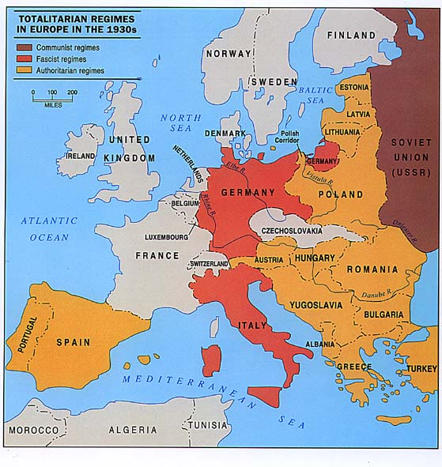
Totalitarian Leaders Take Control in Europe

Slide 8
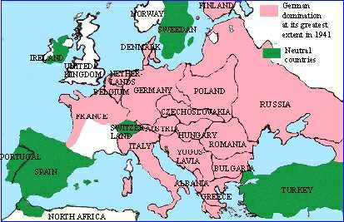
Expansion Begins
Japan, Italy, & Germany began taking over other countries
France & Britain followed policy of appeasement - granting concessions to a potential enemy in the hope that it will maintain peace
FDR did not speak out against German aggression – why?

Slide 9
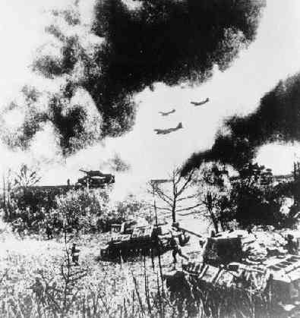
The War Begins in Europe
Britain & France signed alliance with Poland
Sept. 1, 1939 Germany invaded Poland
Blitzkrieg - “lightening war” sudden attack that used speed & firepower – effective because of planes, tanks, motor vehicles, infantry
Britain & France declare war, but do nothing to save Poland

Slide 10
Monday November 9, 2015

Slide 11
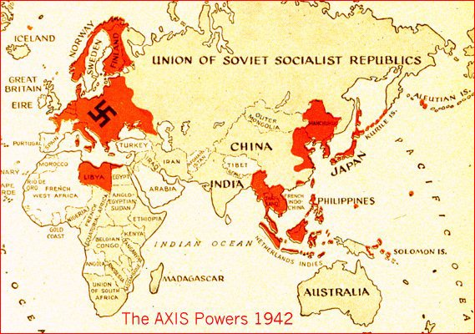
World War II Alliances
Major Axis Powers
Major Allied Powers
Germany
Italy
Japan
Britain
France
Soviet Union (eventually)
United States
China

Slide 12
United States’ Action
Congress passed the Neutrality Acts of 1935, 1936, and 1937 – imposed restrictions on Americans during times of war
example: prohibited sailing on ships owned by nations at war, prevented Americans from making loans to nations at war or selling them weapons

Slide 13
Another Neutrality Act
Roosevelt declared American neutrality but was anti-Nazi
convinced Congress to pass the Neutrality Acts of 1939 – included a cash-and-carry provision – nations at war could buy goods & arms in the U.S. if they paid cash & carried merchandise on their ships

Slide 14
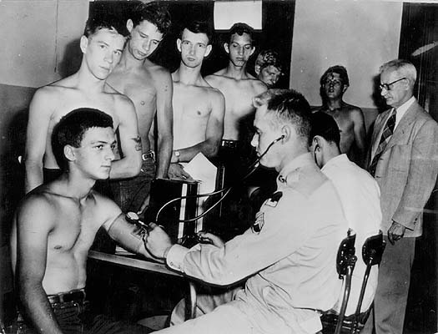
Roosevelt Inches Toward Involvement
1940 – Congress passed Selective Service Act (first peacetime draft)
provided military training of 1.2 million troops each year

Slide 15
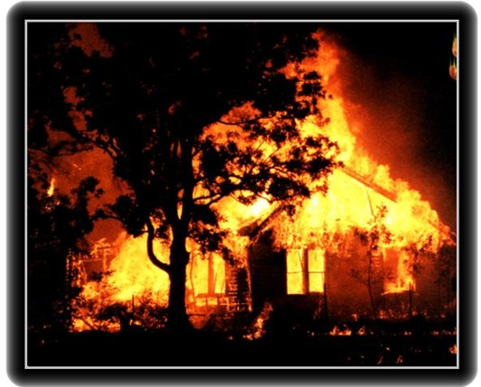
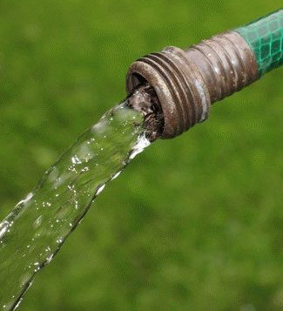
Roosevelt Inches Toward Involvement
1941, Congress passed Lend-Lease Act
allowed Roosevelt to sell or lend war supplies to any country whose defense he considered vital to U.S. safety

Slide 16
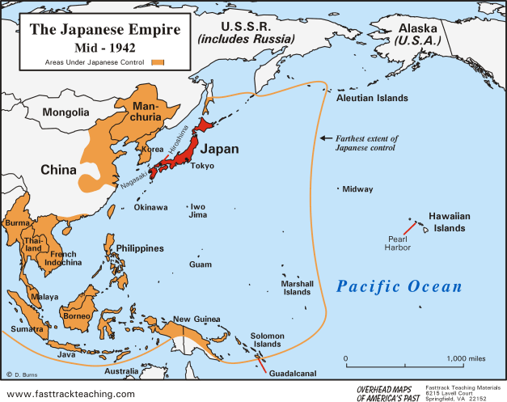
Japanese Expansion Threatens U.S.
Japanese invaded Indochina (Cambodia, Laos & Vietnam)
Americans feared Japan would threaten Philippines & other Pacific islands

Slide 17
http://www.history.com/topics/world-war-ii/world-war-ii-history

Slide 18
Pearl Harbor Links
http://mysocialstudiesteacher.com/wiki/classroom/attackpearlharbor.wmv
https://www.youtube.com/watch?v=3VqQAf74fsE
http://www.history.com/topics/pearl-harbor/speeches#pearl-harbor-attack

Slide 19
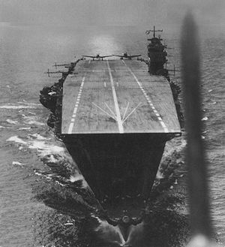
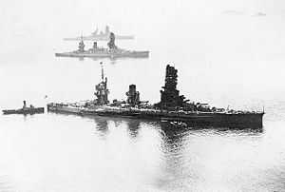
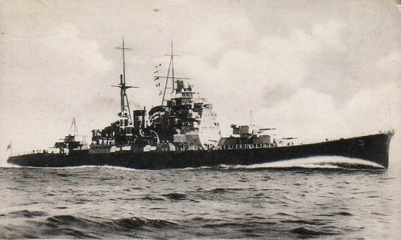
* How did the Japanese battle fleet fly nearly 3,900 miles undetected across the Pacific Ocean???
* Six aircraft carriers, two battleships, two cruisers, and nine destroyers traveled under strict radio silence and screened from view by a large weather front! (came within two hundred miles of the Hawaiian Islands)
Notes:
On November 26, 1941, a Japanese task force (the Striking Force) of six aircraft carriers (Akagi, Kaga, Sōryū, Hiryū, Shōkaku, and Zuikaku) departed northern Japan en route to a position northwest of Hawaii, intending to launch its aircraft to attack Pearl Harbor. In all, 408 aircraft were intended to be used: 360 for the two attack waves, 48 on defensive combat air patrol (CAP), including nine fighters from the first wave…

Slide 20
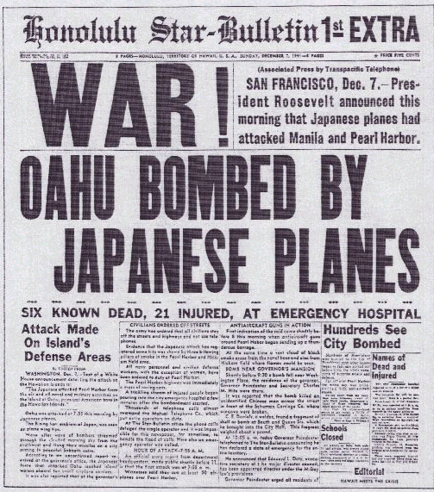
Japan Attacks Pearl Harbor
Dec. 7, 1941, Japanese planes attacked Pearl Harbor in the Hawaiian Islands.
Dropped bombs on American ships at naval base.
in less than two hours, Japan destroyed most of the U.S. Pacific fleet.
more than 2,000 sailors & 68 civilians killed
Dec. 8, 1941 Roosevelt asked Congress to declare war on Japan

Slide 21
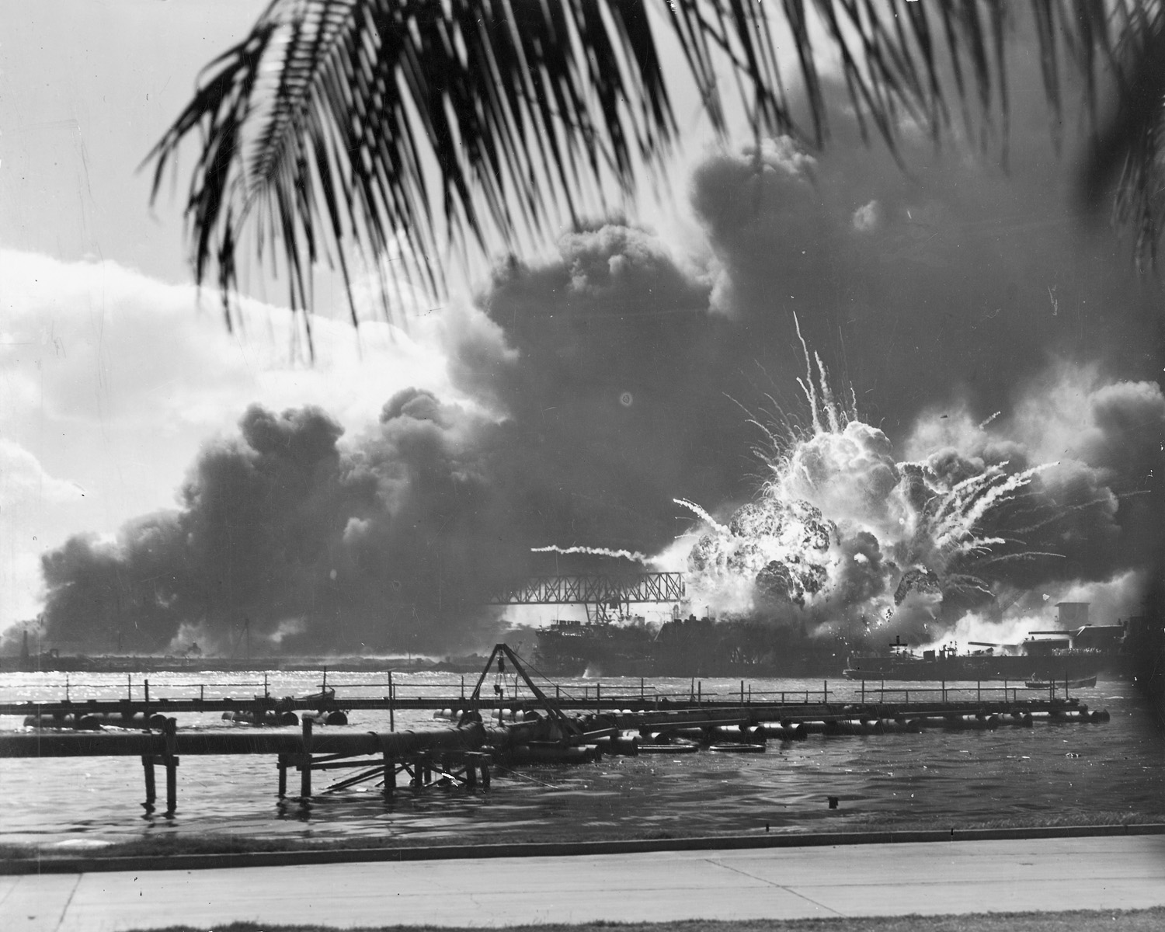
Pearl Harbor
A navy photographer snapped this photograph of the Japanese attack on Pearl Harbor in Hawaii on December 7, 1941, just as the USS Shaw exploded.

Slide 22
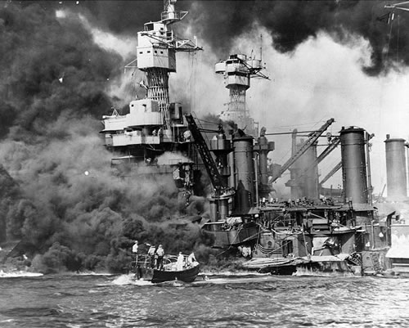
Pearl Harbor
Rescuing survivors near USS West Virginia during the Pearl Harbor attack.

Slide 23
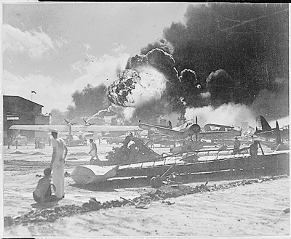
Pearl Harbor
Pearl Harbor, taken by surprise, during the Japanese aerial attack. Wreckage at Naval Air Station, Pearl Harbor. (12/07/1941)

Slide 24
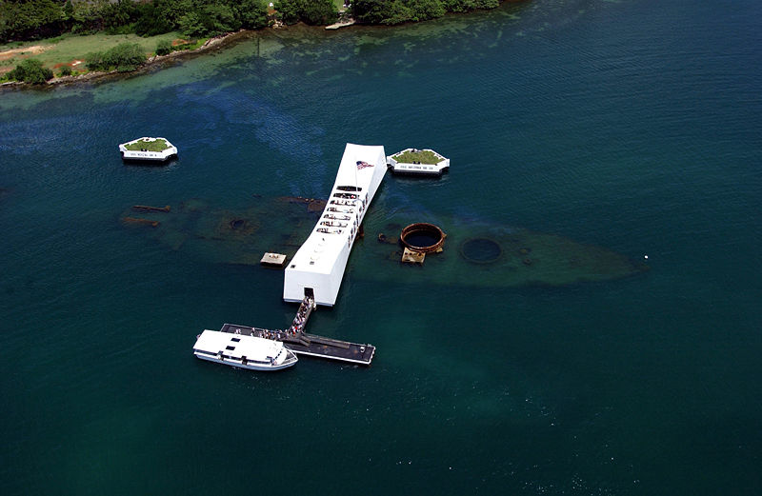
Pearl Harbor
USS Arizona Memorial, marks the resting place of 1,102 of the 1,177 sailors killed on the USS Arizona during the Attack on Pearl Harbor

Slide 25
Homefront Mobilization
More than 16 million Americans served in military
1 million African Americans served in mostly segregated units initially, integrated units later in the war
Women’s Army Corps (WACs) created by Congress in1943 to provide clerical workers, truck drivers, instructors & lab technicians for the U.S. Army – 150,000 women volunteer for the service

Slide 26
Pearl Harbor
Just before 8 a.m. on December 7, 1941, hundreds of Japanese fighter planes attacked the American naval base at Pearl Harbor near Honolulu, Hawaii. The barrage lasted just two hours, but it was devastating: The Japanese managed to destroy nearly 20 American naval vessels, including eight enormous battleships, and almost 200 airplanes. More than 2,000 Americans soldiers and sailors died in the attack, and another 1,000 were wounded.

Slide 27
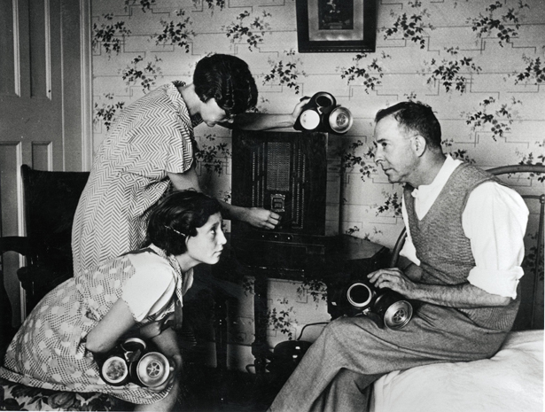
Diary Entry
You are a teenager, living in Hawaii in 1941. You listened to FDR declare to congress war on Japan with your parents. They both look extremely worried.
Write your diary entry for December 8th 1941.
How does the outbreak of war make you feel?
What do you think your parents are worried about?
Are you worried?
Why?
What do you think might happen to you and your family?

Slide 28
November 6 20157

Slide 29
If you need to go to the vending machine or restroom use the time before class!

Slide 30
The American Homefront

Slide 31
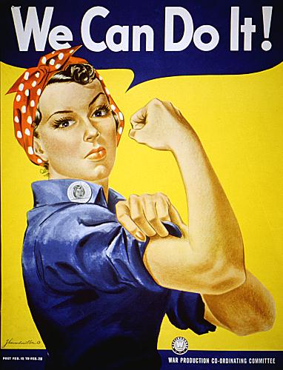
Women Work for Victory
Women’s contribution to the war:
worked in heavy industry, need for workers ended common practice of women quitting their jobs once married
“Rosie the Riveter”

Slide 32
https://www.youtube.com/watch?v=bU2tt1h53jM

Slide 33
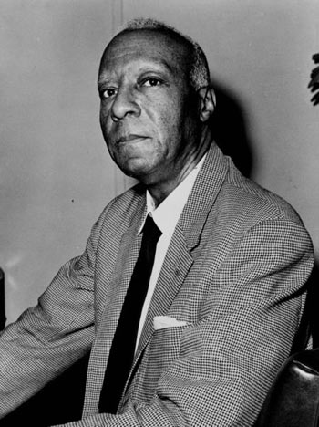
African Americans Gain Civil Rights
Double “V” campaign:
need for victory against dictators abroad & discrimination in U.S.
A. Philip Randolph:
organized protest march on Washington, D.C. & convinced FDR to issue Executive Order 8802 – assured fair hiring practices in jobs funded w/ gov’t money & est. Fair Employment Practices Committee

Slide 34
Challenges to Civil Liberties
Roosevelt ordered 110,000 Japanese Americans into “relocation camps” – internment (temporary imprisonment)
Moved to Utah, California, Arizona, Wyoming, Arkansas, & Idaho
Had to sell homes, businesses, & belongings
Over 17,000 Japanese Americans served in Army units even while friends & families were in camps
Korematsu v. U.S. decision upheld internment

Slide 35
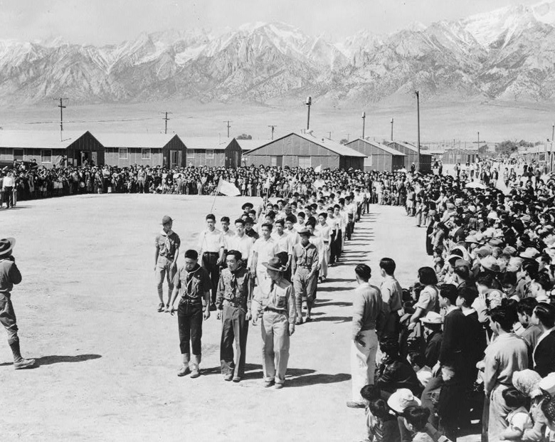
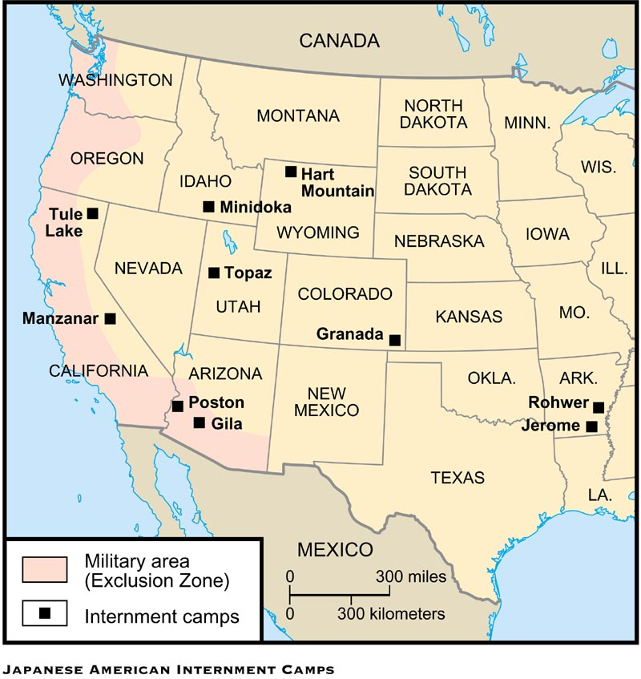
Japanese Internment Camps

Slide 36
http://www.history.com/topics/world-war-ii/japanese-american-relocation

Slide 37
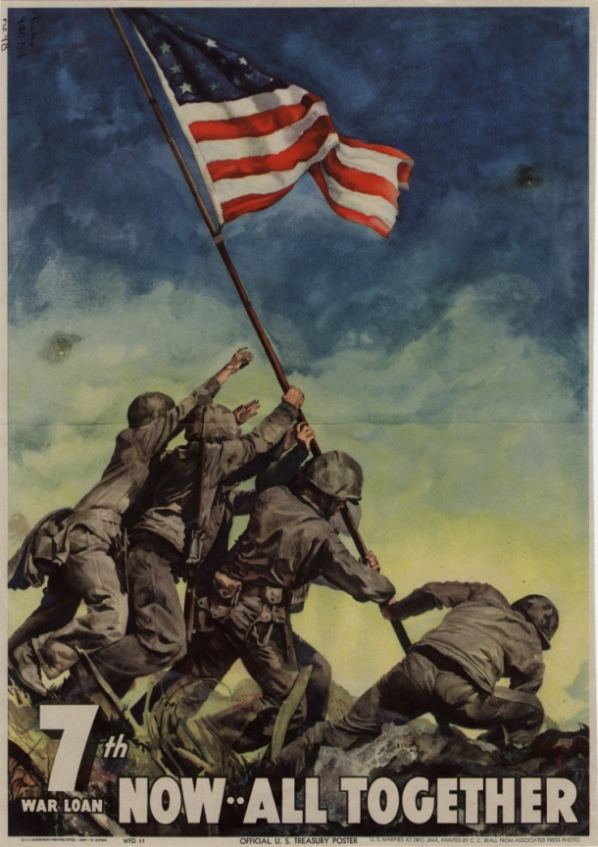
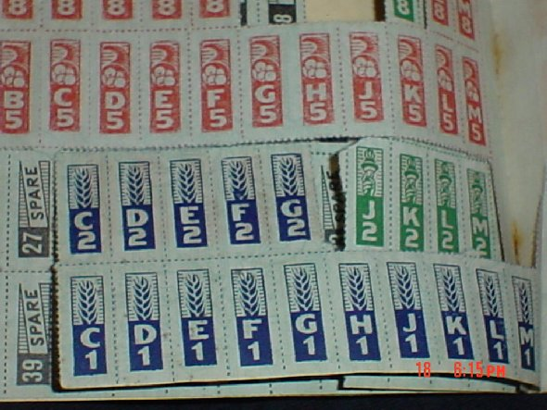
Supporting War Effort
Cost of WWII: $330 billion
Financed: imposed a 5% tax on working Americas; Americans bought war bonds
Rationing: Americans were issued coupon books that limited the amount of certain goods they could buy

Slide 38
Victory Gardens
Planted gardens in backyards, schoolyards, city parks and empty lots to produce more food for war effort.

Slide 39
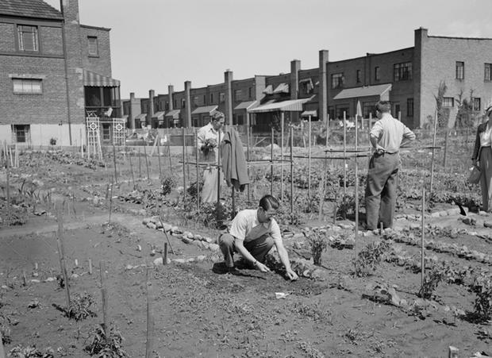

Slide 40
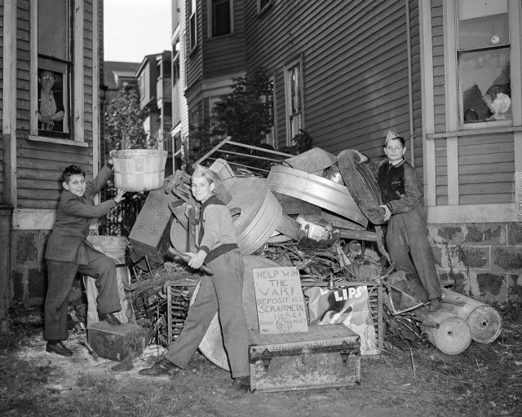
Scrap Drives
Organized Collection of rubber, tin, aluminum and steel for the US government to use during WWII

Slide 41
Will this picture help me win the war?
Office of War Information: radio broadcasts, newspapers, posters, photographs, films and other forms of media, that served as the connection between the battlefront and civilian communities.

Slide 42
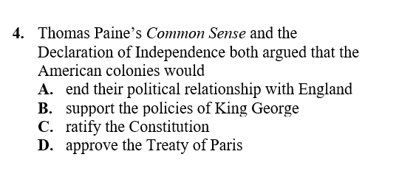

Slide 43
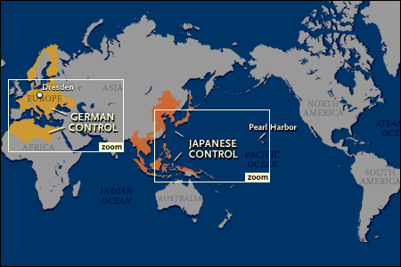
World War II Map (also page 822)

Slide 44
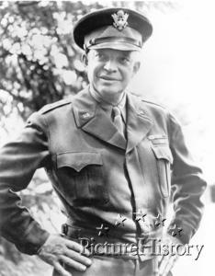
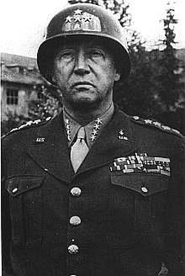
European Theatre: Key People
Gen. Dwight “Ike” Eisenhower –
commander of all American forces
in Europe; Africa, Italy; Supreme
Commander of Allied Forces;
D-Day
Gen. George “Blood and Guts” Patton – commanded forces in North Africa & Sicily , later in France; leader in tank warfare
page 805

Slide 45
http://www.history.com/topics/world-war-ii/george-smith-patton

Slide 46
http://www.history.com/topics/world-war-ii/d-day/videos/d-day-invasion-of-normandy?m=528e394da93ae&s=undefined&f=1&free=false

Slide 47
European Theatre
Operation Overlord (D-Day)
Date: June 6, 1944
Description: the Allies led by Gen. Dwight D. Eisenhower landed on the beaches of Normandy, France; high American causality rates at Omaha beach; *Allies successful at gaining ground in France
total of 4,413 dead
page 820 - 821

Slide 48
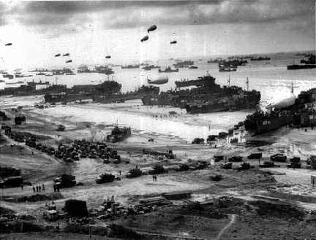
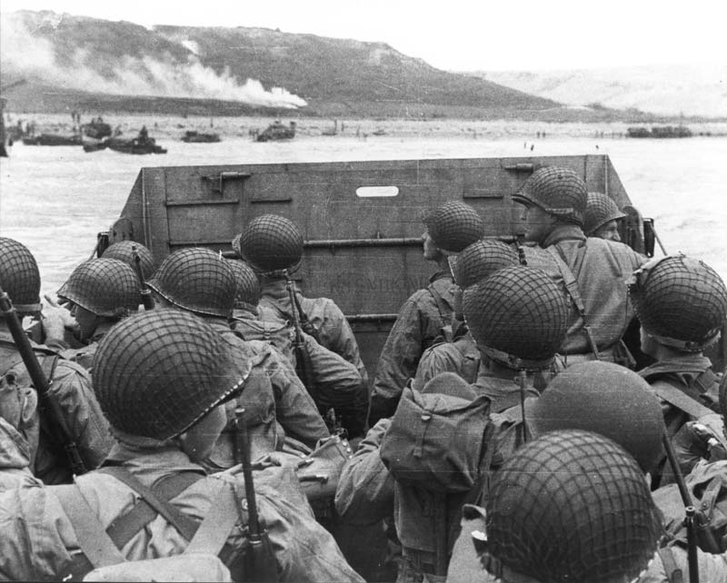
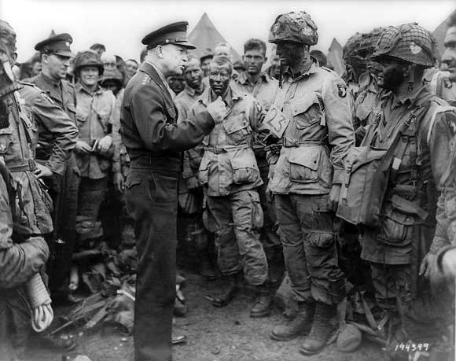
D-Day
Eisenhower addresses paratroopers on D-Day.

Slide 49
European Theatre
Fall of Berlin & V-E Day
Date: 1945
Description: the Allies & the Soviets closed in on Berlin (Germany’s capital); Hitler committed suicide in April and German forces surrendered on May 7, 1945 (V-E Day “Victory in Europe”)

Slide 50
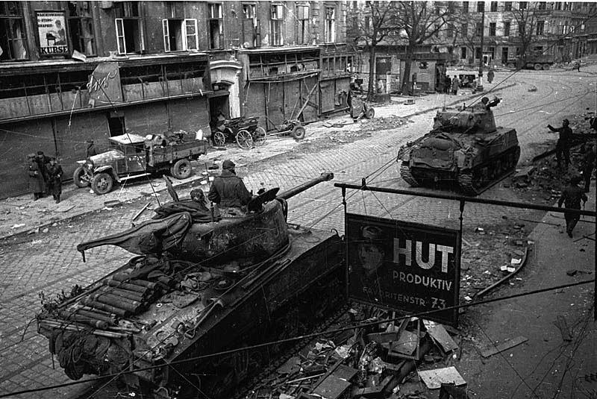
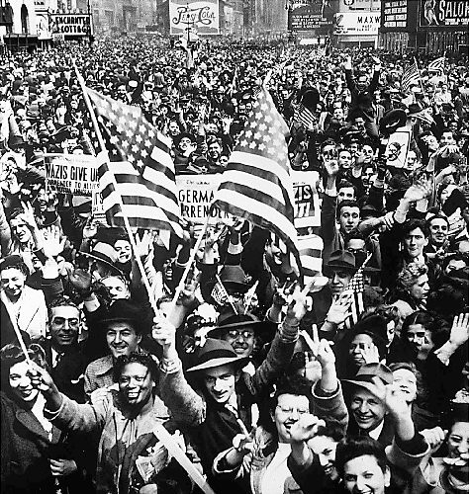
Fall of Berlin & V-E Day
Allied forces
capture Berlin
Americans celebrate V-E Day in Times Square

Slide 51
Pacific Theatre
Midway
Date: 1942
Description: Japan (under Admiral Yamamoto) attempted to destroy American aircraft carriers in Pacific; Navy code breakers intercepted message & under U.S Admiral Chester Nimitz’s leadership U.S defeated Japan; * turning point of the war in the Pacific – stopped Japan’s advance

Slide 52
http://www.history.com/topics/world-war-ii/d-day/videos/kamikaze-pilots?m=528e394da93ae&s=undefined&f=1&free=false

Slide 53
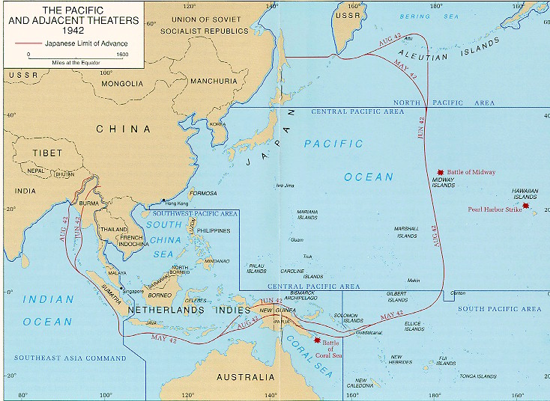
Battle of Midway
Battle of Midway
Pearl Harbor

Slide 54
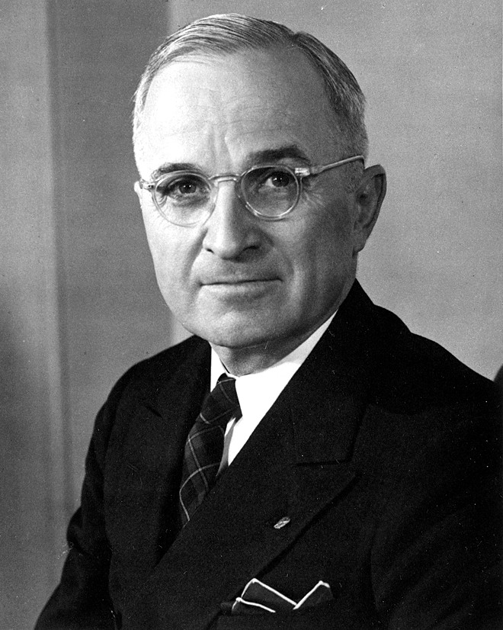
FDR’s death
served 4 terms as President
died in office on April 12, 1945, while at Warm Springs, Georgia
Vice President Harry S. Truman became President

Slide 55
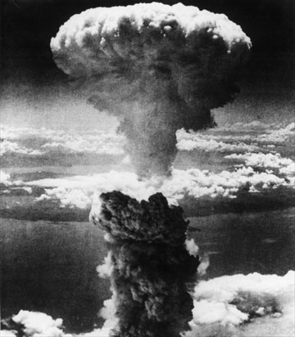
The Manhattan Project
Manhattan Project – code-name
Project leaders: General Leslie Groves & physicist J. Robert Oppenheimer
Los Alamos, New Mexico
Truman made decision to drop 2 atomic bombs on Japan to save American lives

Slide 56
http://www.history.com/topics/world-war-ii/d-day/videos/manhattan-project?m=528e394da93ae&s=undefined&f=1&free=false

Slide 57
Pacific Theatre
Hiroshima & Nagasaki / V-J Day
Date: 1945
Description: U.S. dropped 1st atomic bomb on Hiroshima (60,000 dead or missing); 3 days later U.S. dropped 2nd atomic bomb on Nagasaki (35,000 dead); Japan surrenders August 15, 1945 (V-J Day “Victory in Japan”)

Slide 58
Effects of the War

Slide 59
World War II Allied Conferences
Potsdam (July ‘45)
Leaders: Harry S. Truman (U.S.), Clement Atlee (Britain), Stalin (Soviet Union)
Decisions Reached: decided to divide Germany (& Berlin) into four zones of occupation: Soviet, American, British, & French

Slide 60
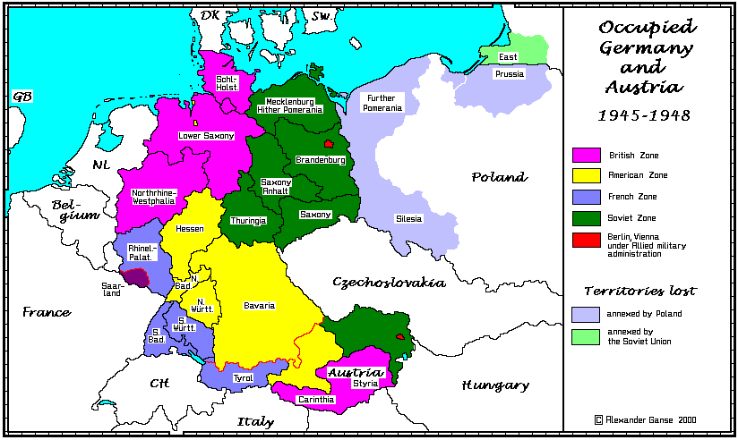
Potsdam: Division of Germany

Slide 61
Changing Balance of World Power
After WWII, two superpowers emerge:
United States
Soviet Union
United States: strongest of the two, wealthy, militarily powerful, confident
Soviet Union: industries, cities, & people suffered during war but controlled most of Eastern Europe

Slide 62
Creation of the United Nations
When: April 1945
Where: permanent home in New York City
U.N. General Assembly: make decisions on important issues such as peace and security, admission of new members & budget
Security Council: responsible for maintaining world peace and security

Slide 63
November 11, 2015

